Slide 1
Standardization, and how we integrate standards in our process of developing knowledge tools and resources

Slide 2
Overview
Introduction
The role of the National Archives (NAN) in standardization
Knowledge tools and resources
How standards can be used as practical instruments
Creating a feed-back loop

Slide 3
Our role in standardization
ISO
TC 46/SC 4 Technical interoperability
A.o. Dublin Core standard
Member of
ISO
TC 171 Document management applications
A.o. PDF-standards
Member of
Liaison
National Archives
NEN Committee 38004611
ISO TC 46/SC 11 Archives/records management
A.o. ISO 15489-1, 23081
Member of
Member of
Represents NEN (Head of Delegation)
ISO TC 20/SC 13 Space data
OAIS (ISO 14721), ISO 16363
Member of
CEN TC 468 Management and preservation of digital content
Member of

Slide 4
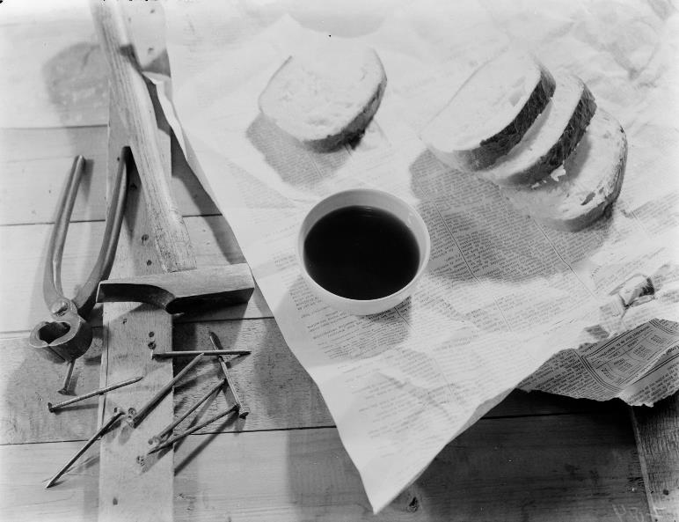
Knowledge tools and resources
Any form of recorded and reusable knowledge about rendering government information sustainably accessible, intended to transfer knowledge to governmental organizations and public archival institutions
Scope: national, regional and local level
Two tastes: guidelines and standards
Possible subjects
Fundamentals (Archiving by Design)
More detail on fundamentals (metadata, disposition, file formats)
Use of fundamentals in specific use-cases (collaborations, social media archiving)
Processes from archival law (appraisal, publication restrictions)
Notes:
Knowledge tools and resources for long-term accessibility of government information
Possible subjects:
Division in four possibilities:
1. Fundament
2. Further detail on elements of fundaments/AbD: metadata, disposition, file formats
3. Explanation of the fundaments for specific use-cases or user-groups (for example collaborations, social media archiving)
4. Processes from archival law (restrictions on publication, appraisal)
Output of knowledge creation
They describe the best way to do something (make a product or a process, deliver a service, etc.)
Form: factsheets, frameworks, how-to’s, standards
In itself not mandatory to be used (some are developed into standards with ‘comply or explain’ status)

Slide 5
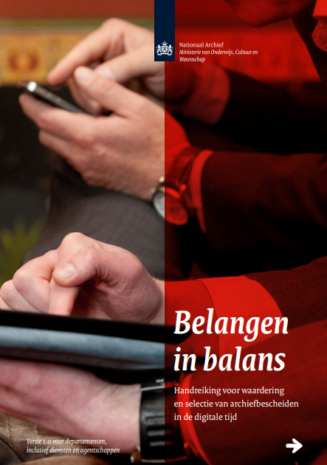
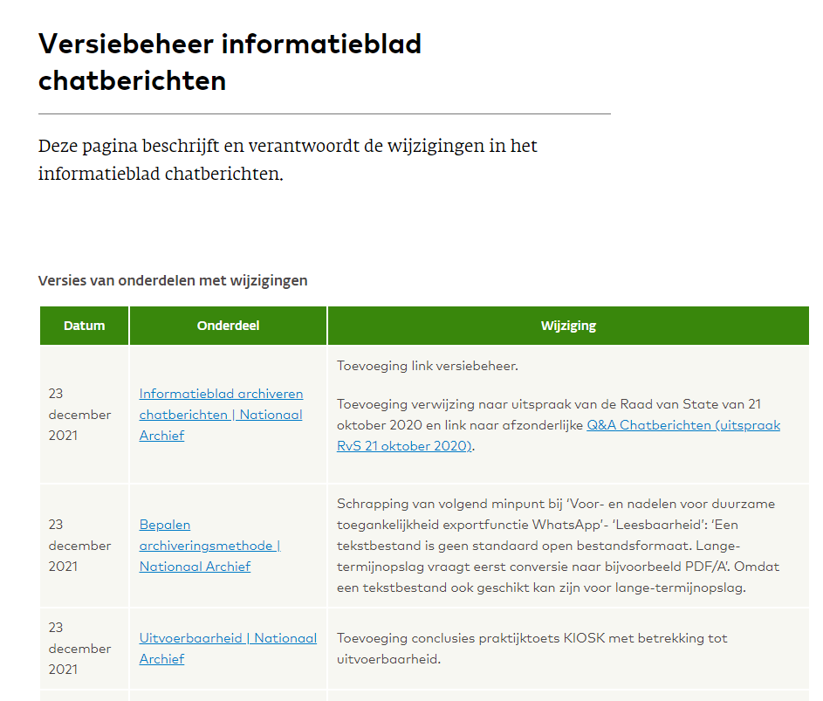
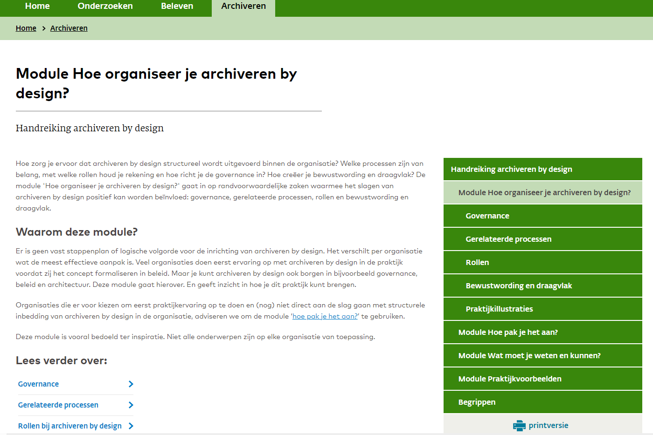
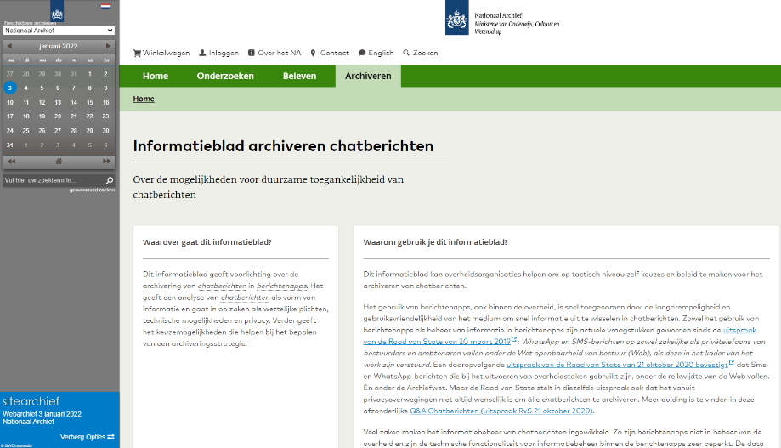
Publishing platform and design
Website National Archives,
from PDF to web pages
Modular
More flexible design
Easier to adapt
‘Print version’ still possible
Notes:
From digital paper to webversions

Slide 6
NAN Knowledge tools and standards
DUTO framework -> provides (a.o.) model requirements for records systems Draws from ISO 15489-1, ISO 16175-1, ISO 13008
MDTO -> standard for metadata, based on ISO 23081
Guideline for digital disposition -> draws from ISO 15489-1
Guideline for WARC-validation -> draws from ISO 28500
Risk analysis -> draws from ISO 18128
Notes:
Laten samenvallen met slide 7

Slide 7
Use of standards in our national context
Why not simply copy-paste ISO standards?
Core philosophy of NAN: archiving by design as the way forward to achieve sustainable accessibility of information
Make choices in
the design phase
Think about
future use
Look at the future
Notes:
Why not just copy-paste?
What are the cosiderations?
Appropriate measures
Apply in our advisory and consulting services
Role of the NA to translate to practice. (there is a certain generic abstraction that needs translation to specifc contexts)
Prohibiting factore smaller organistions: pricing and capacity for translation to practice.

Slide 8
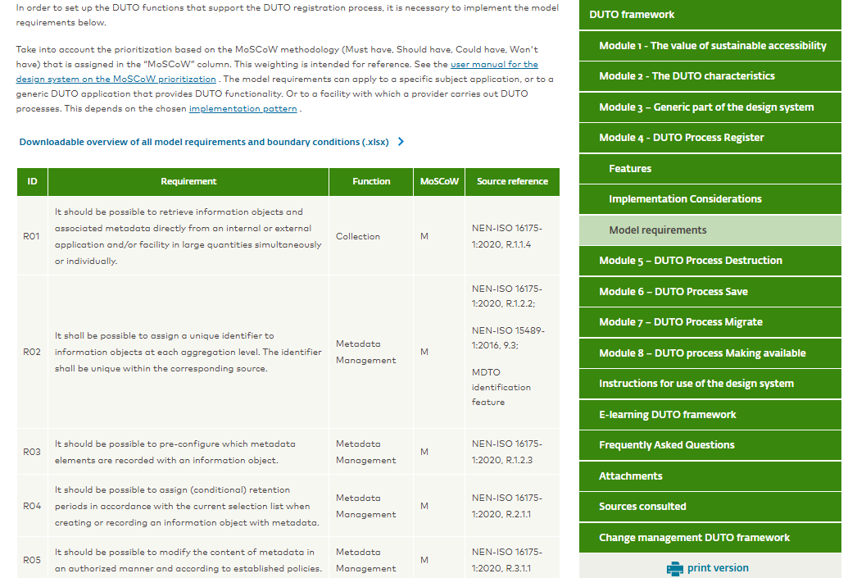

Slide 9
Process
Never finished – continuous evaluation
Active user engagement
Feedback sessions
Re-use of knowledge through national experts in ISO working groups
Archiving by design as guiding principle
Modular publication on website

Slide 10
Process and feedback loop, simplified

Slide 11
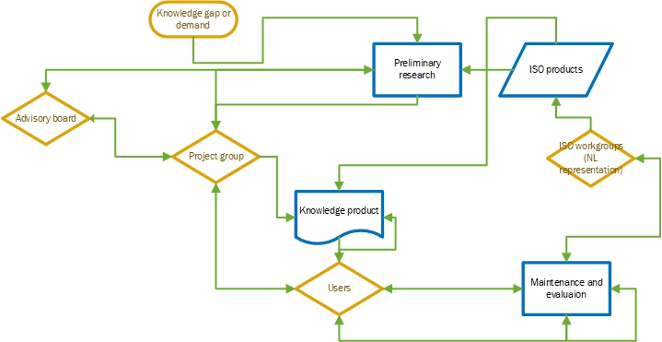
Process and feedback loop, simplified
Notes:
We have experience with formulating requirements based on ISO 16175-1, and also how they are used by organisations. Later this year ISO 16175-1 will start its periodical review, this can be used as input.

Slide 12
To summarize, the value of the use of standards for both NAN and ISO
Standardisation in knowledge tools and resources
Sharing of international expertise
Platform for sharing practical experience of translating standards to national context
Internationalization of archives and record management (for example EU cooperation requires standardisation)

