Slide 1
‘Standard’ retention schedule for Dutch municipalities and intermunicipal organisations
Association of Netherlands Municipalities (VNG)

Slide 2
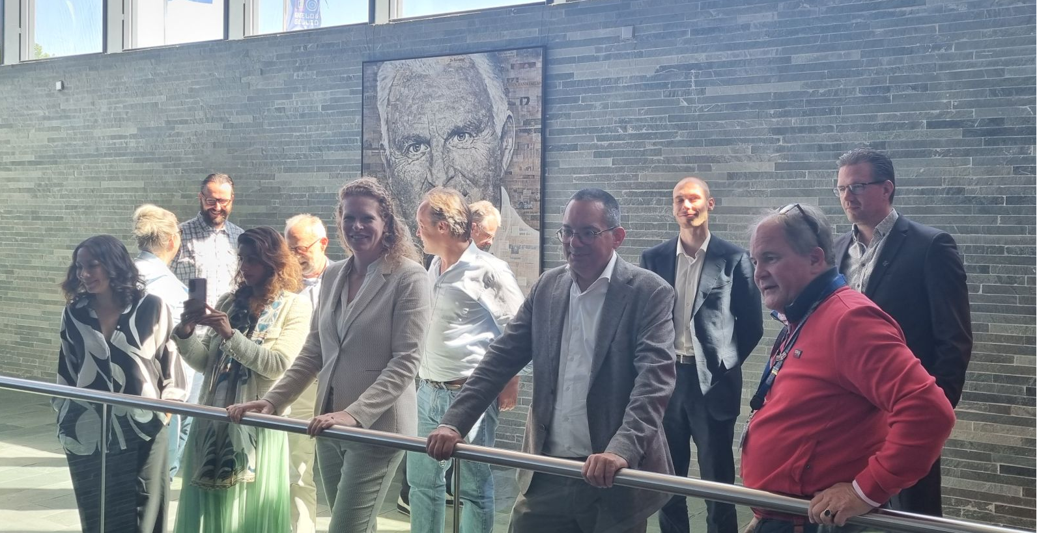
Advisory committee on archives and records management
Tasks
‘Strategic information consultation’ for municipal retention schedules
Policy advice for VNG management and board
Advice on the development of VNG products In the room today: Jonne Schaafsma, committee secretariat and policy advisor records management and transparency act (Woo/FOIA) Joost van Koutrik, committee member and deputy city archivist for Utrecht & Nieuwegein

Slide 3
Model retention schedules
Two schedules in effect
1. Municipal work processes and ‘case types’
Versions 1983 / 2005 / 2012 / 2017 / 2020
2. E-mail retention following Capstone (NARA) We will be focussing on the first one, from 2017 onward.

Slide 4
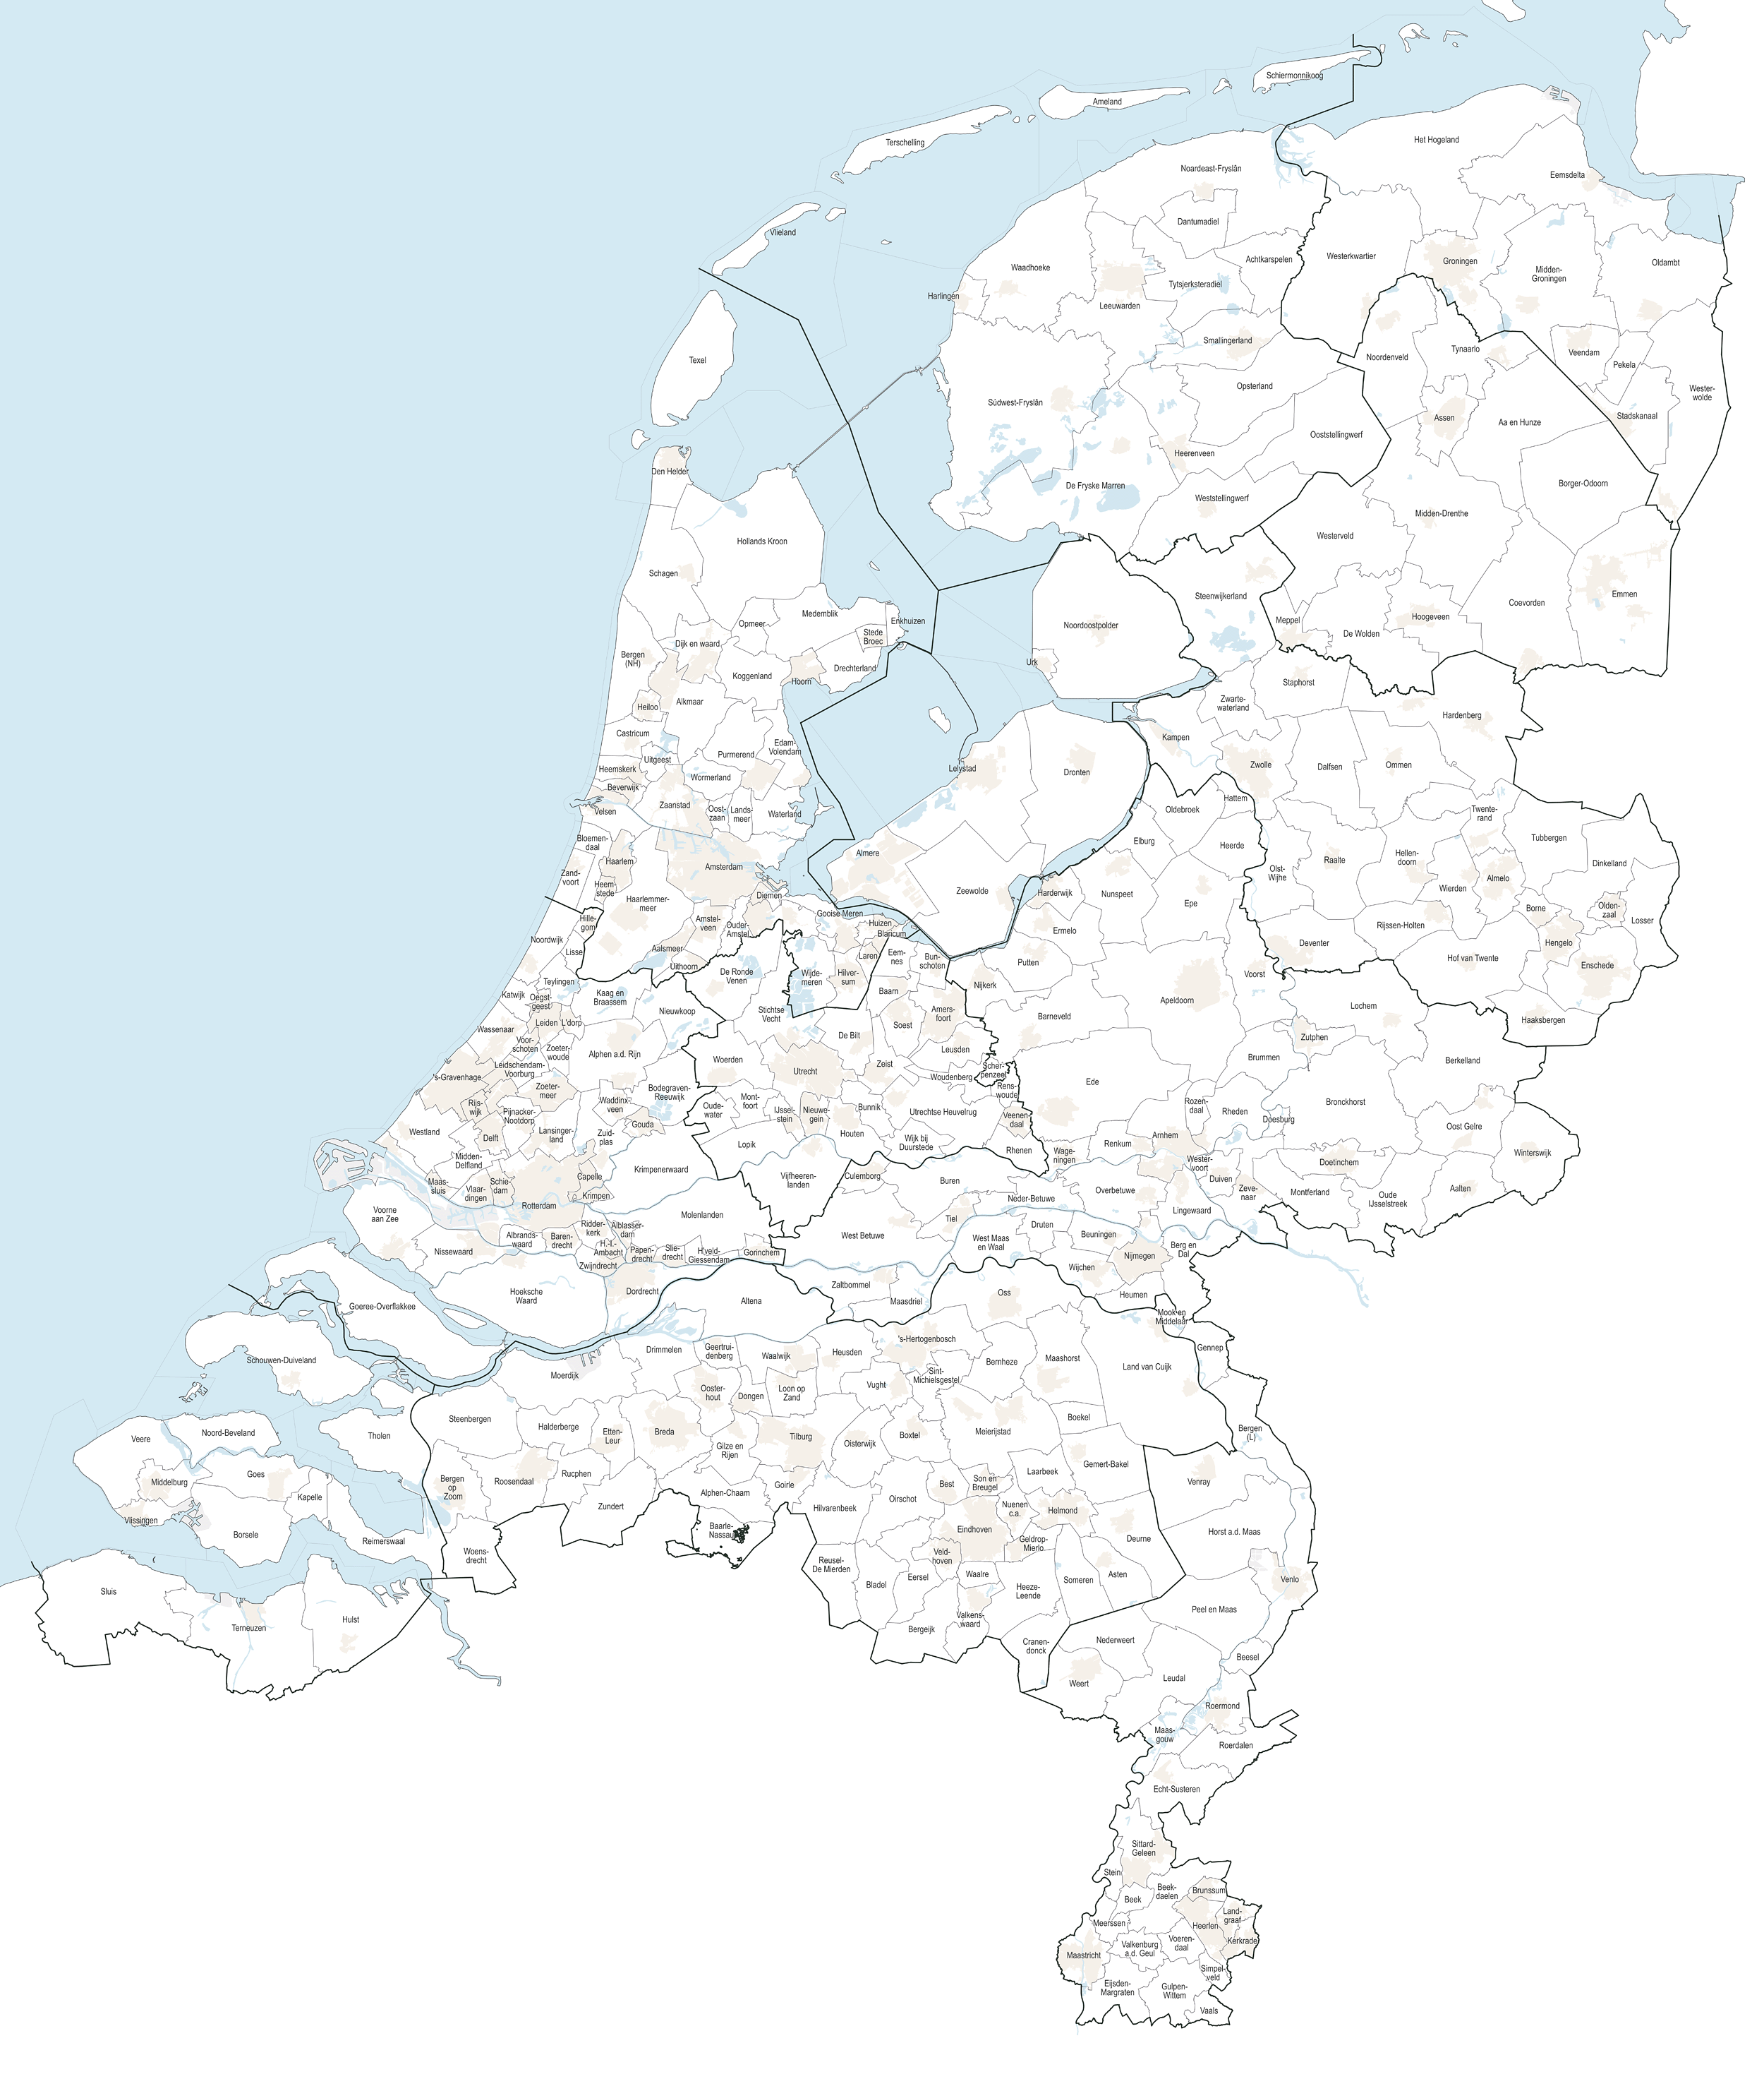
Applicable to
342 municipalities
ranging in size
from
Amsterdam (approx. 931,300)
to
Schiermonnikoog (972)
Source: Wikipedia page ‘Municipalities in the Netherlands (data November 2024)

Slide 5
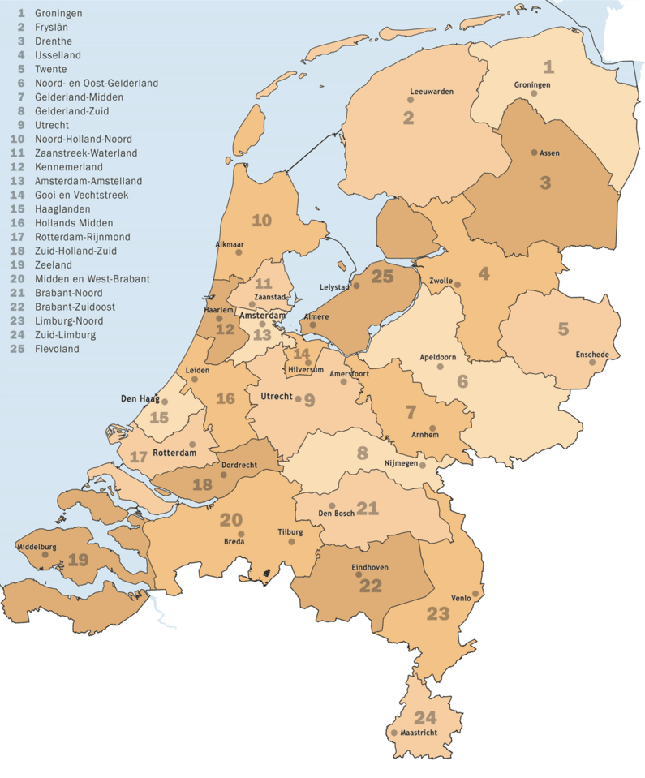
Applicable to
342 municipalities
25 safety regions
facilitating regional cooperation in dealing with crises, disasters and
disruptions of public order
Source: Instituut Fysieke Veiligheid, 2023

Slide 6
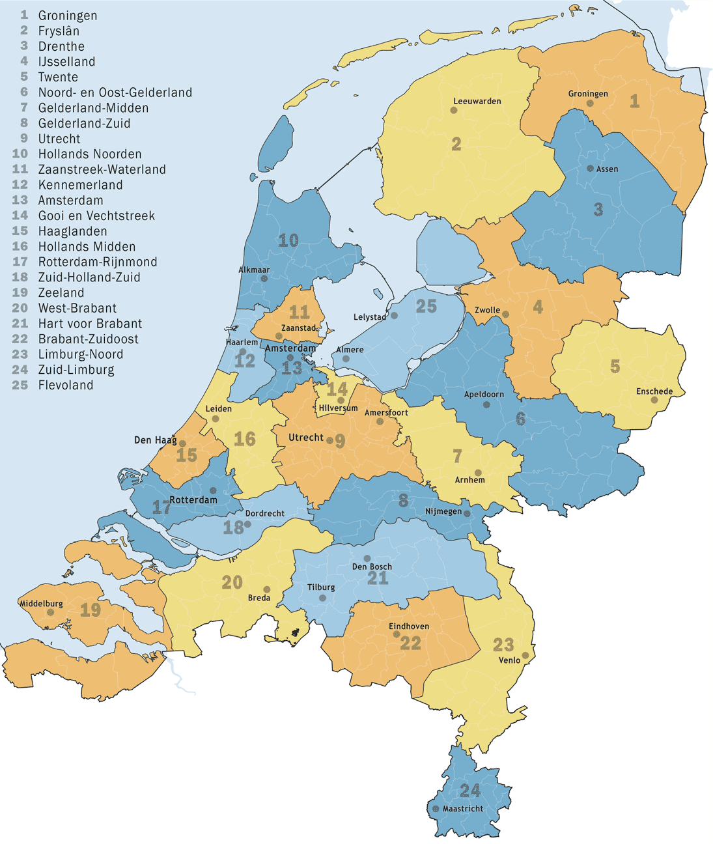
Applicable to
342 municipalities
25 safety regions
25 municipal health services
Source: Jan-Willem van Aalst (Wikipedia), 2023

Slide 7
Applicable to
342 municipalities
25 safety regions
25 municipal health services
… social services, employment agencies, regions for compulsory education oversight, municipal waste management, environmental agencies, regional expertise and information centers…
In total more than 800 organisations.
Source: Wikipedia page ‘Municipalities in the Netherlands (data November 2024)

Slide 8
Method (standard Dutch government)
Valuation and retention policy
System analysis
Hotspot monitor
Risk analysis

Slide 9
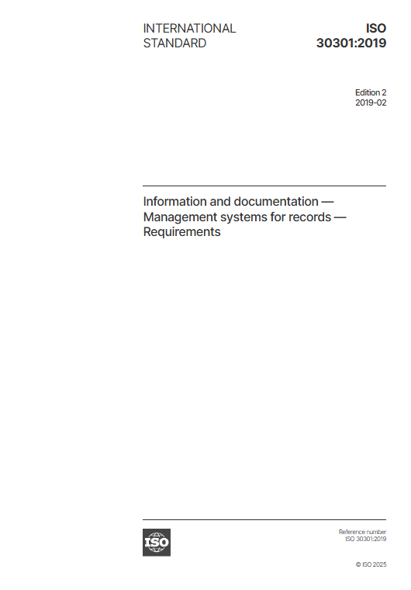
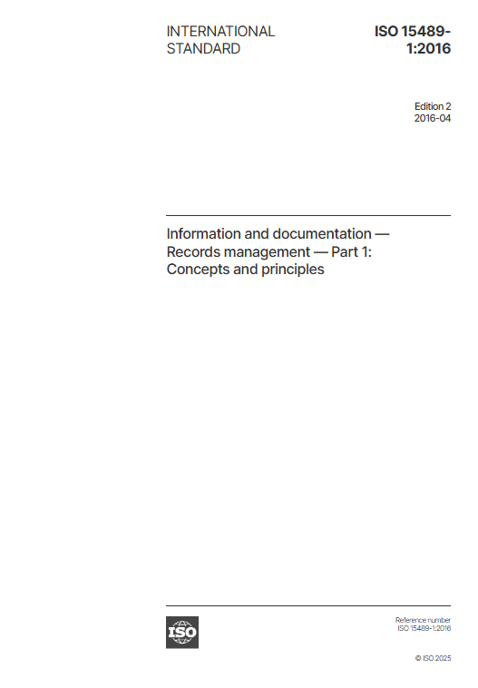
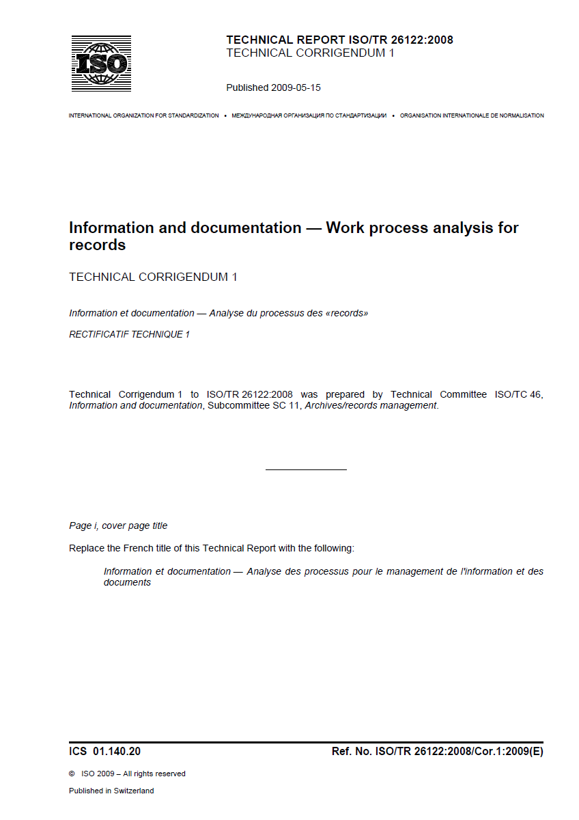
System analysis, compare:

Slide 10
Risk analysis (no explicit legal periods)
Risk class | Risk or value assessment | Retention period
1 | No or very limited value | 1 year
2 | Value for a limited period | 5 years
3 | Evidential value for a medium period, e.g. legal consequences or business operations | 10 years
4 | Evidential value for a longer period, mostly business operations | 20 years
5 | Evidential value in case of litigation or expiration, e.g. environmental care or contamination | 50 years

Slide 11
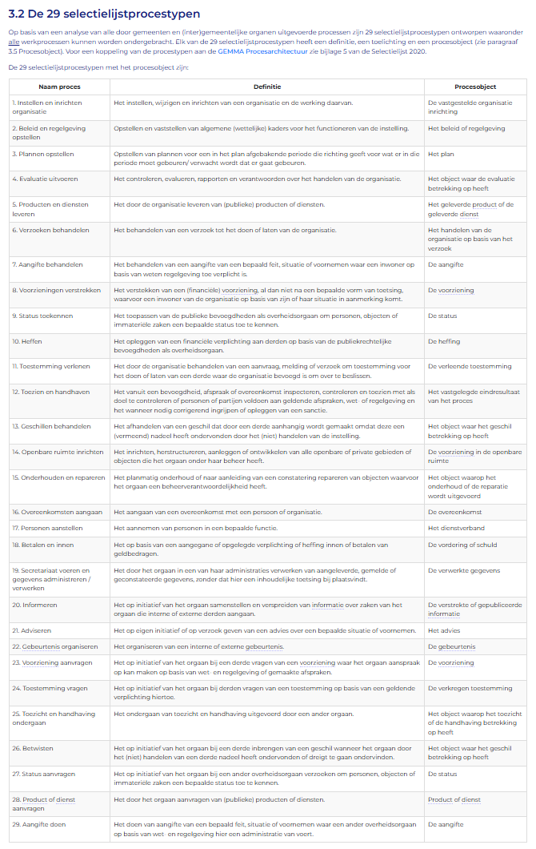
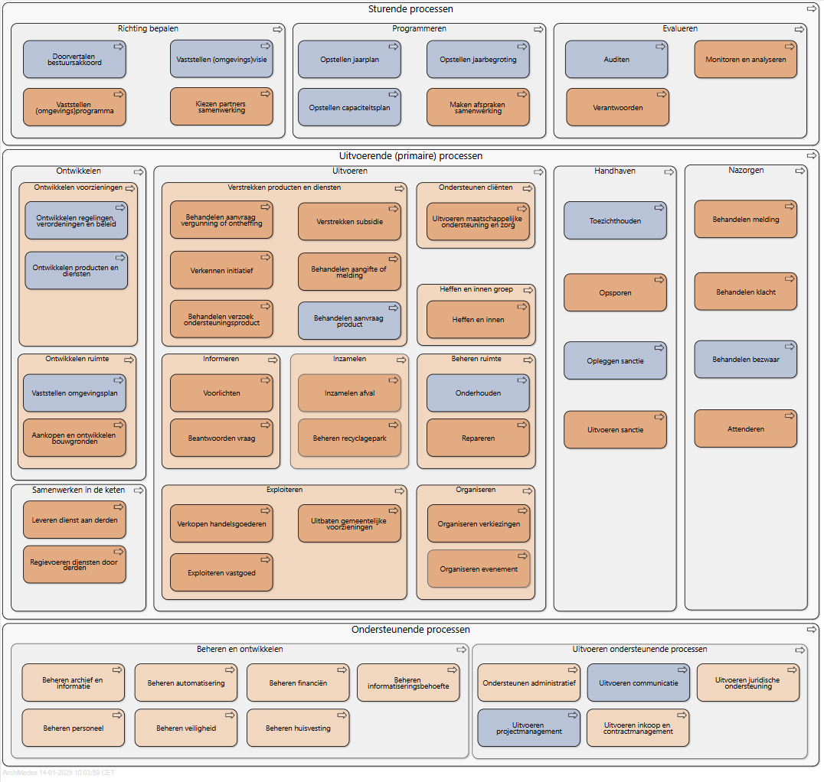
Integration with information architecture
Source: Business process model municipal information architecture GEMMA

Slide 12
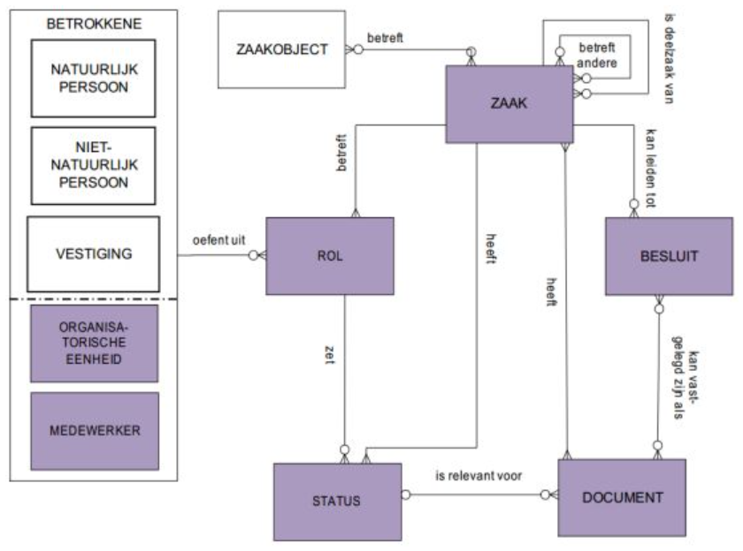
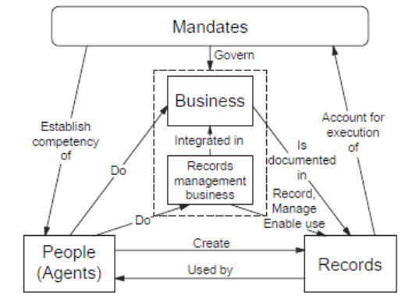
… and municipal ‘case type’ model
Source: Municipal information architecture GEMMA / ISO 23081

Slide 13
Basic logic
Retention schedule process 1-29
Process result
type 1
Generic result 1.1
Specific result
1.1.1
Process result
type 2
Generic result
1.2
Specific result
1.1.2
Possible process objects:
buildings,
legal rules,
people,
etc.
Retention rule 1.1
Retention rule
1.1.1
Retention rule
1.1.2
Retention rule
1.2

Slide 14
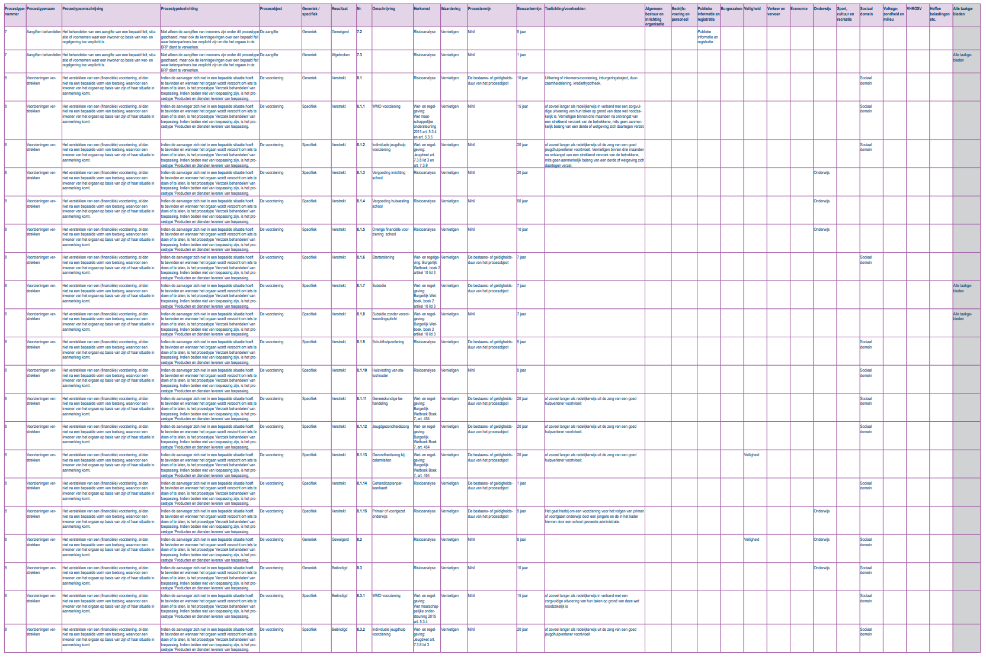
Resulting in ‘standard’ retention schedule
346 retention rules
divided in 29 process types
formats:
pdf
xlsx
reference tool

Slide 15
Formal process (Archives decree)
appointed archivist
chief information officer
Strategic
Information cOnsultation
public notice
decision and publication
external specialist

Slide 16
Next step: common retention schedules for all local and regional government
Working in linked information and process chains:
Municipal government
Provincial government
Water authorities
Source: Wikipedia page ‘Municipalities in the Netherlands (data November 2024)

Slide 17
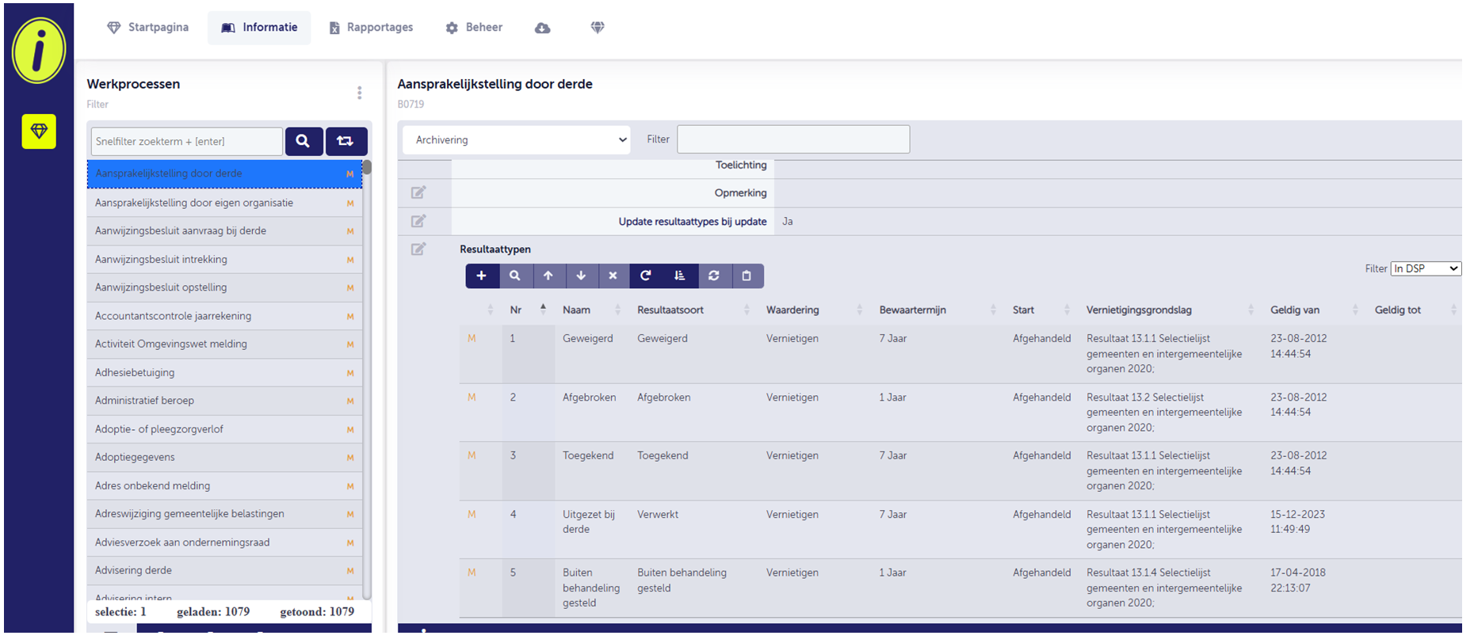
Integration in model file plans
Source: Municipal model file plan in iNavigator (2025)

Slide 18
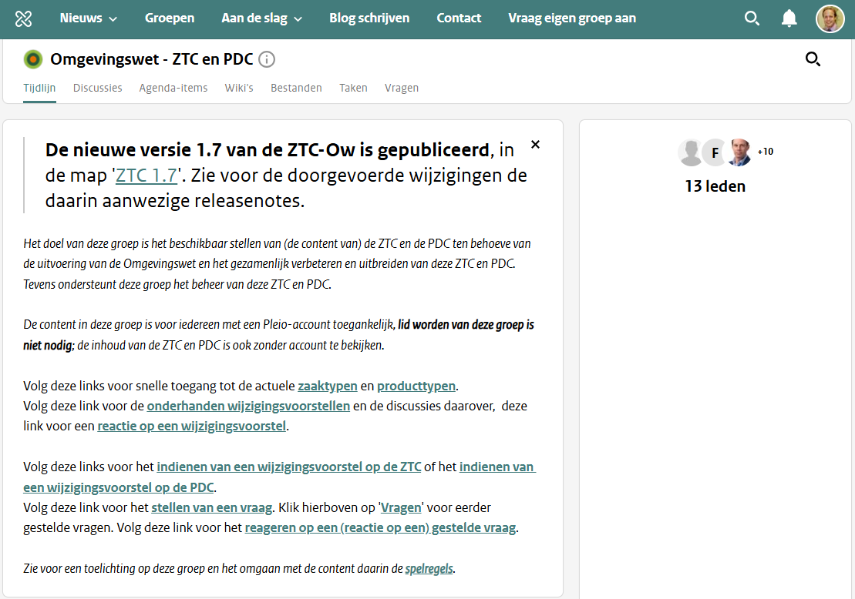
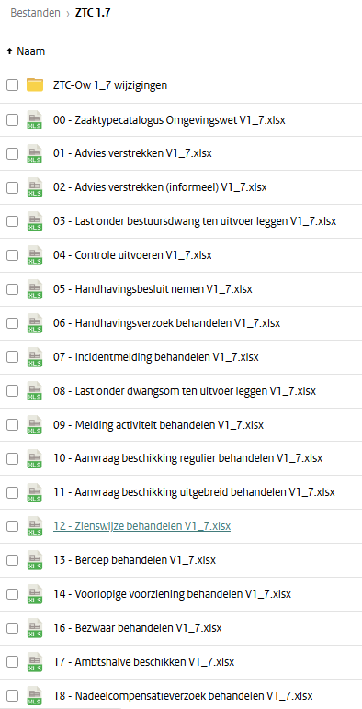
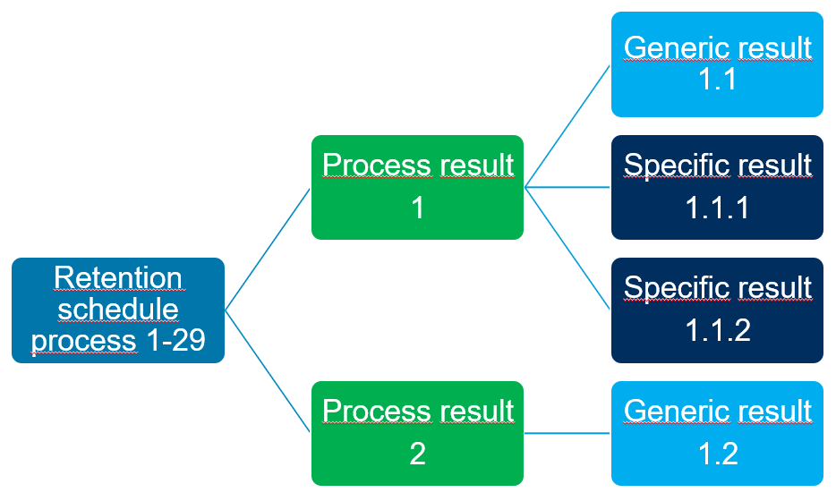
Integration in model process metadata
Example: case types Dutch Environmental decree, following ‘case type’ results

Slide 19
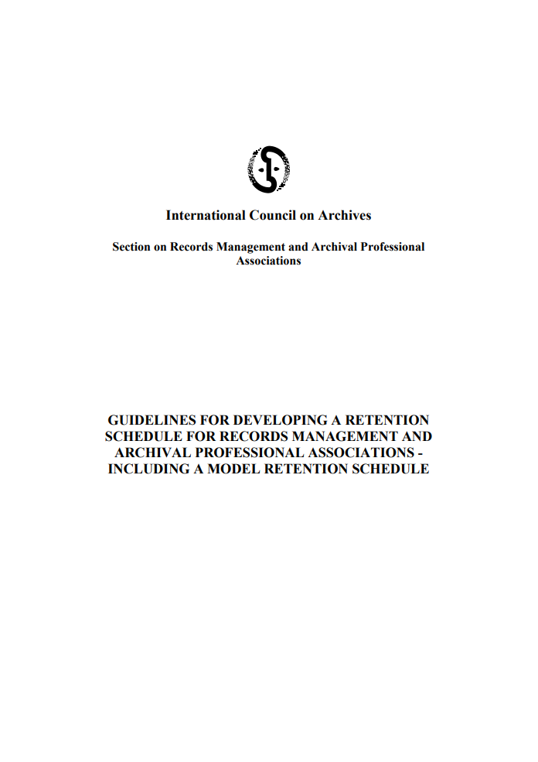
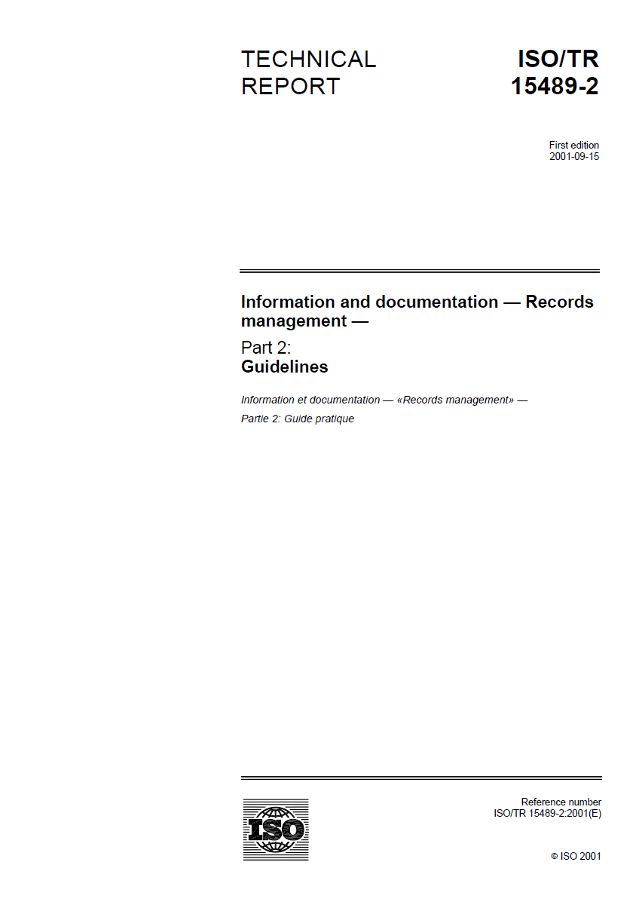
Have we found comparable standards?

