Slide 1
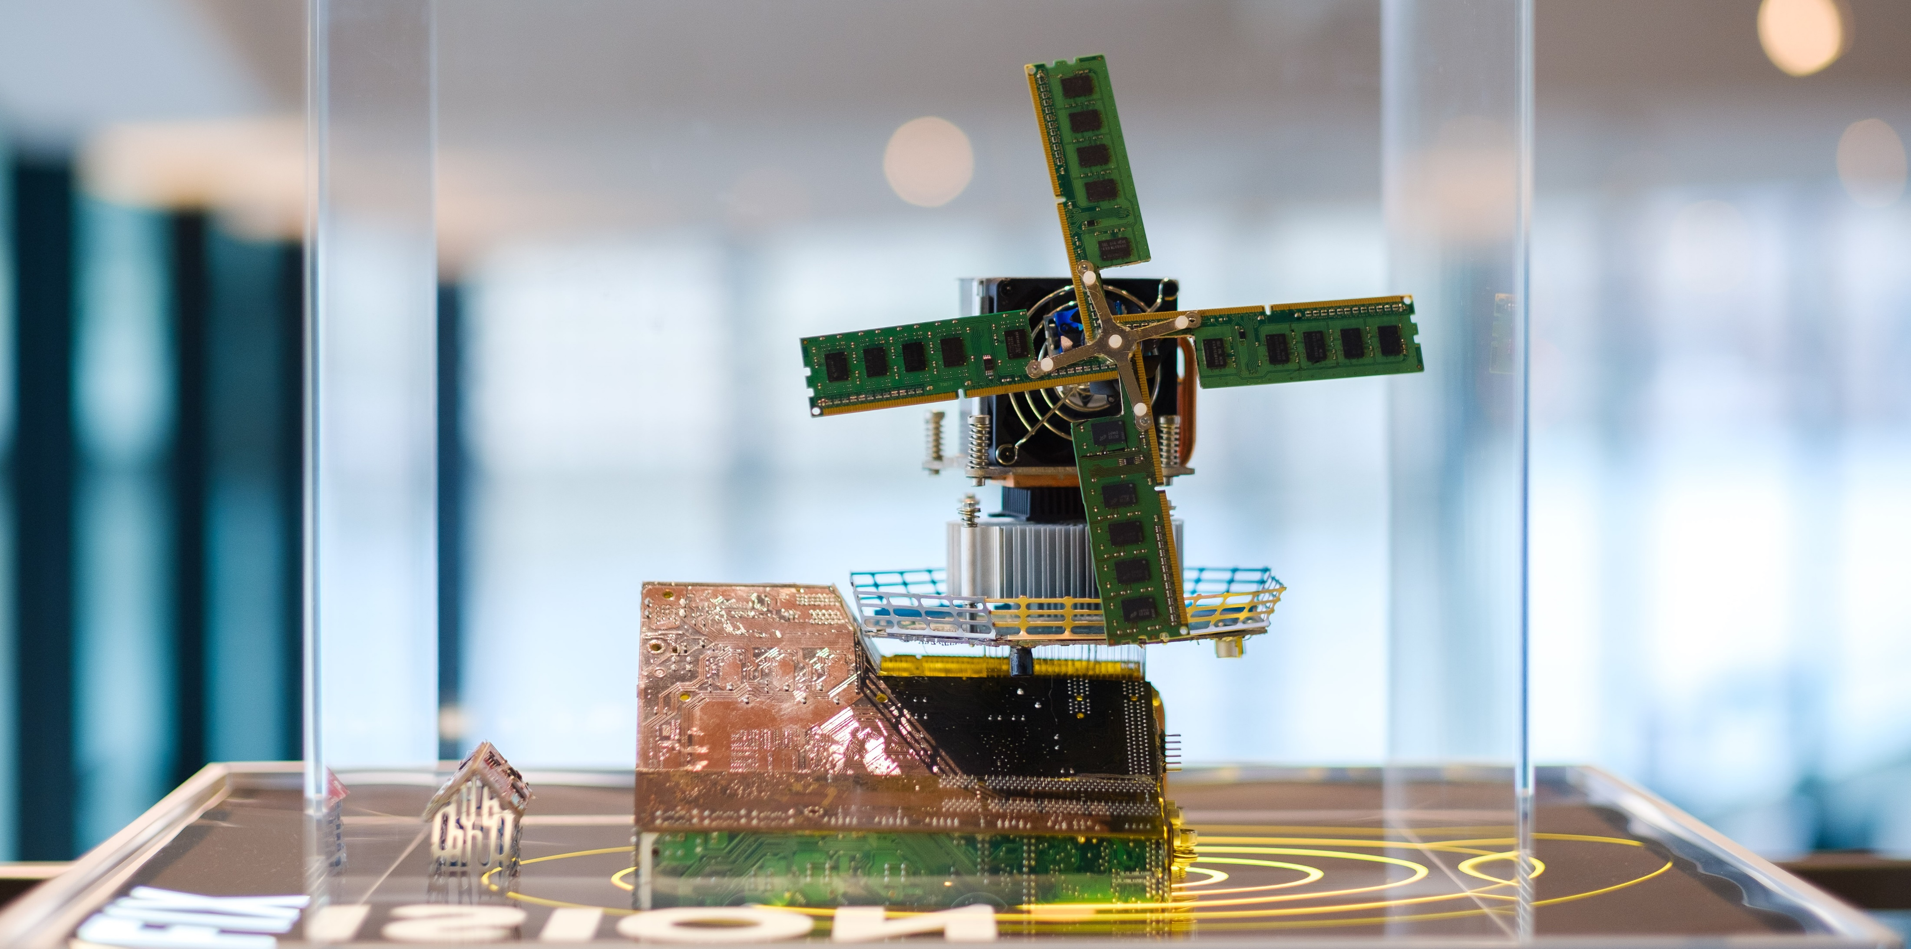
Preserving our national treasures KB National Library of the Netherlands
21 May 2025
Jeffrey van der Hoeven

Slide 2
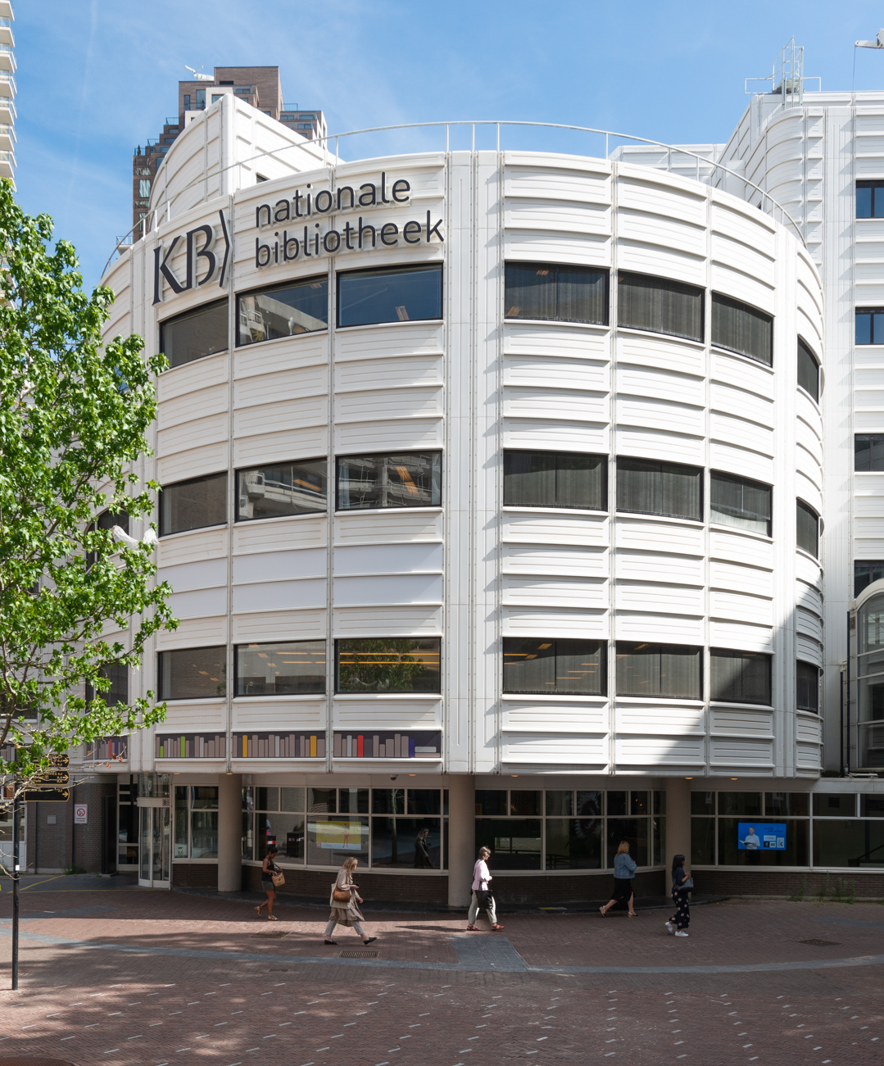
About the library
Founded in 1798
Deposit library since 1974
Serving two laws:
To preserve everything published in and about the Netherlands (but no legal deposit)
To coordinate and service the digital infrastructure for the public library domain (since 2015)
Yearly budget 100 million euro
Financed by ministry of Education, Culture & Science
500 FTE / 650+ employees

Slide 3
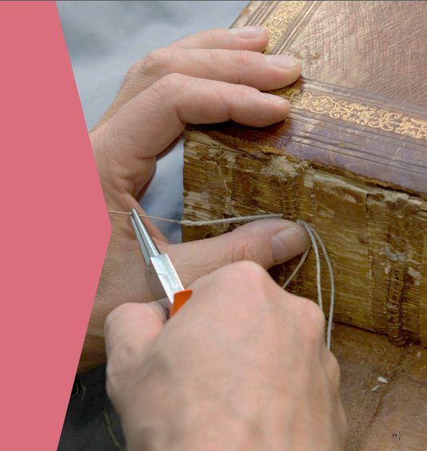
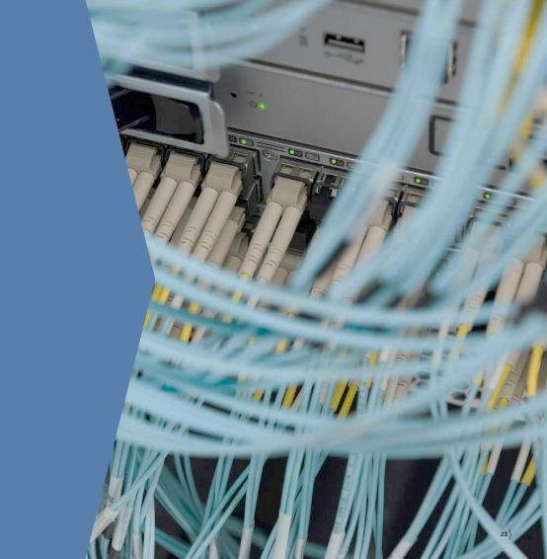
Preserving our collections

Slide 4
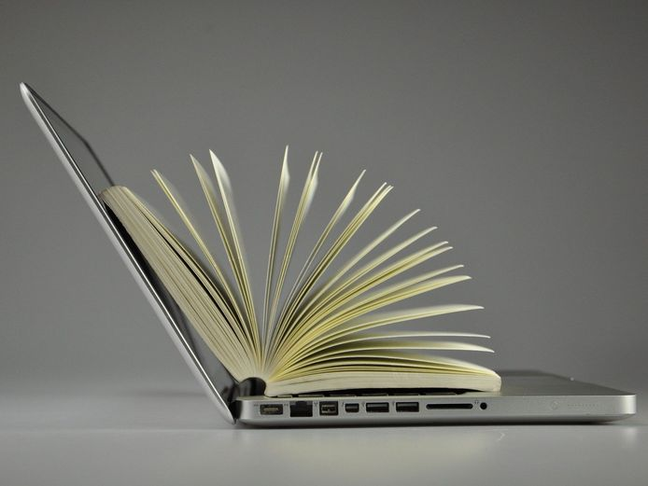
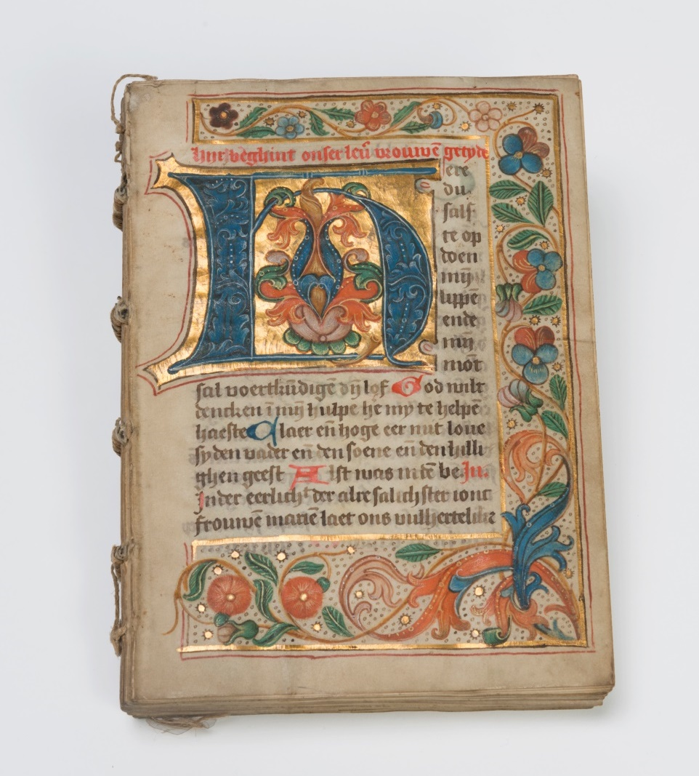
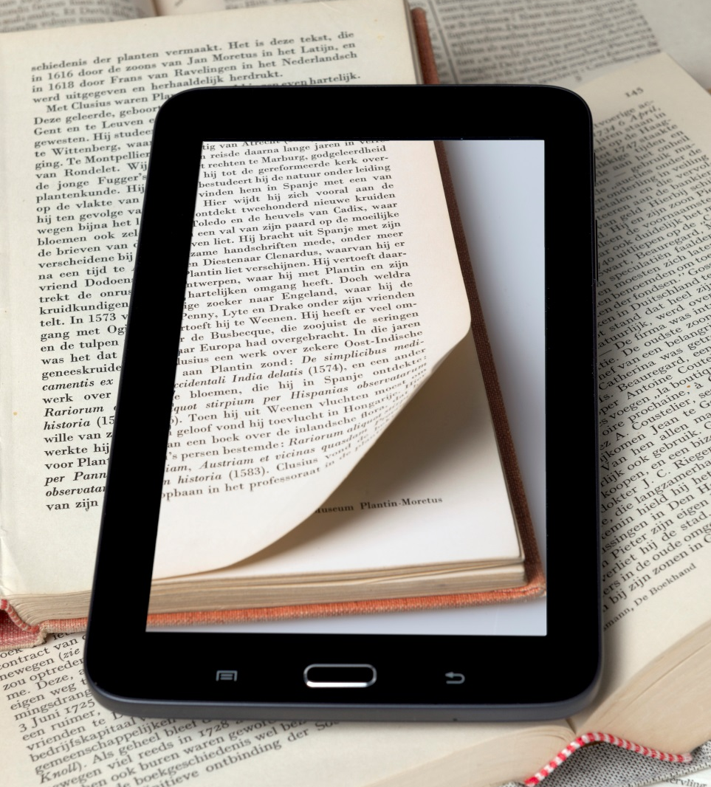
KB collections
Printed / written | amount
Books | 3,500,000
Magazines | 700,000
News papers | 100,000
Special collections (e.g. manuscripts) | 575,000
In total: | ~122 kilometers
Digital | amount
Scientific publications (articles) | 45,000,000
e-books | 100,000
Web sites | 25,000
Digitized pages books, magazines, news | 120,000,000
Digital carriers (CD’s, floppy, etc.) | 30,000
In total: | 2 Petabytes 2 billion files

Slide 5
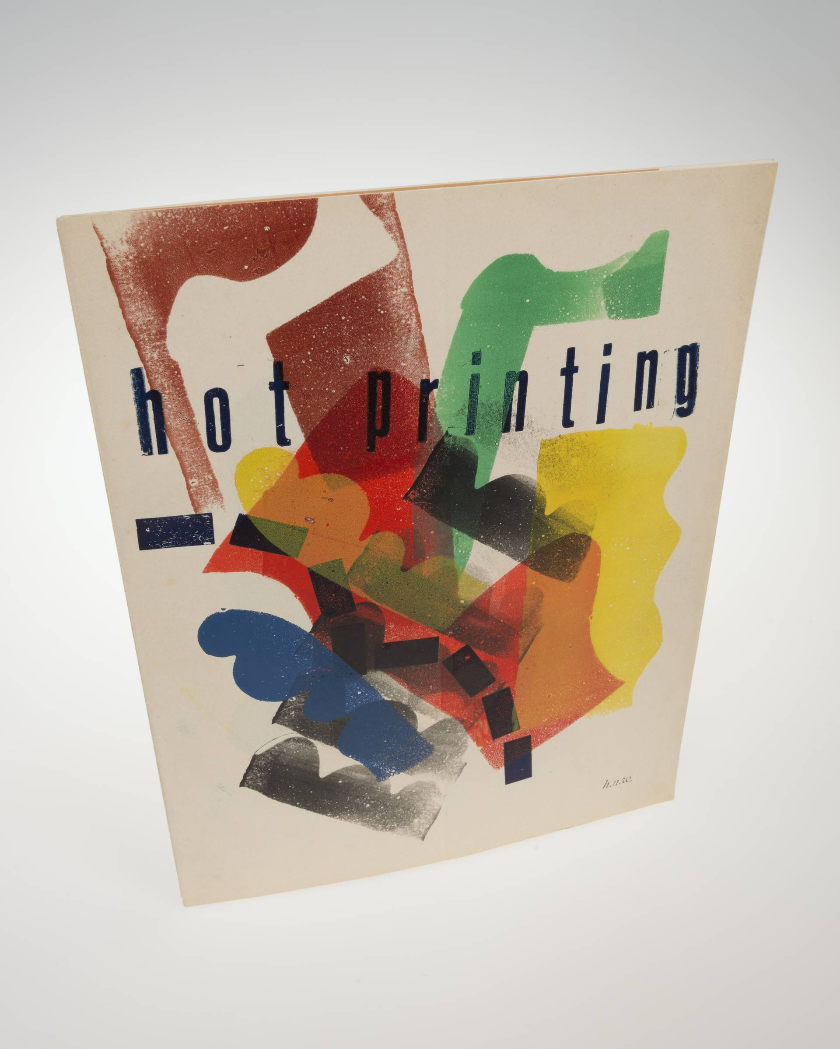
Digital library maturity
History (1990 – current)
Shift of focus to traditional and digital publishing
Various deals with archiving digital content from large international publishers and open access publishers
Start web archiving project: web archiving on a selective basis, 2007-present
Launched the Metamorfoze programme, set the industry standard for high-quality scanning: Preservation Imaging Guidelines
Large-scale digitization of news papers and books via Metamorfoze and partnerships Google & Proquest
Operational e-Depot since 2002: our archiving solution for preservation of digital collections
2021: e-Depot received CoreTrustSeal (CTS) certificate as being a trusted digital repository

Slide 6
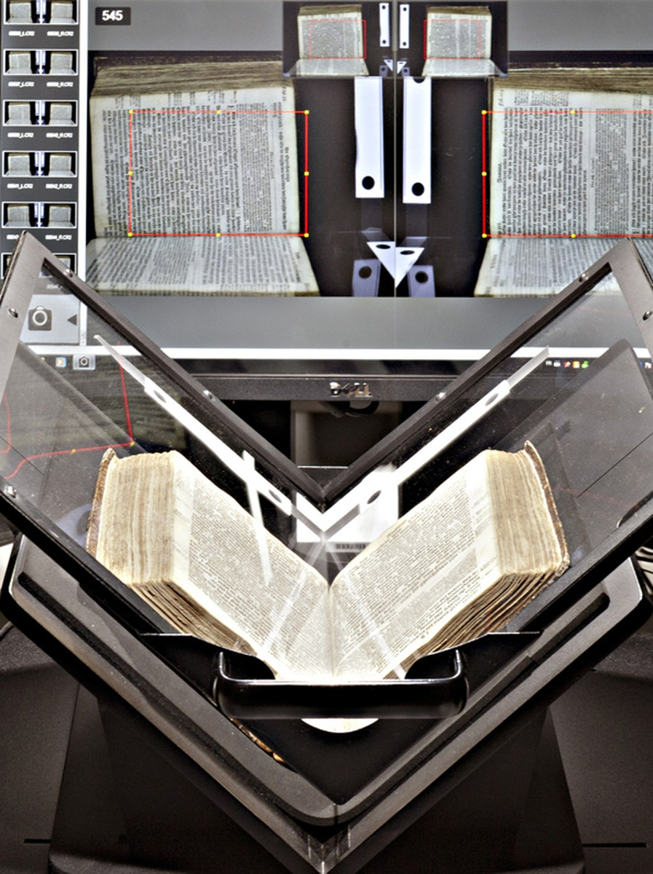
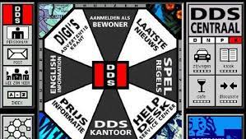
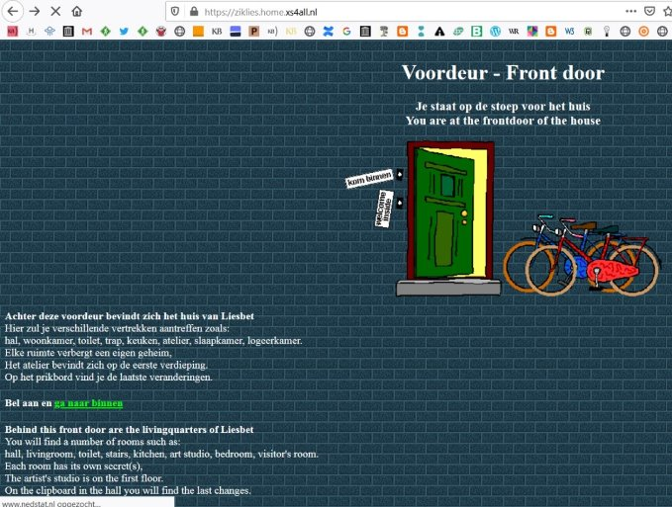
De Digitale Stad, 1996
XS4all website ‘Liesbet’s virtual home’, 1995

Slide 7
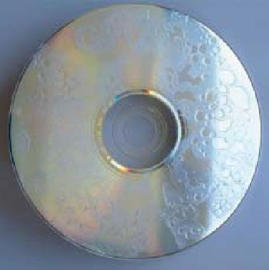
Deterioration of media carrier

Slide 8
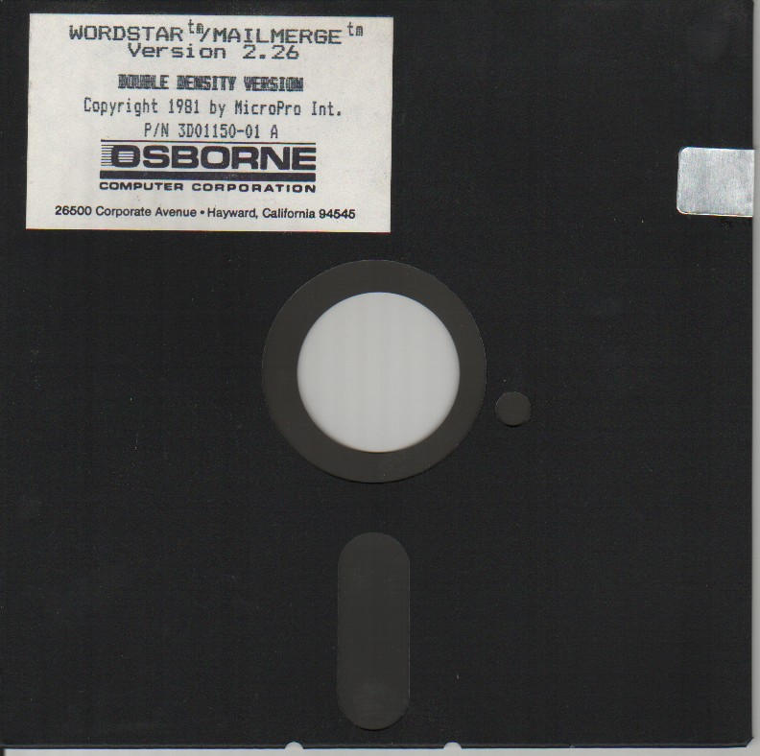
Useless media formats

Slide 9
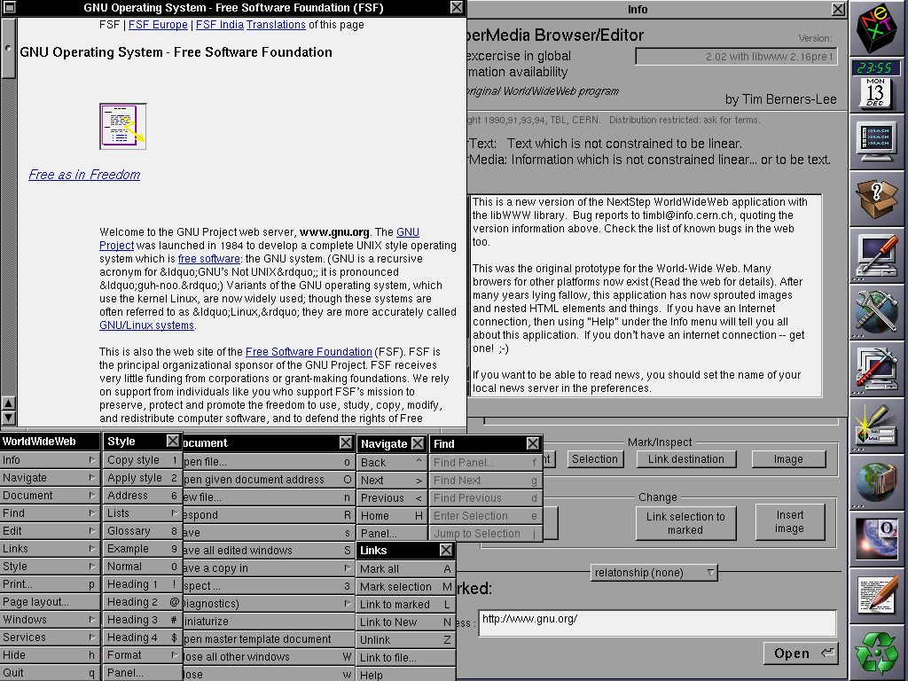
Ancient software
http://en.wikipedia.org

Slide 10
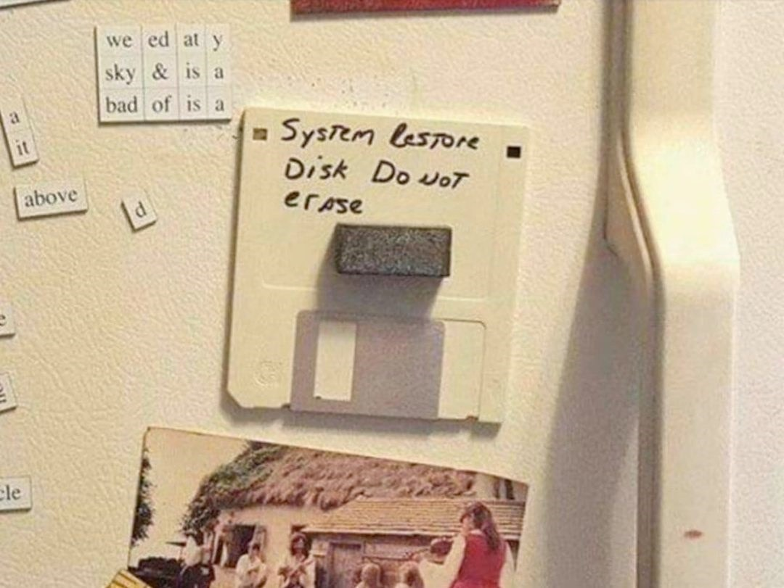
“Human failure”

Slide 11
Key concepts of preservation
Trustworthiness
Integrity
Bit-integrity
Integrity: Is it complete?
Authenticity: Is it real?
Keeping record information about objects
Standards support the longevity and portability
Main standards in use for registration and preservation:
METS, PREMIS, IFLA-LRM, RDA
Version-integrity
IP-integrity
Information-integrity
Collection-integrity
Authenticity
Intent
Provenance
History

Slide 12
Scope of preservation
Trustworthy Digital Repository (TDR)
Organisational
Legal
Technical
Mission
Succession
Collection policy
Contract man.
Staff policy
Finance
Expertise
etc.
Privacy
Copyright
Security
Backup
Infrastructure
Disaster recovery
Preservation
Digital lifecycle management
Provenance
Preservation planning
etc.

Slide 13
Current challenges digital collection care
Scale & migrations
ICT landscape complexity & overcoming legacy
Threats & cybersecurity
Access & re-use (changing demands)

Slide 14
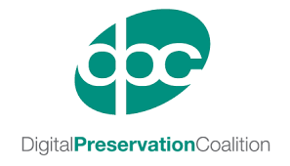
KBNL & partners
National:
Nationaal Archief
University libraries
Cultural heritage organisations
Dutch Digital Heritage Network (NDE)
International cooperation:
national libraries & archives
LIBER
Open Preservation Foundation (OPF)
International Internet Preservation Consortium (IIPC)
Digital Preservation Coalition (DPC)
METS editorial board, PREMIS
More about KBNL & preservation:
https://www.kb.nl/en/about-us/expertise/digital-preservation

