Slide 1

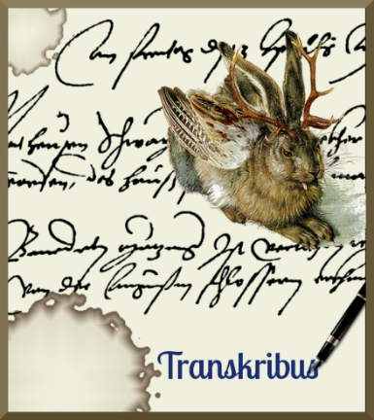
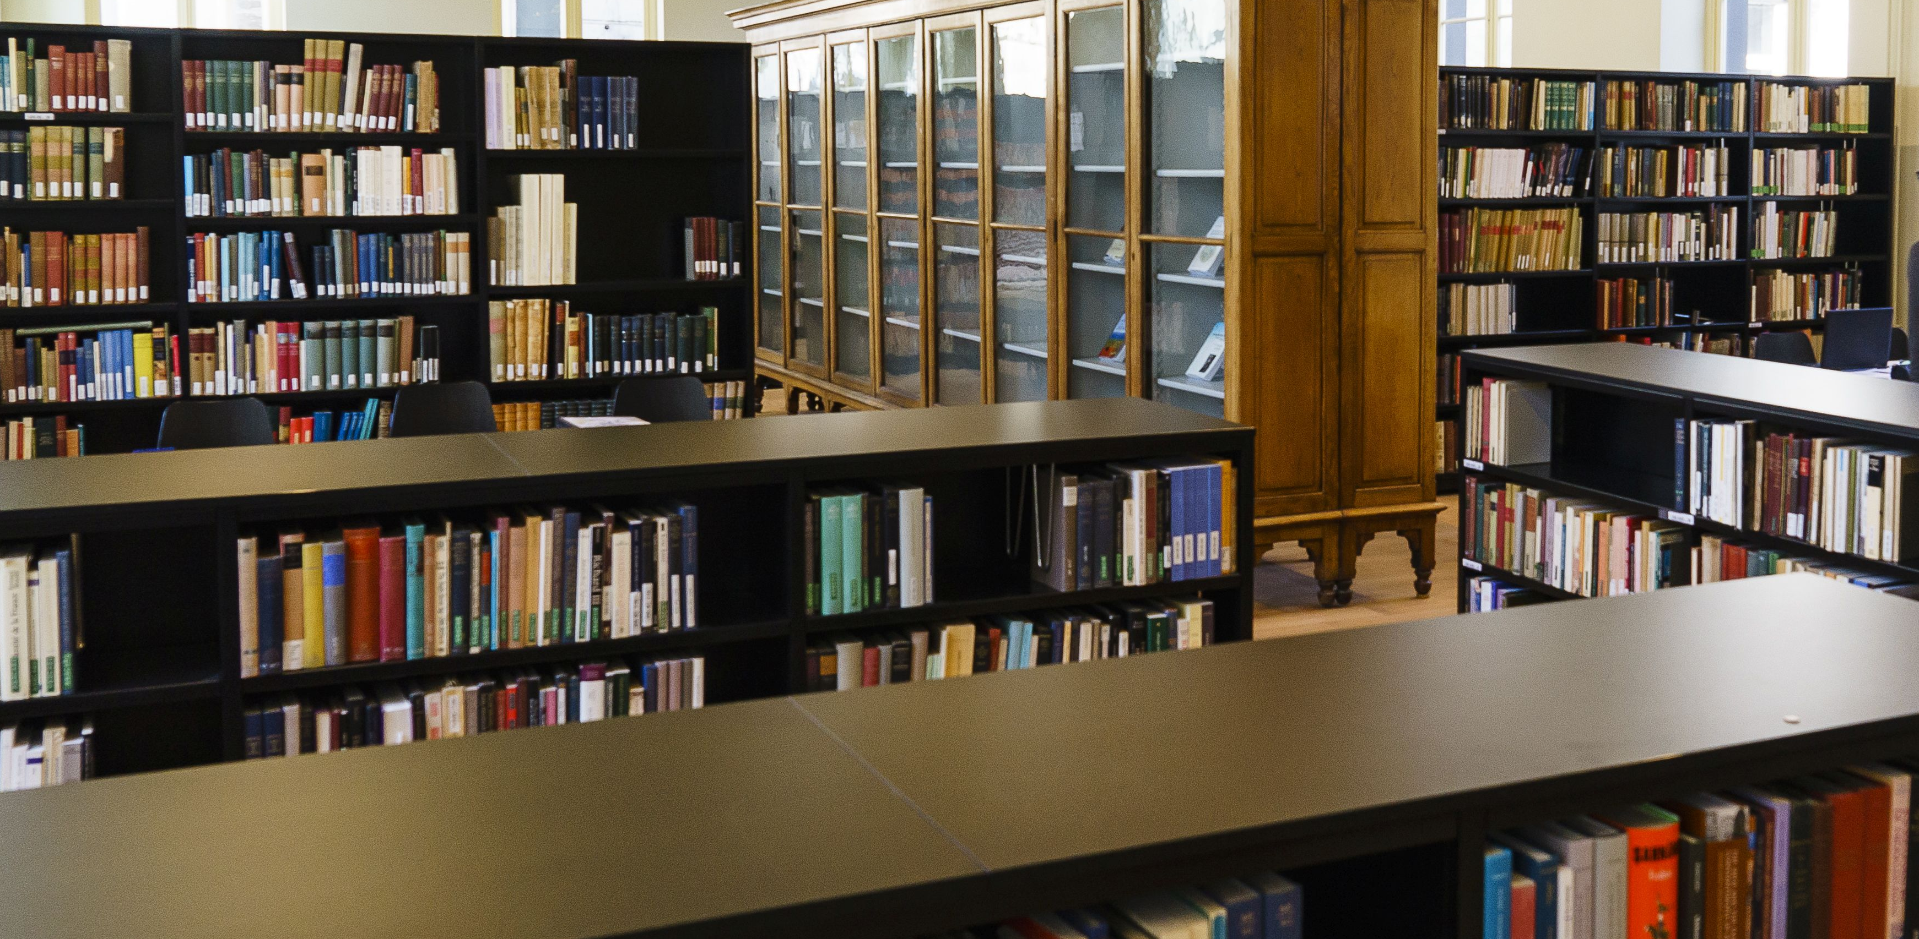

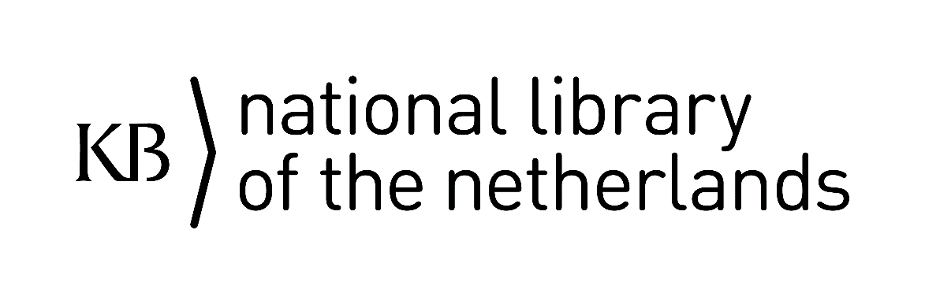

Transkribus-LA ervaringen met drukwerk
Researcher-in-Residence project ‘Entangled Histories’.
Vroegmoderne provincial regelgeving.
Team: Michel de Gruijter (PM), Annemieke Romein (PI) en Sara Veldhoen (SP).

Slide 2
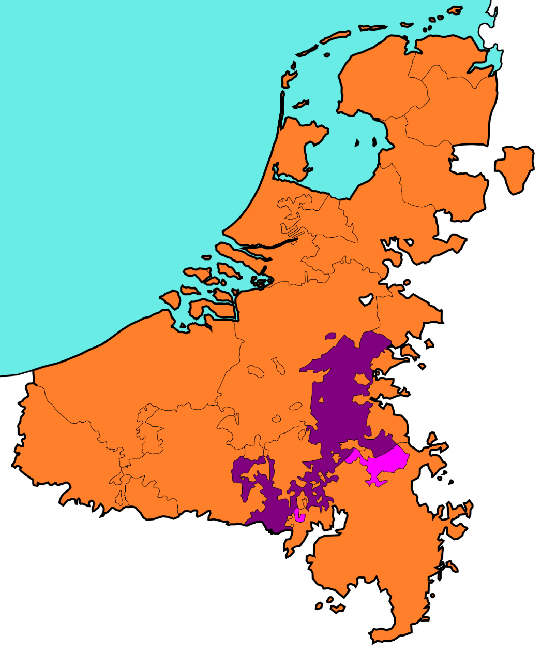
Hypothesis
Vroegmoderne staten zagen zich vaak geconfronteerd met problemen.
Omdat het voortbestaan op het spel stond, moesten ze snel en adequaat handelen.
Zodoende was het ontzettend belangrijk om wet- en regelgeving te kopiëren, aan te passen en te implementeren – wanneer deze in andere gebieden al succesvol bleken te zijn!
Notes:
Let us first give you some context regarding our project ‘Entangled Histories’ at the KB National Library of the Netherlands.
I (Annemieke) applied for the researcher-in-residence position about a year ago. This is a fully funded part-time function to use the KB collection to answer a specific research question.
My focus is on early modern legislation. Since the Low Countries – or, 17 Provinces – were small, they seemed to have to cope with a lot. In my BA, years ago, I encountered legislation against beggars and vagrants stating that they needed to leave within a week, or else they would be chased down. But where did they go? I assumed that, when they crossed the border another area would end up with the same troubles. Hence, I came up with the following hypothesis: ‘Early Modern European states struggled for survival, making it impossible to ‘reinvent the wheel’ each time a problem arose. Hence, it was of tremendous importance to copy, adapt and implement normative rules (aka legislation) that were already proven succesful elsewhere.’ This hypothesis is broader than the Low Countries, but within this project, we do “narrow it down” to the 17 provinces to test it.
It may be interesting to know that early modern legislation was announced by the city crier and then stuck to ‘known places’ around the cities and towns. Here you see a part of a painting that shows such a ‘known place’ in Amsterdam (the Paalhuis).

Slide 3
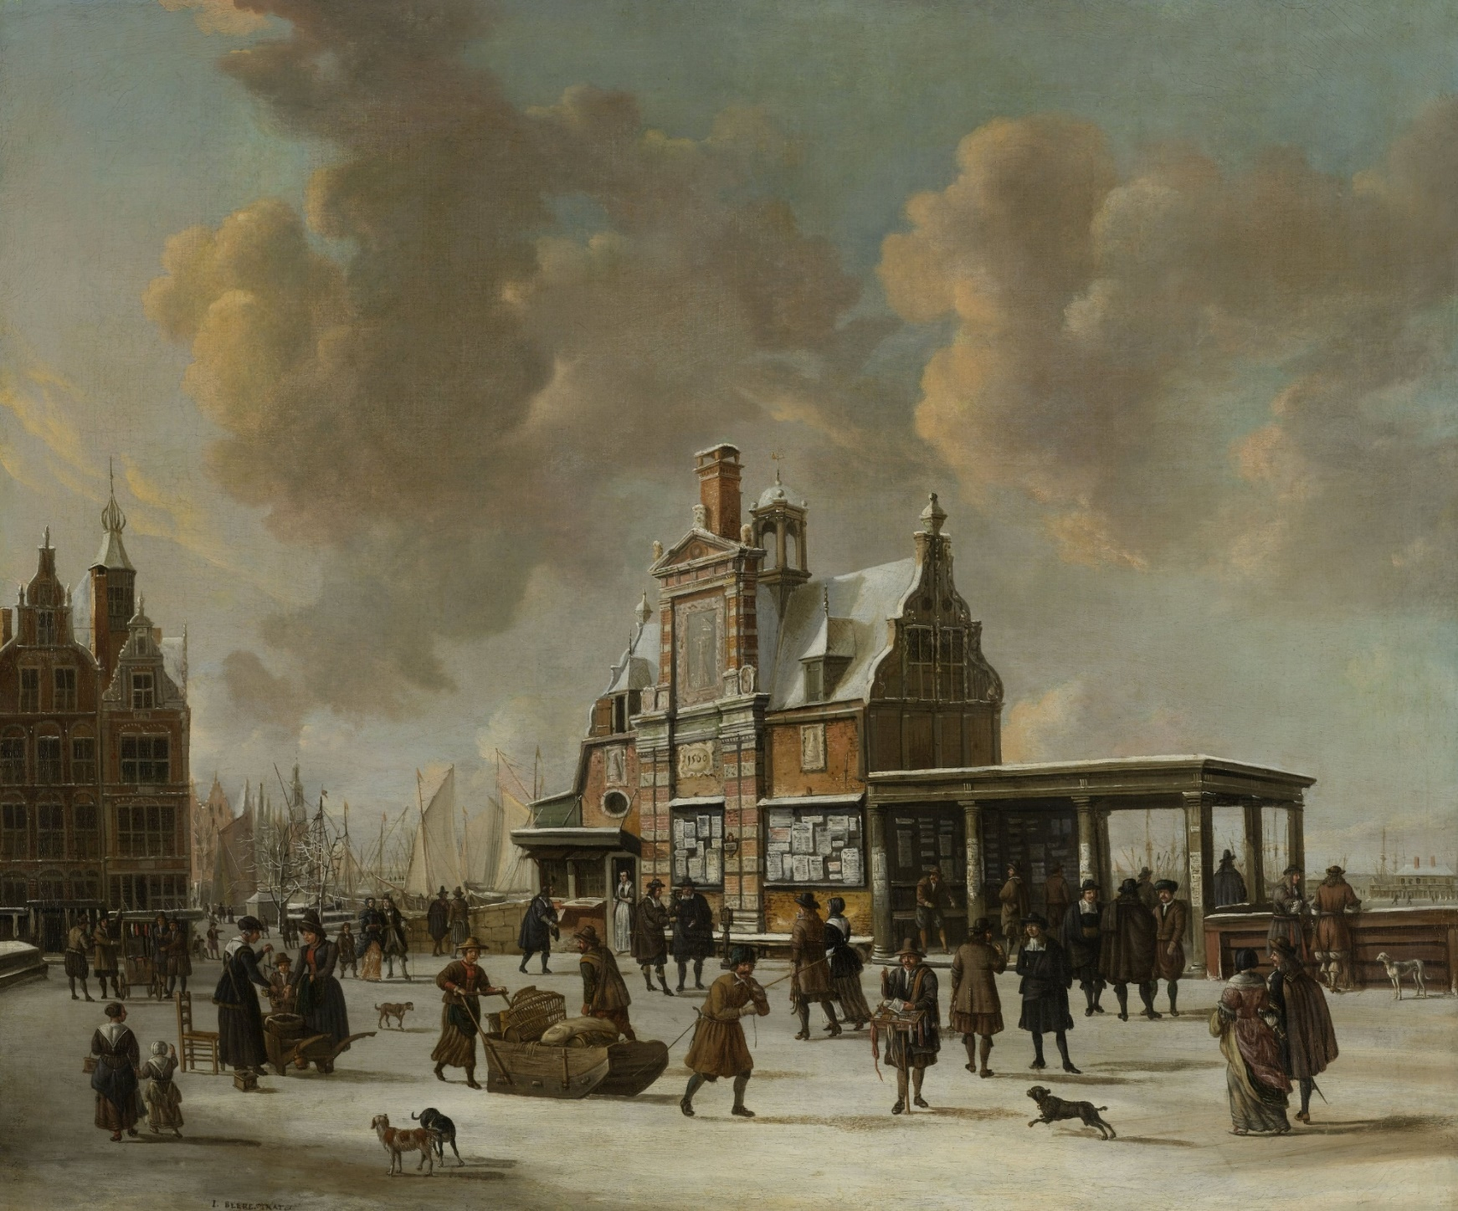
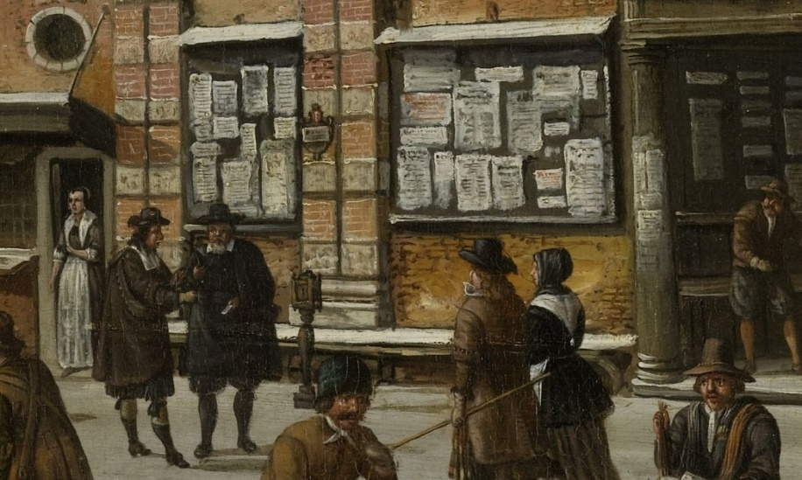

Slide 4
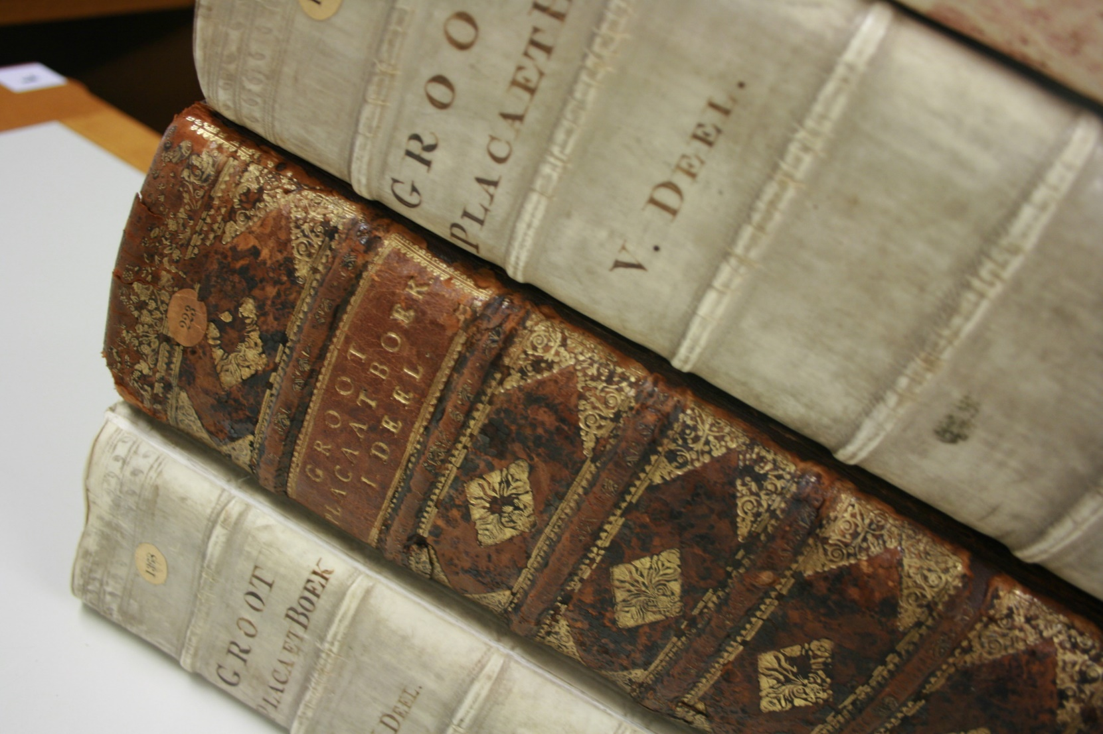
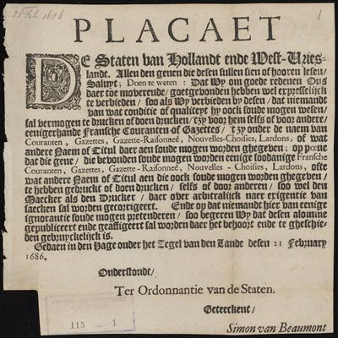
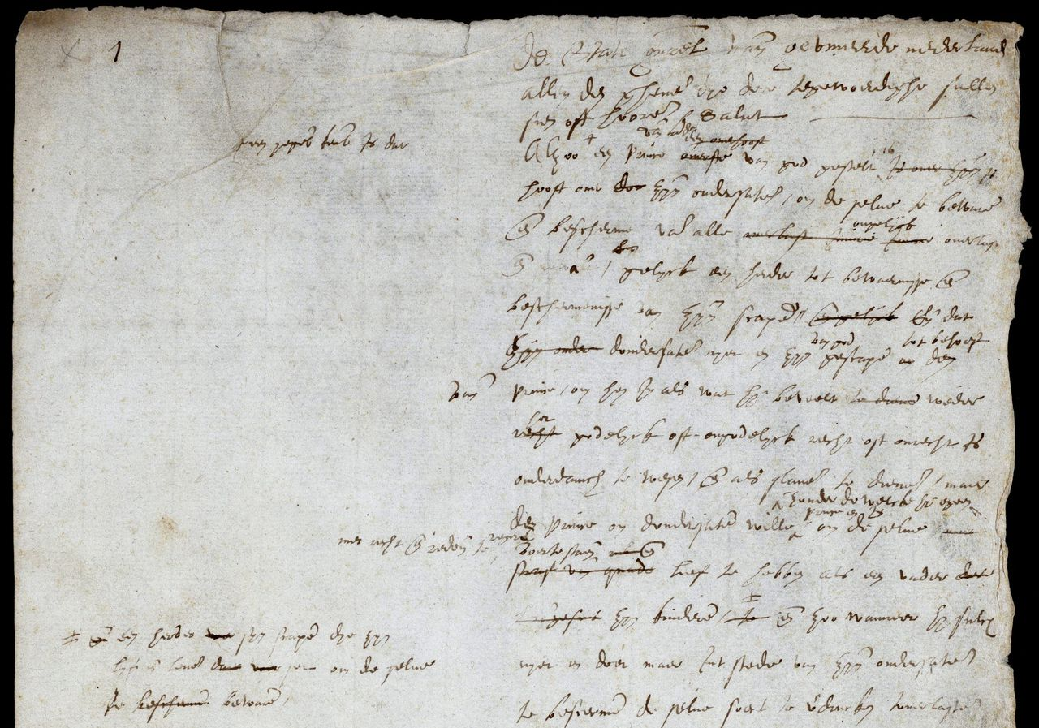
Wie wat bewaard,…
Provinciale wetgeving (en soms stedelijke ‘costumen’) werden gebundeld.
Selectie.
Grote variatie in onderwerpen.
Notes:
Links onder: https://library.maastrichtuniversity.nl/collections/databases/digitale-plakkaatzoeker/
Rechts onder: Plakkaat van Verlatinghe, pagina 1 (NA)

Slide 5
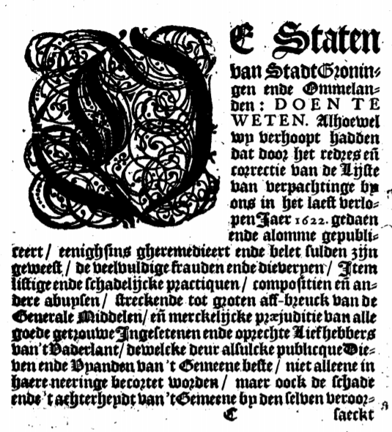
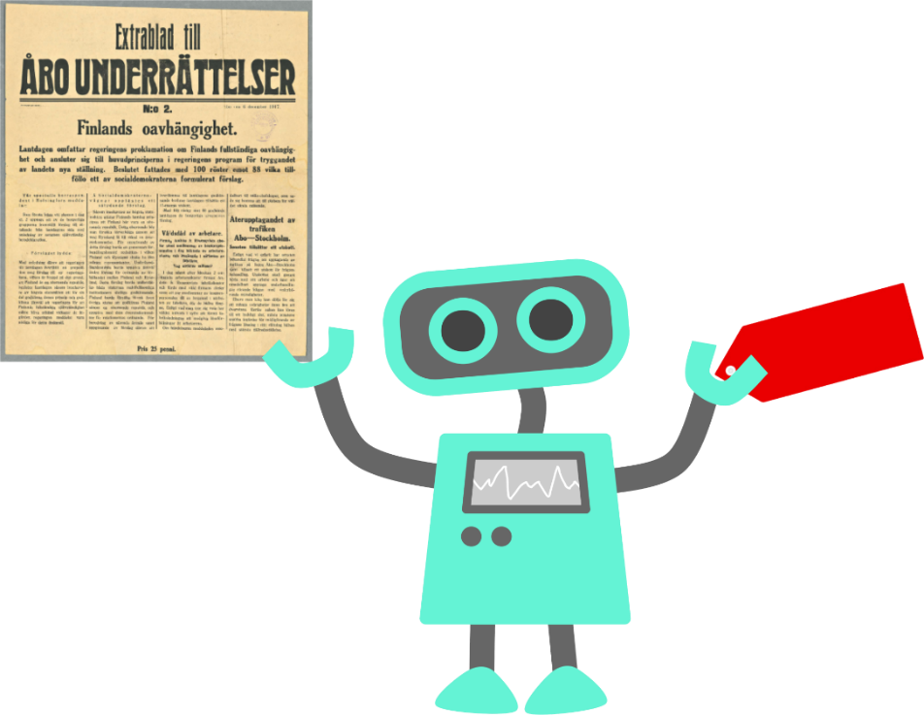
Drie doelen:
Verbeteren van de OCR dmv HTR+ (ATR).
Segmentatie van de tekst.
Automatische indexatie d.m.v.: Annif.
Annif (annif.org)
Library of Finland

Slide 6
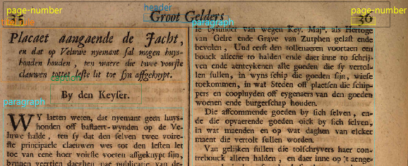
Segmentatie
‘Visueel’: P2PaLA (Transkribus/Valencia)
‘Tekstgebaseerd/locatie’: NLE Document Understanding
Notes:
P2PaLa is a lay-out analysis tool incorportated within Transkribus. It has been created by the Technical University of Valencía (Spain). One can tag the text-regions with metadata such as page-number, paragraph and header, as is shown on the slide. It does need a lot of training-data to create a model. Best not to do it with to many tags, as this can tick the system off.

Slide 7
Layout-analyse trainen P2PaLA

Slide 8
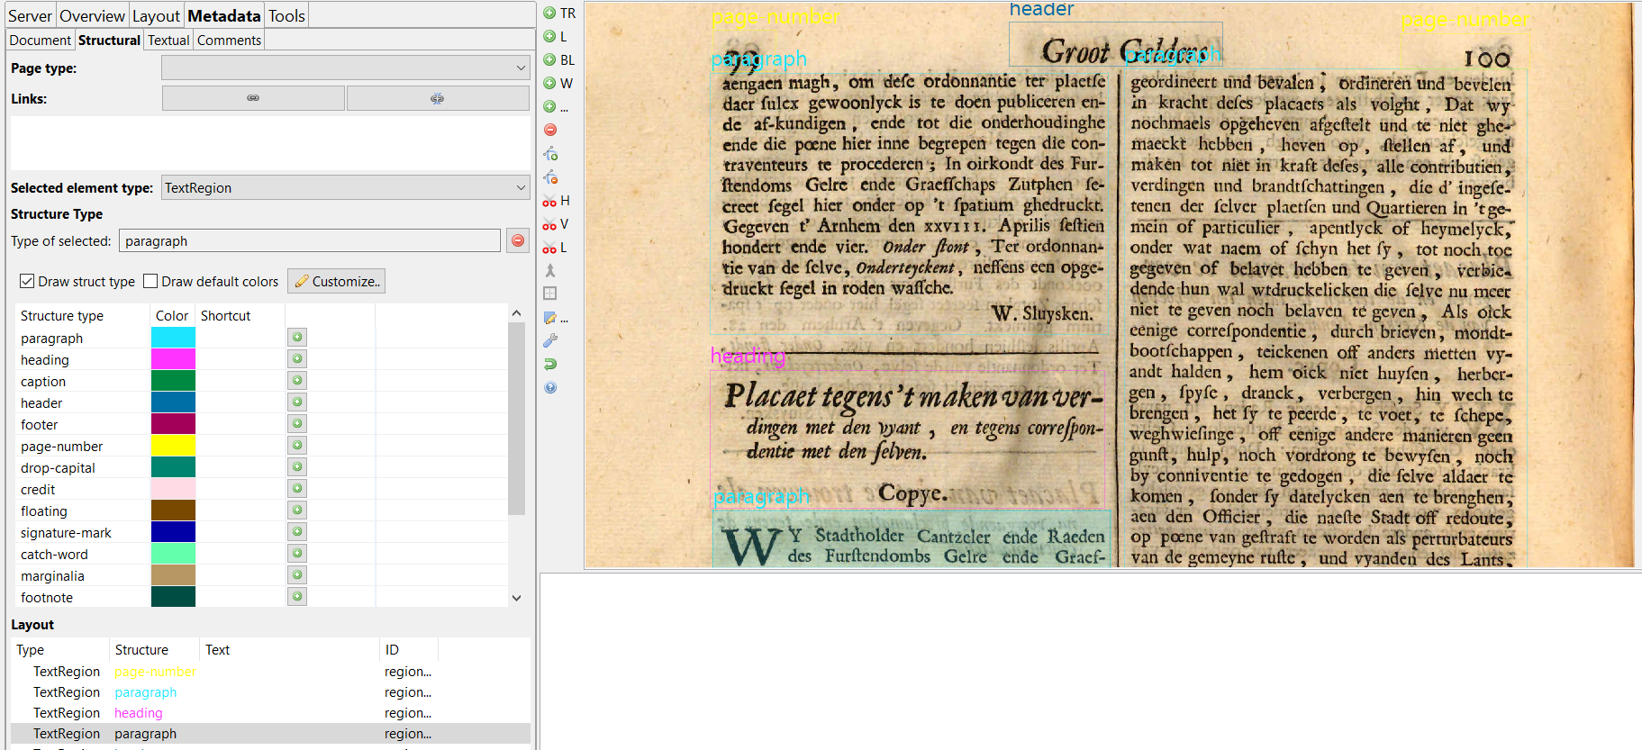
Geef je tekst structuur-tags (dan pas BL)

Slide 9
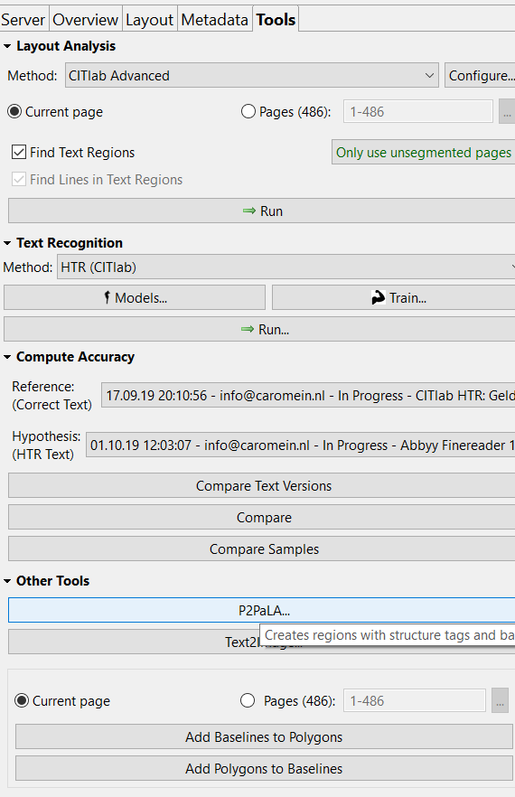
P2PaLA
Je hebt dus een groot aantal pagina’s nodig die al structuurtags hebben.
± 200 voor een redelijke uitkomst (maar ook dan nog onzeker)

Slide 10
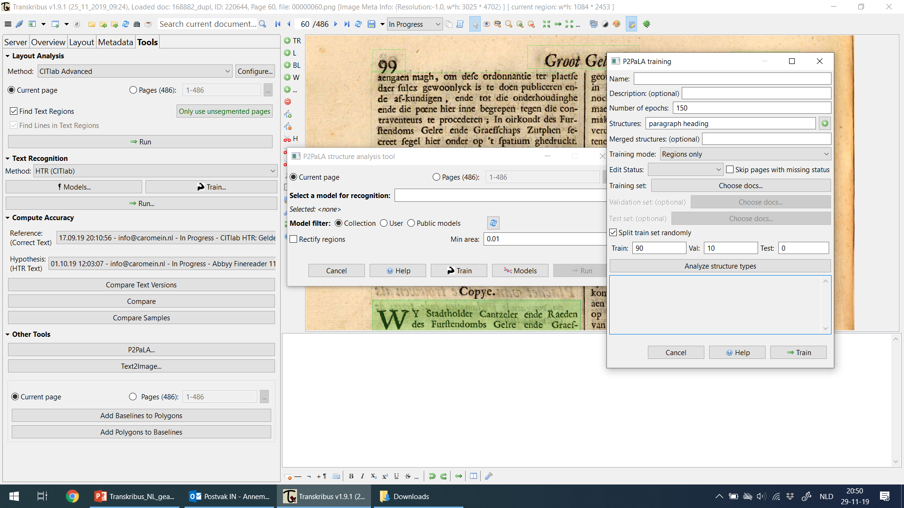

Slide 11
Layout-analyse trainen
NLE Document Understanding
Ook/ juist ook voor tabellen!
De volgende dia’s komen van de
Naver Labs Europe booth at DevView 2019 (Korea) en EMNLP 2019 (Hong Kong)

Slide 12
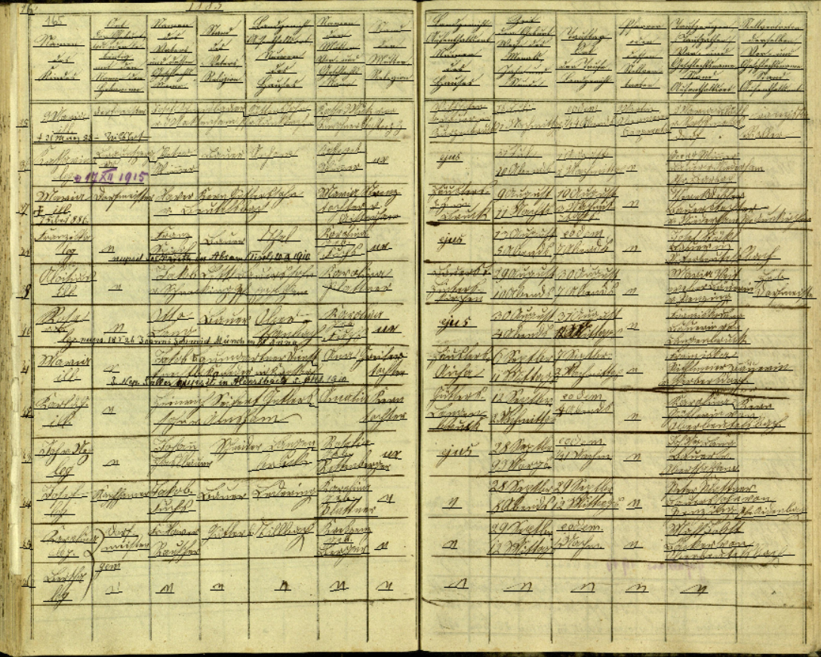
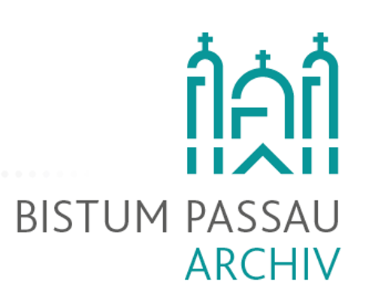


→ Information extraction
NLE Document Understanding – Naverlab Europe
Hervé Dejean
Jean-Luc Meunier
Notes:
Passau is a German, Bayern bishopric.
The parish registers recorded the profession of fathers and husbands. The death registers contained the job of the deceased.
The 19th century is characterized by the development of new professions and technology emerging alongside historical professions.
It’s remarkable how they changed in the diocese of Passau between the city and the rural areas, highly developed regions and those far from industrialization.
The variety and distribution of professions in the entire diocese tell researchers important information about the levels of education and the affinity to modern life in the 19th century. Visualizing on a map shows how professions spread throughout the territory and how they changed over time.

Slide 13
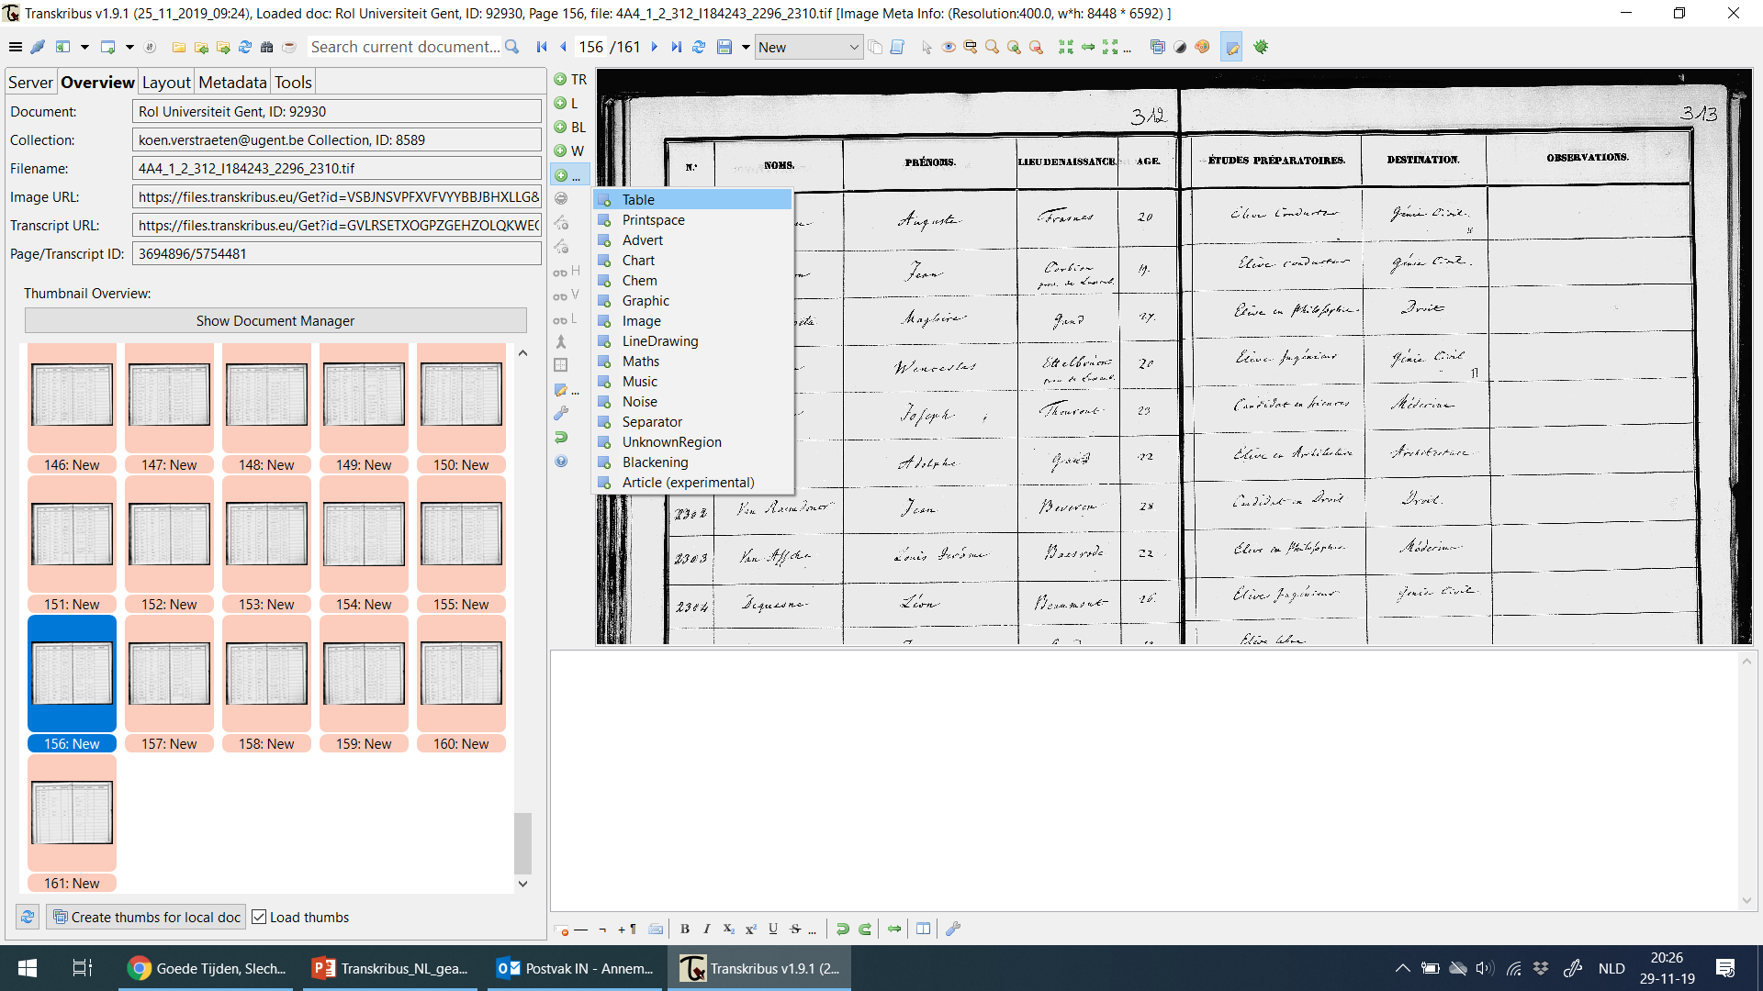
Stap 1. Tabellen markeren!
Rijen en kolommen in een tabel zijn lastig: niet systematische scheidingslijn, voorgedrukte lijnen, scheef geschreven of gescand, stijl varieert tussen auteurs, informatie in de verkeerde kolom.

Slide 14
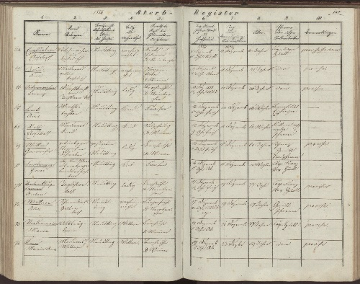
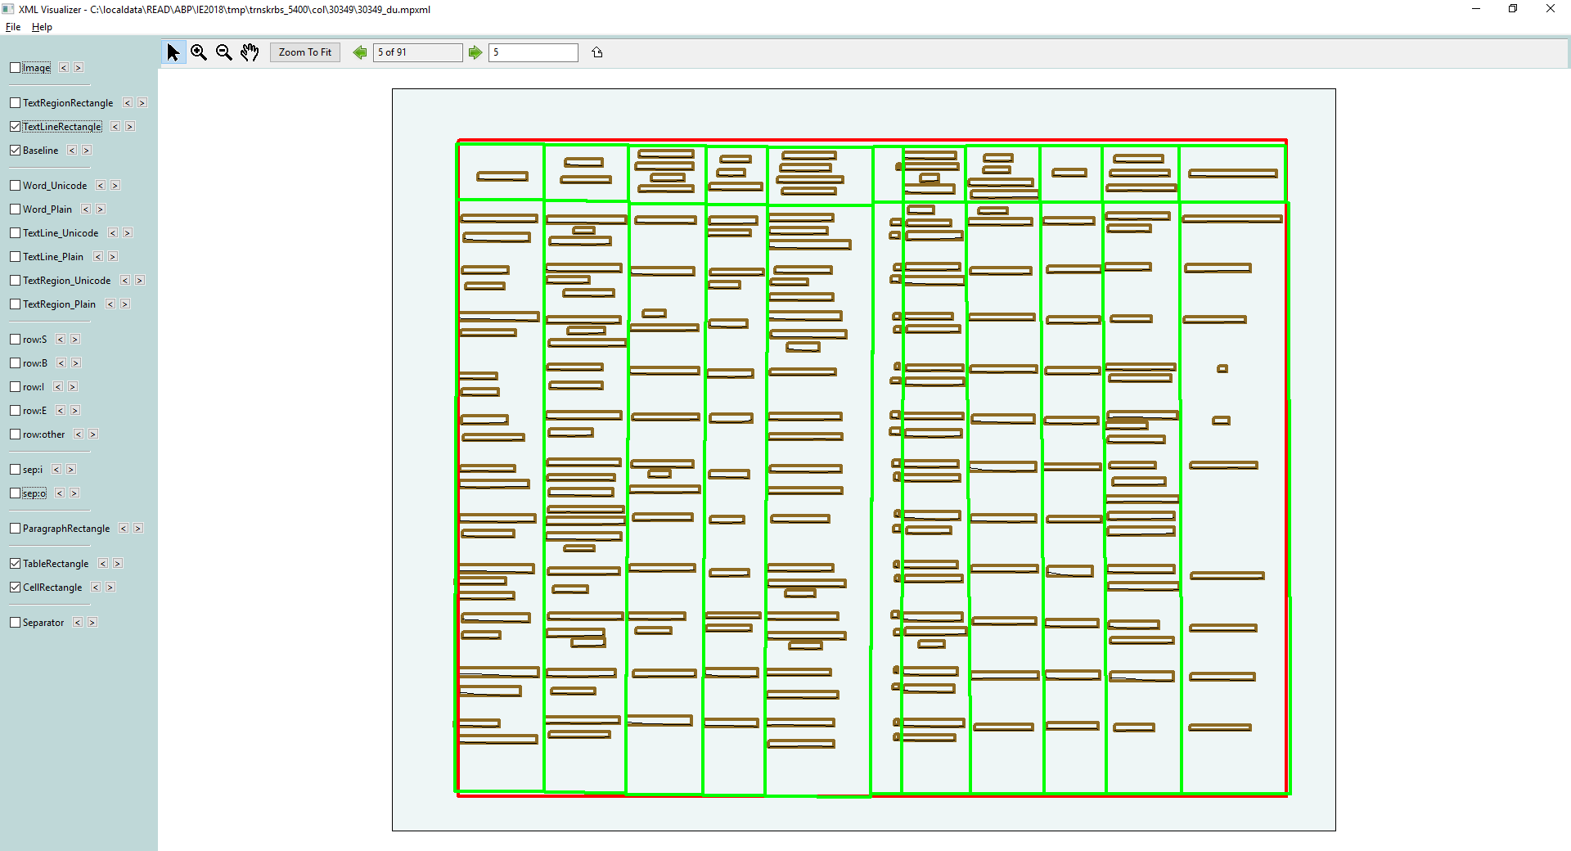
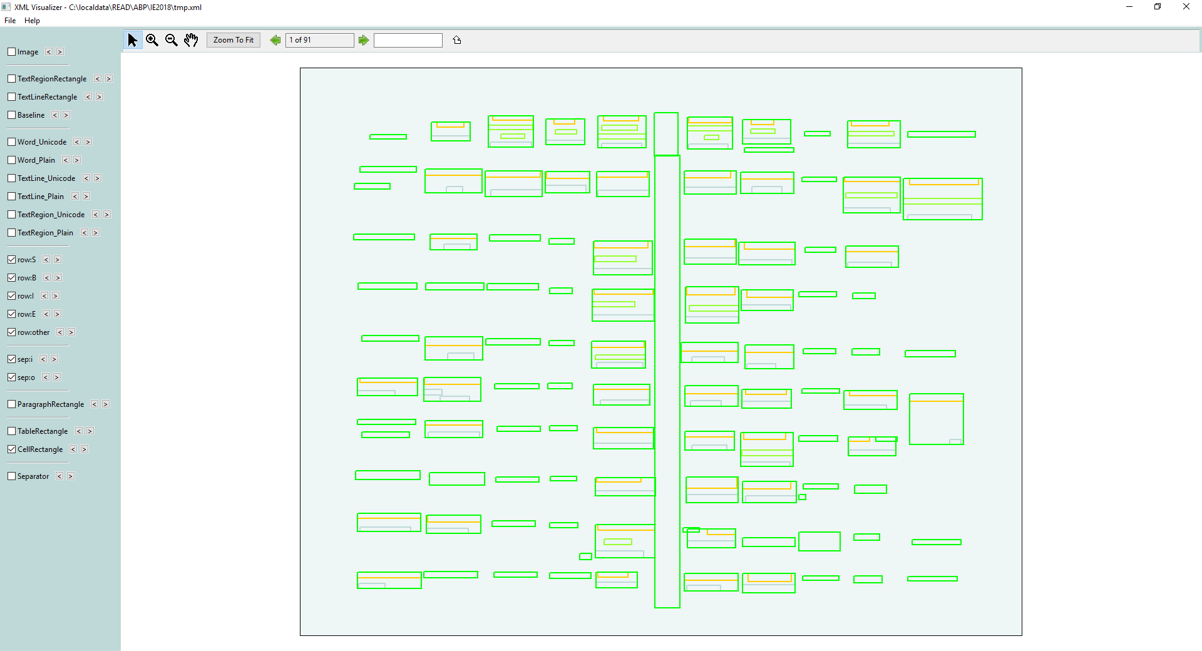
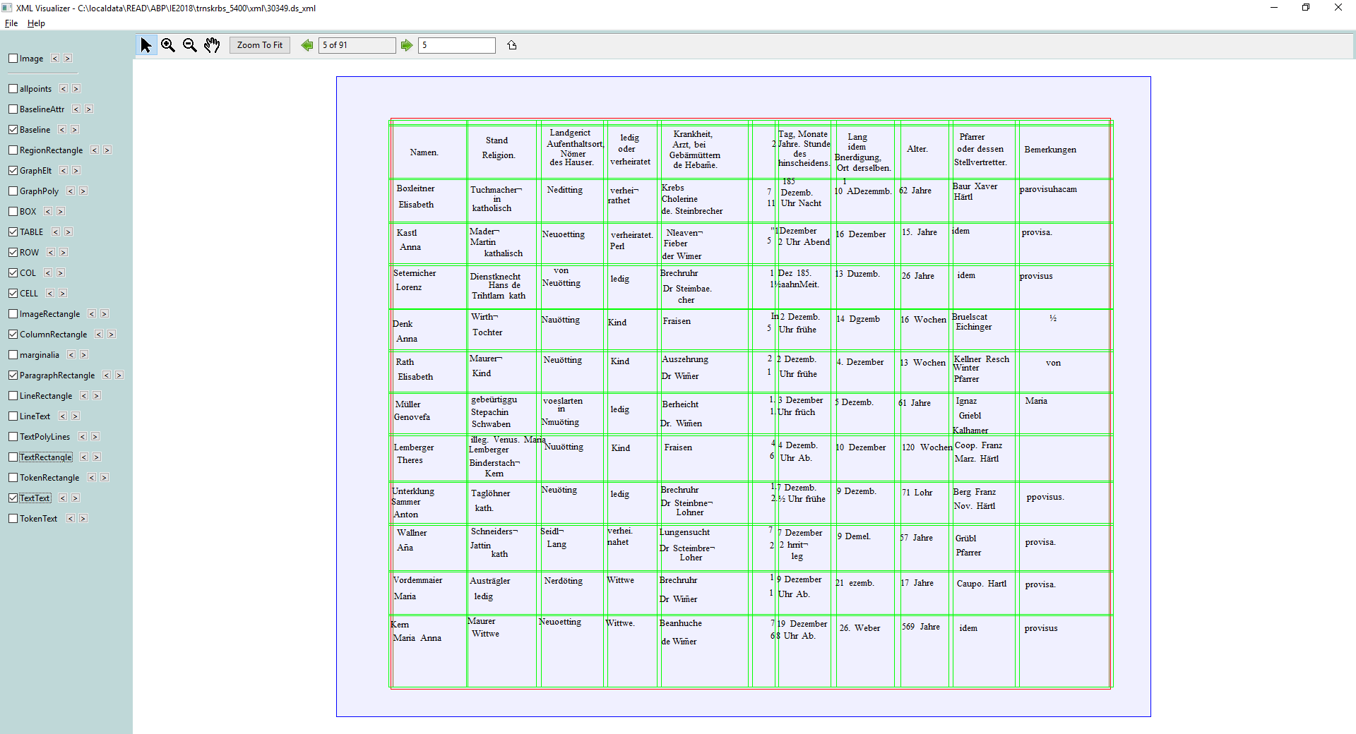
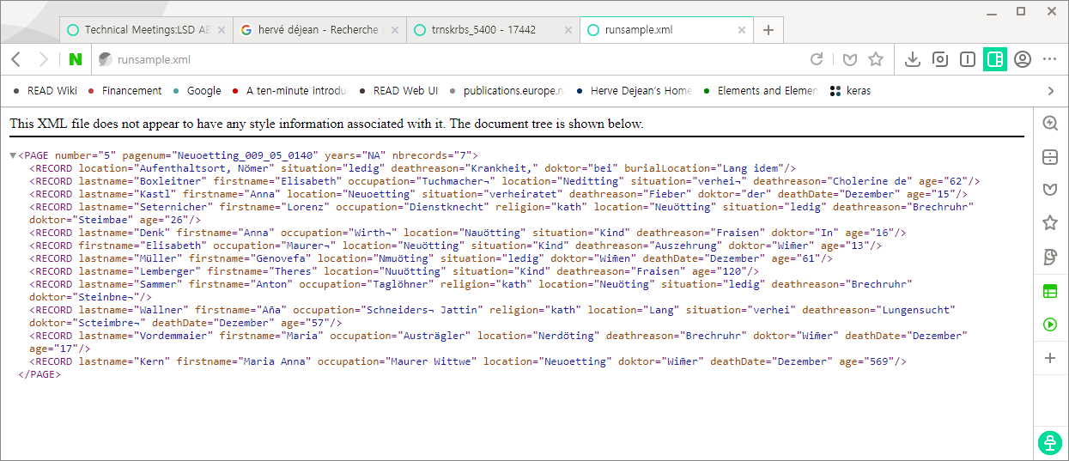
Globale workflow Naverlab’s Document Understanding
Data collection / Ground truth
Text line detection (URO)
Table Understanding (NLE)
Handwritten Text Recognition (URO)
Information Extraction (NLE)
Notes:
Show 144 GT with images
Data ground Truth: 1000 images have been properly annotated (rows / columns)

Slide 15

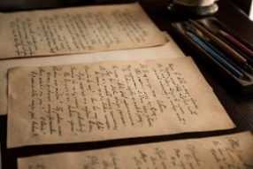
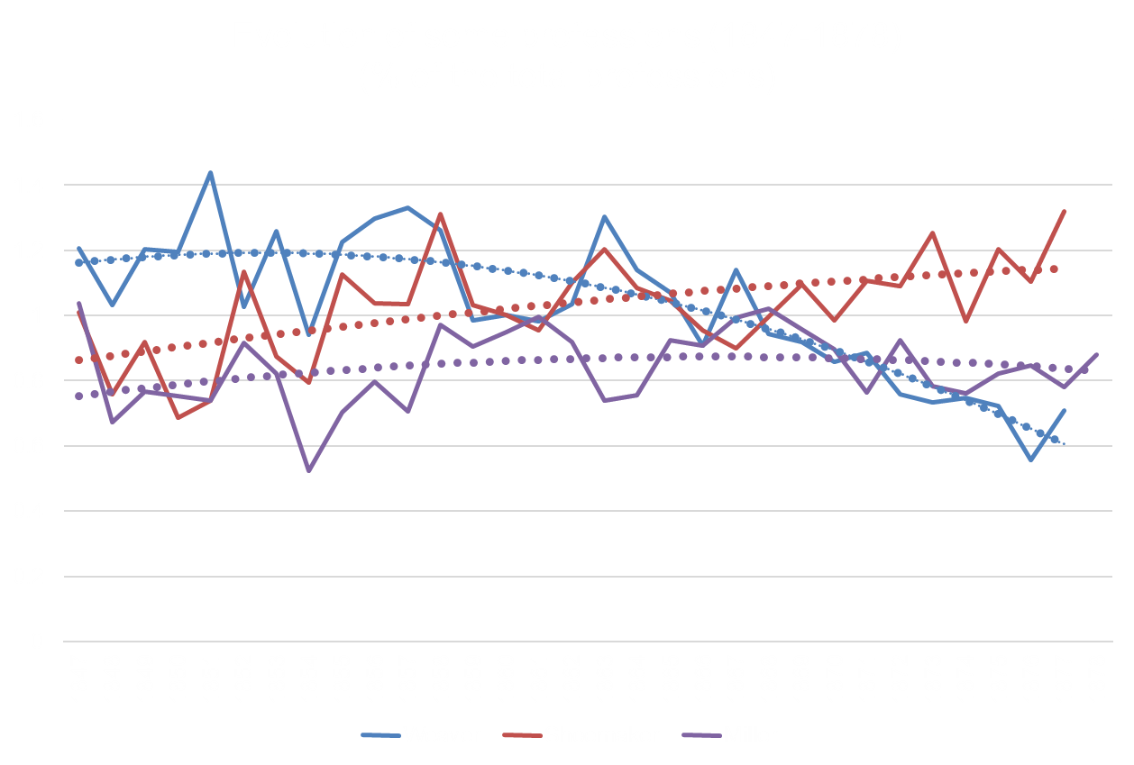
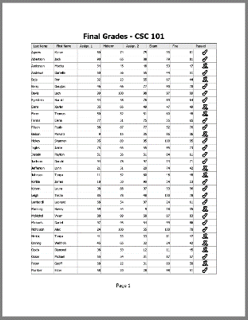
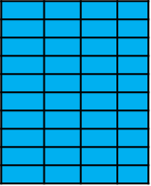
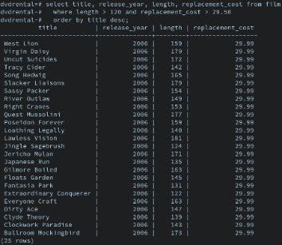
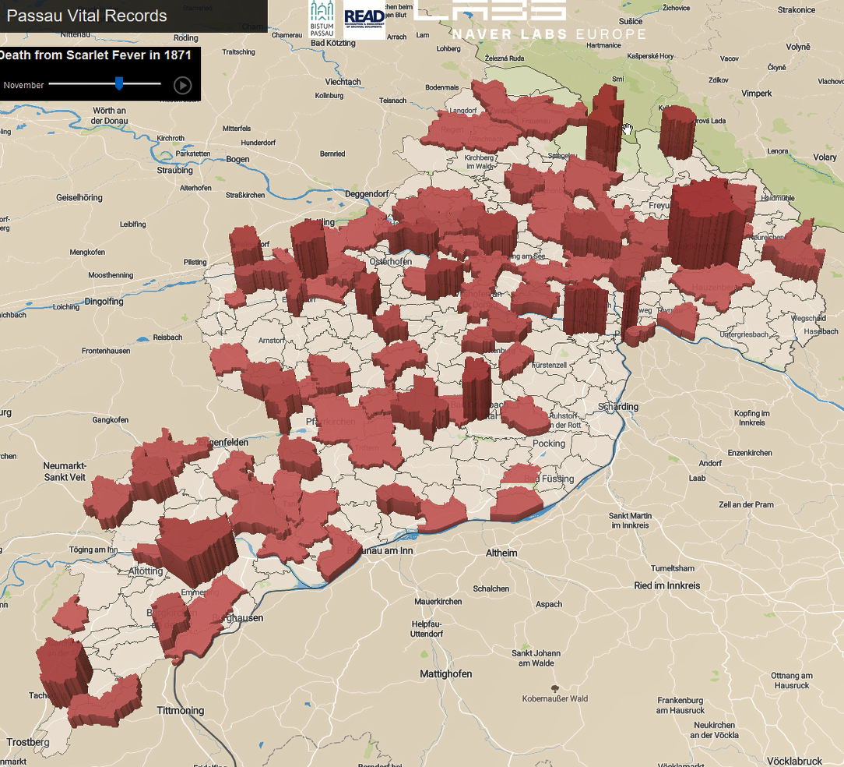

Proces van Document Understanding
Begrip voor de document layout (organisatie) zodat Information Extraction kan plaatsvinden
OCR/HTR
Analysis
Our Input
Raw text
Text, position
Layout Structure
Information (database)

Slide 16
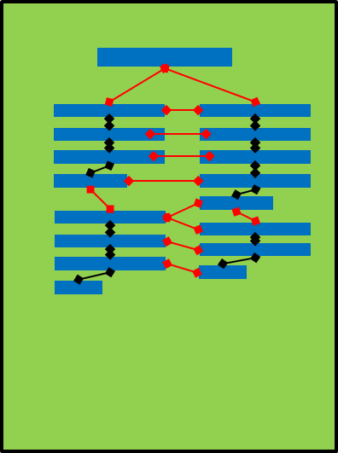
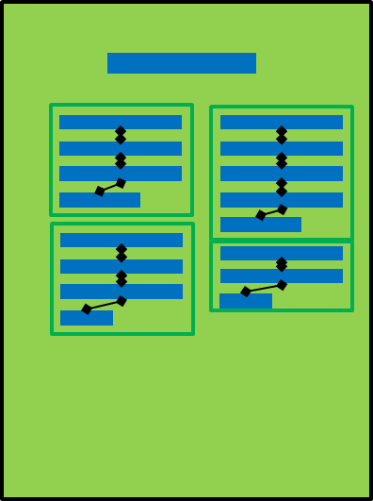
Aanpak: één tool voor Document Layout/Understanding
Graph Creation
Nodes: textlines
Edges: positional relations
Page Layout Segmentation
Edge classification
Document Reconstruction
Notes:
Our Approach: a Unified Tool for Document Layout/Understanding
Graph-based Approach
One page: one graph
Nodes: textlines
Edges: positional relations
Task: nodes/edge classification
Two Structured Machine Learning Approaches
Graph Conditional Random Fields (CRF)
Graph Convolutional Networks (GCN)

Slide 17
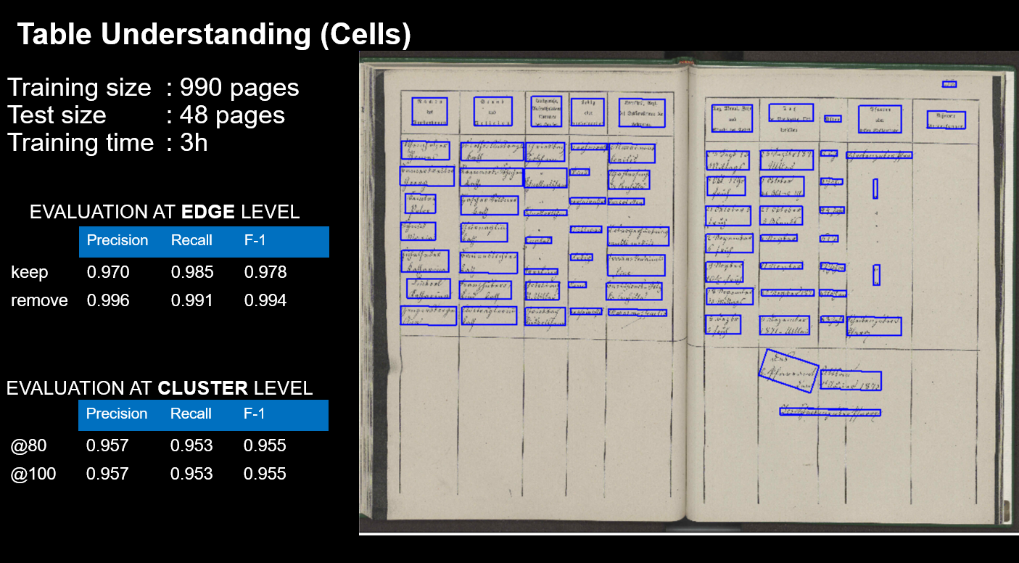

Slide 18
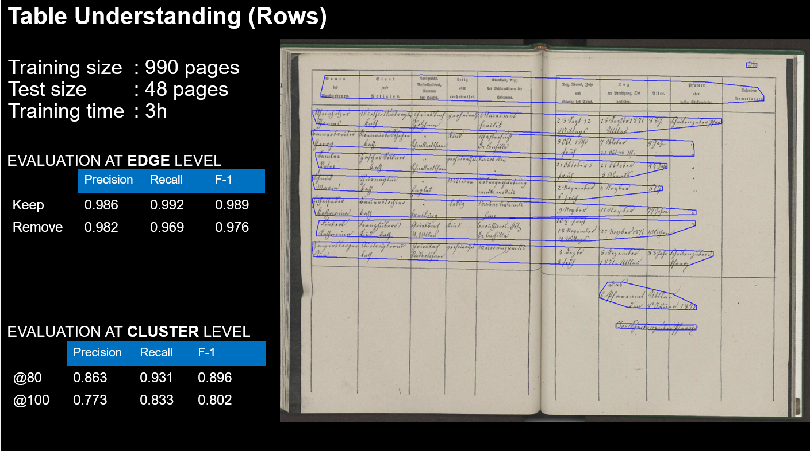
Notes:
Handwritten Text Recognition + Information Extraction
Generating Annotated Data from ABP Database (synthetic)
First name, last name
Location
Profession
Religion
Reason of death
Death/burial date
Age
Family status

Slide 19

Visualize how disease spread over the Passau region

Slide 21
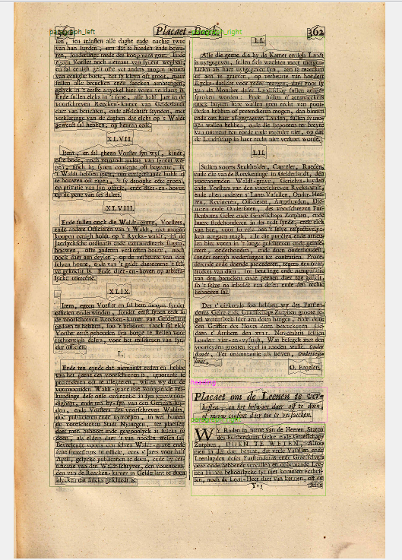

Slide 22
Conclusies m.b.t. segmenteren van de teksten

