Slide 1
The National Archives
Developing a Programme for Schools Education with Archival Collections
Andrew Payne
Head of Education & Outreach
@The_History_Man
@UKNatArchives
@UKNatArcEdu

Slide 2
Find out more…
Presentation & Resources…
http://bit.ly/2gptnvy
www.nationalarchives.gov.uk/education
Contact…
education@nationalarchives.gov.uk
@The_History_Man
@UKNatArchives
@UKNatArcEdu

Slide 3
History is a verb
not a noun!

Slide 4
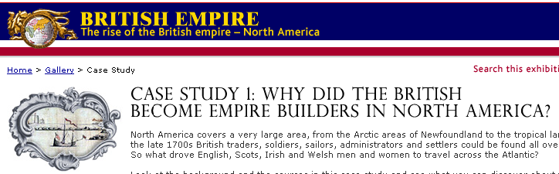
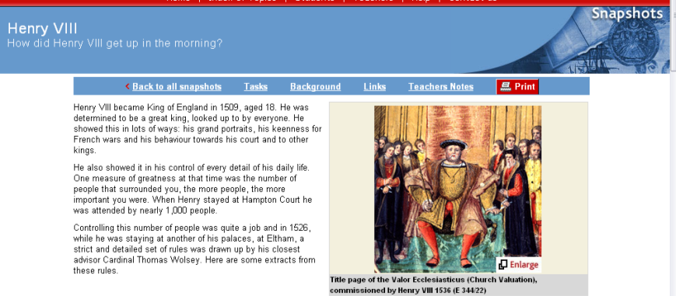
Enquiry questions to drive activity…
How did Henry VIII get up in the morning?

Slide 5
Developing the Activity
Select documents for their potential to support an enquiry
Use documents for investigation not illustration
Formulate an overarching enquiry question
Sources are used constructively to answer the enquiry question
Students investigate to select evidence to support judgements not just to find information from sources
Primary source First
Secondary contextual information – Second
Originals and scanned copies before transcripts (usually)
Full sources or lengthy extracts
Structure & scaffolding for the enquiry process

Slide 6
Documents are not just about literacy
Use the original (or facsimile)
Use whole documents (or length extracts)
Turn barrier words into windows into the document
Don’t use glossaries – identify 5 key words and teach these before the activity
Begin with observations
Encourage questioning
Test hypotheses
Engage own knowledge and prior understanding

Slide 7
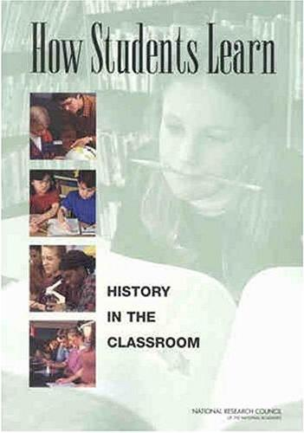
Engage Prior Understanding
“Students come to the classroom with preconceptions about how the world works. If their initial understanding is not engaged, they may fail to grasp the new concepts and information…”
Suzanne Donovan & John Brandsford
How Students Learn p.1
National Academies Press 2005

Slide 8
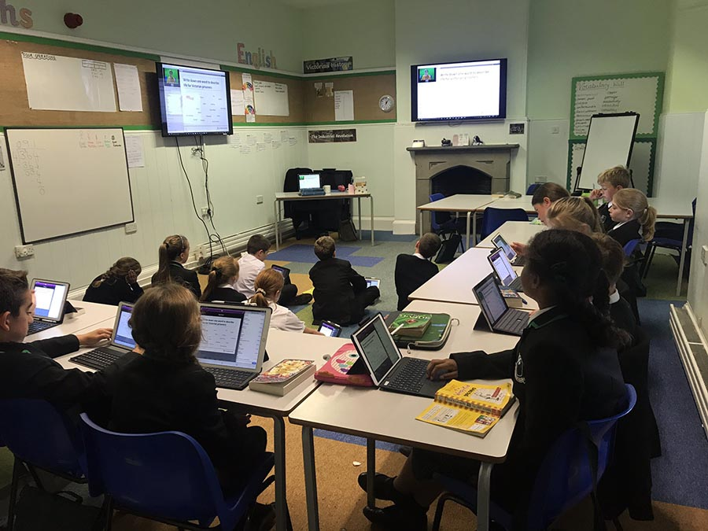
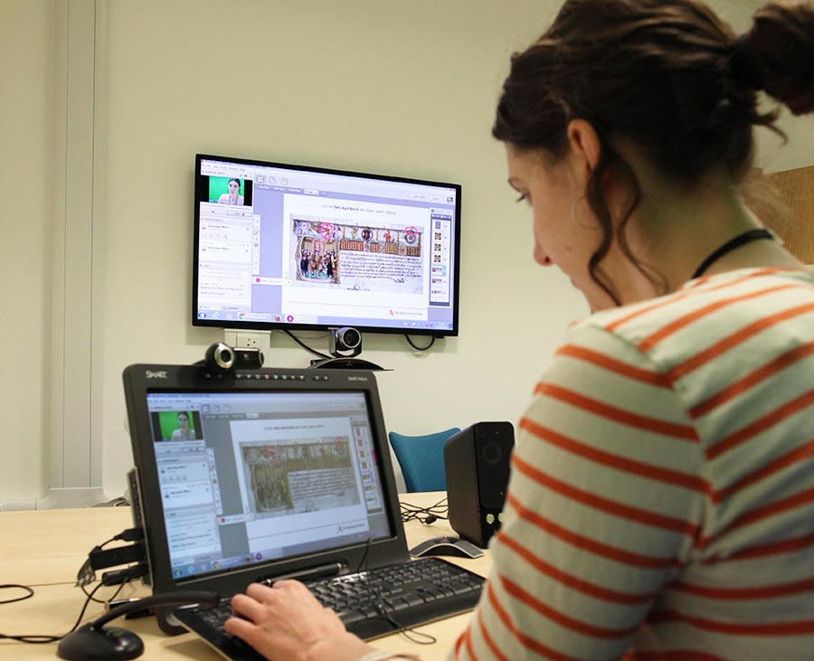
Locked Down But Not Locked Out…
https://blog.nationalarchives.gov.uk/locked-down-but-not-locked-out/
Notes:
While digital represents the greatest challenge for all archives around the world, it also offers huge opportunities. This was no more apparent than in March 2019 when we had to close The National Archives as a result of the lockdown implemented by the UK government in response to the global coronavirus pandemic. Suddenly we could no longer provide workshops and other programmes to our 15,000 students, 2,000 teachers and growing family and community audiences.

Slide 9
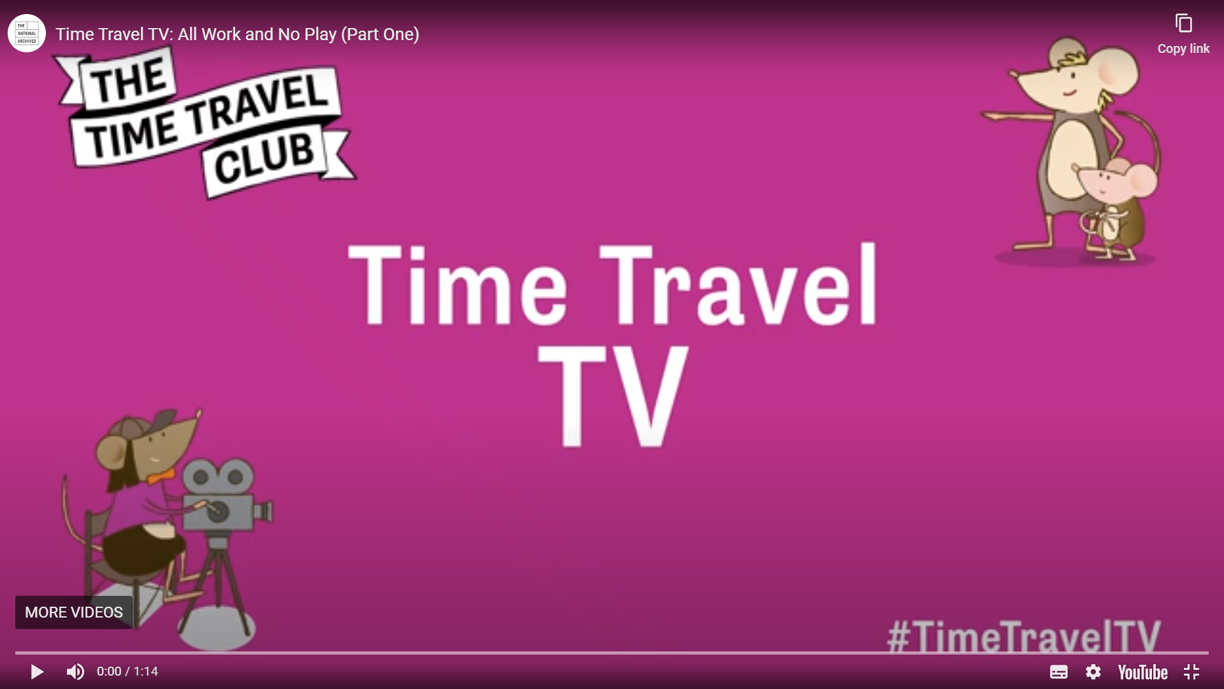
https://www.nationalarchives.gov.uk/education/students/time-travel-tv/
Notes:
Our response, however was immediate and highly creative. On 23 April we launched Time Travel TV to offer video-based lessons for home-schoolers. I am so proud of how my team responded to this challenge, offering engaging and clearly structured lessons within 4 weeks of the national lockdown. The only other organisation to respond so quickly was the BBC!

Slide 10
Pre-recorded video lessons
Structure the session for activity. What will the students do?
Use the screen recording feature in your favourite platform
Ensure the sound is the best possible quality. Use a headset or a high quality external microphone
Position yourself in the frame carefully
Use images for virtual backdrops to give sense of place
Keep the video sections short
  2 – 3 minutes for primary
  6 – 8 minutes for secondary
Use the mystery document technique to set up the enquiry
Intersperse video sections with student activity

Slide 11
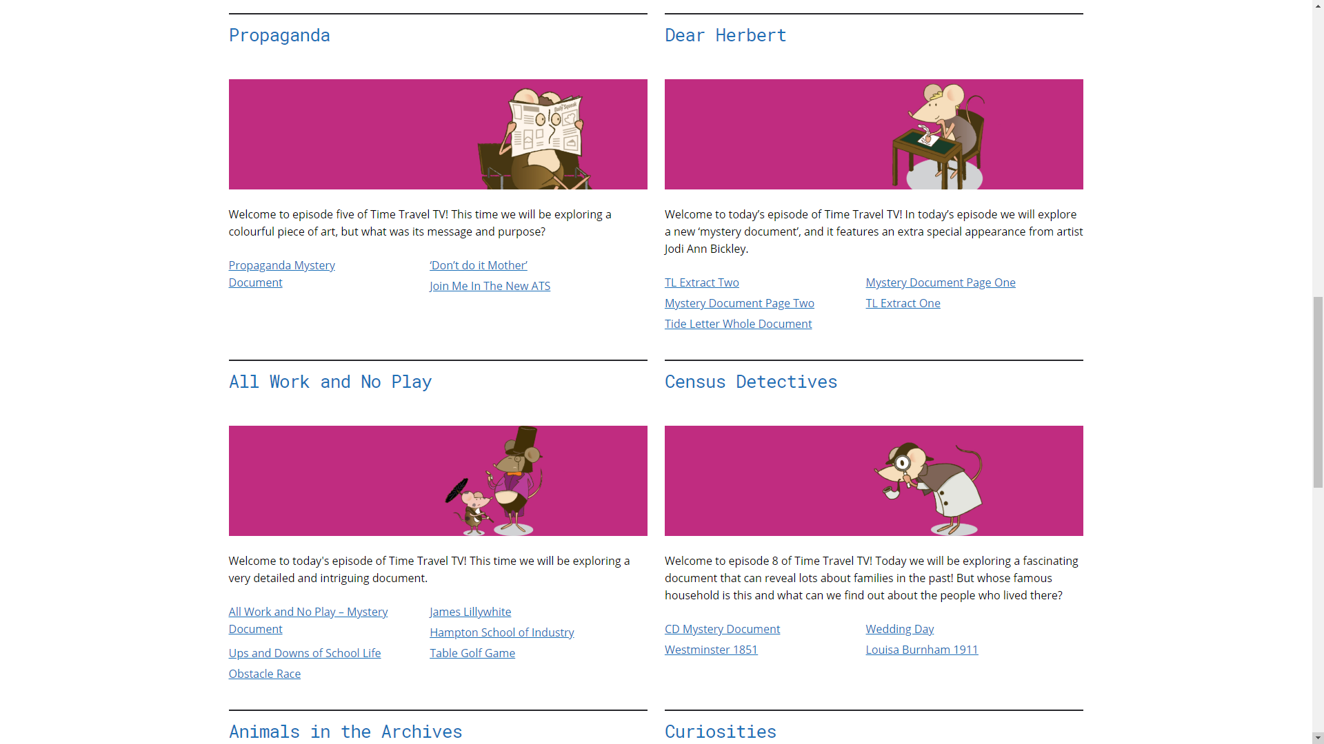

Slide 12
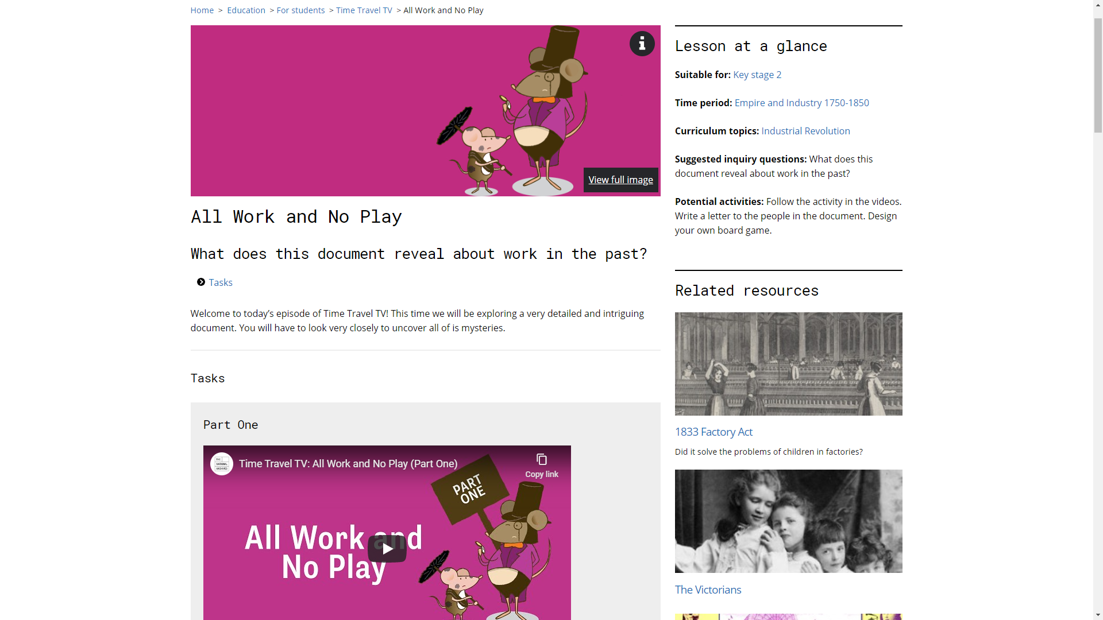

Slide 13
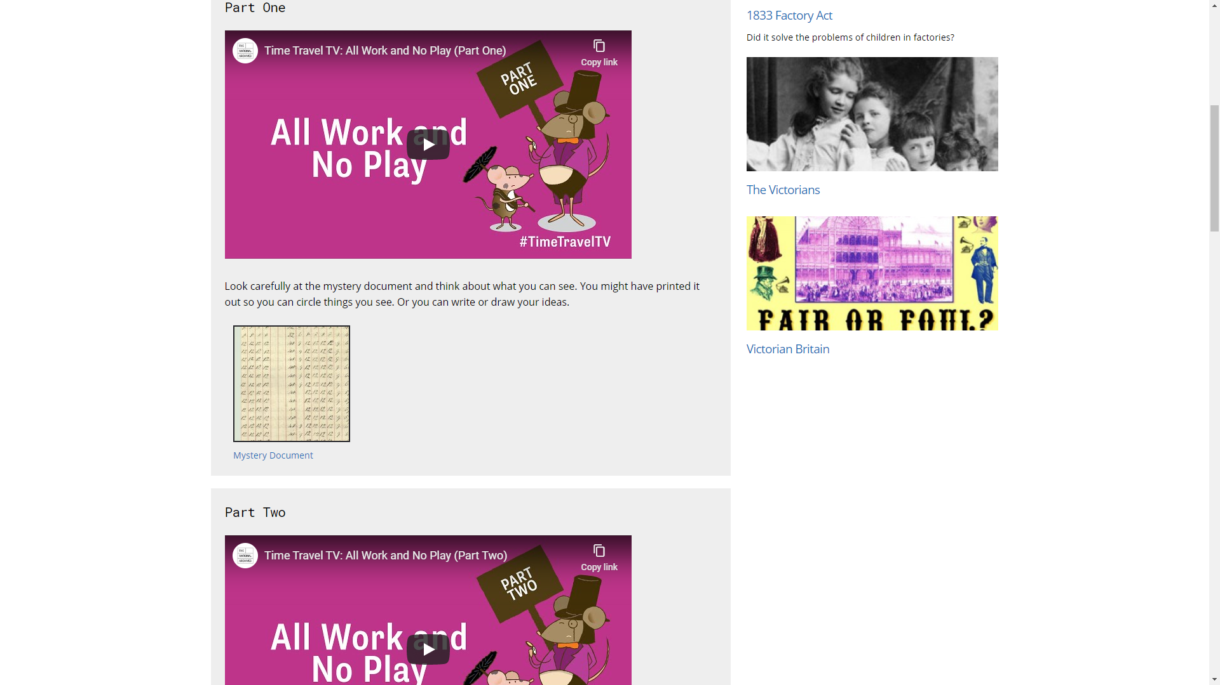

Slide 14
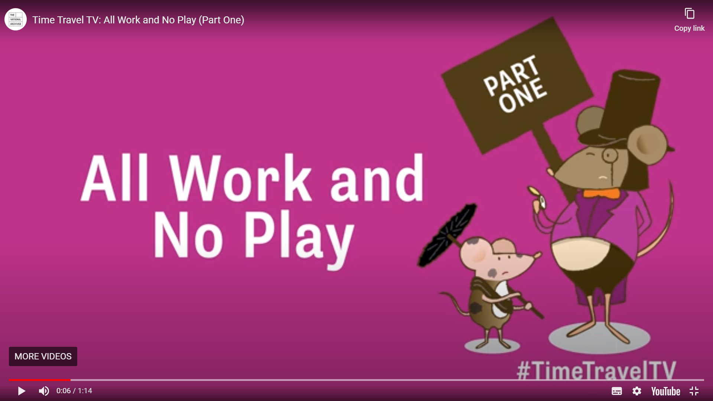

Slide 15
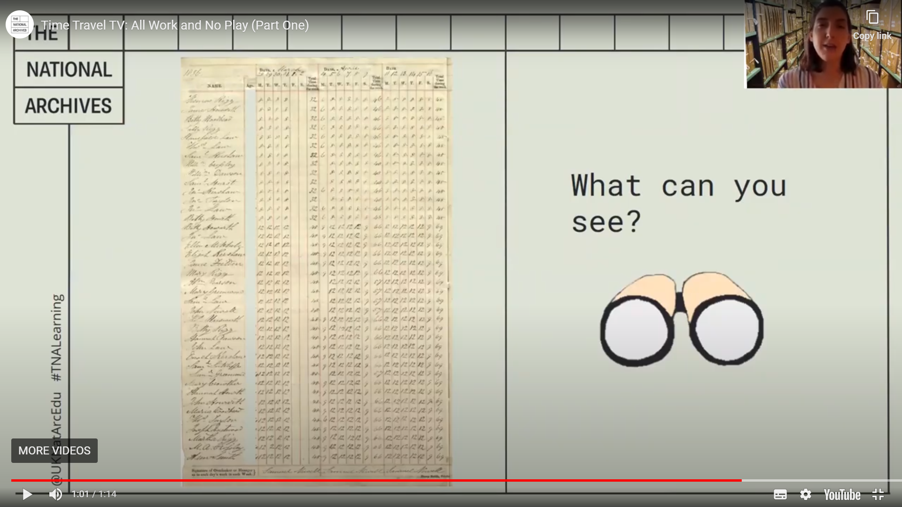

Slide 16
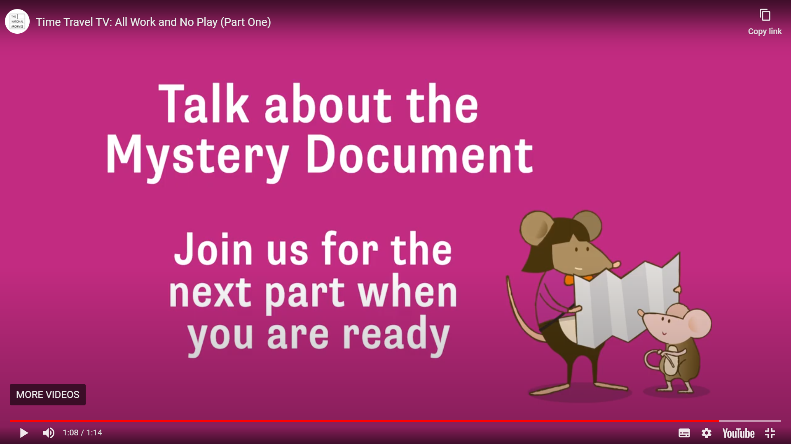

Slide 17
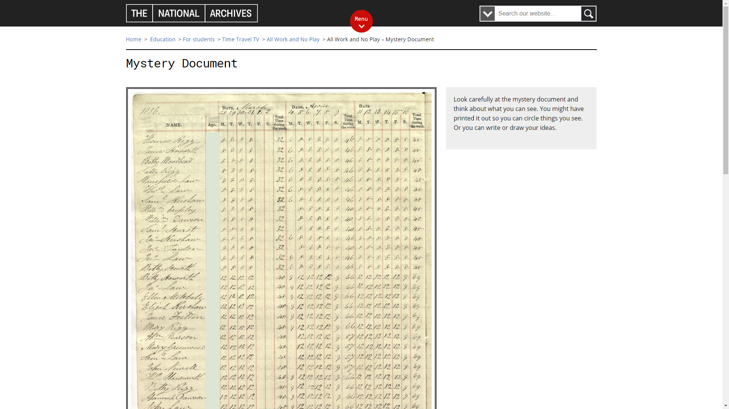

Slide 18
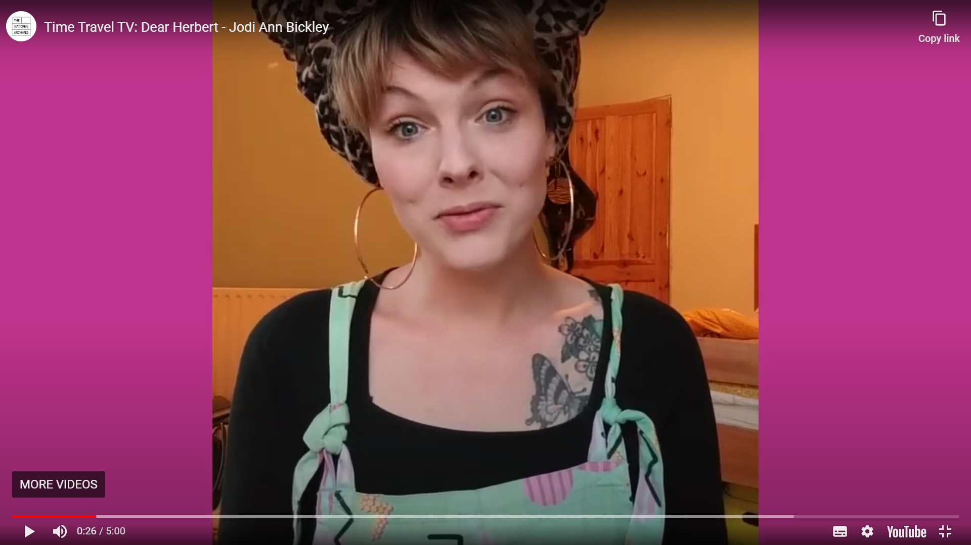
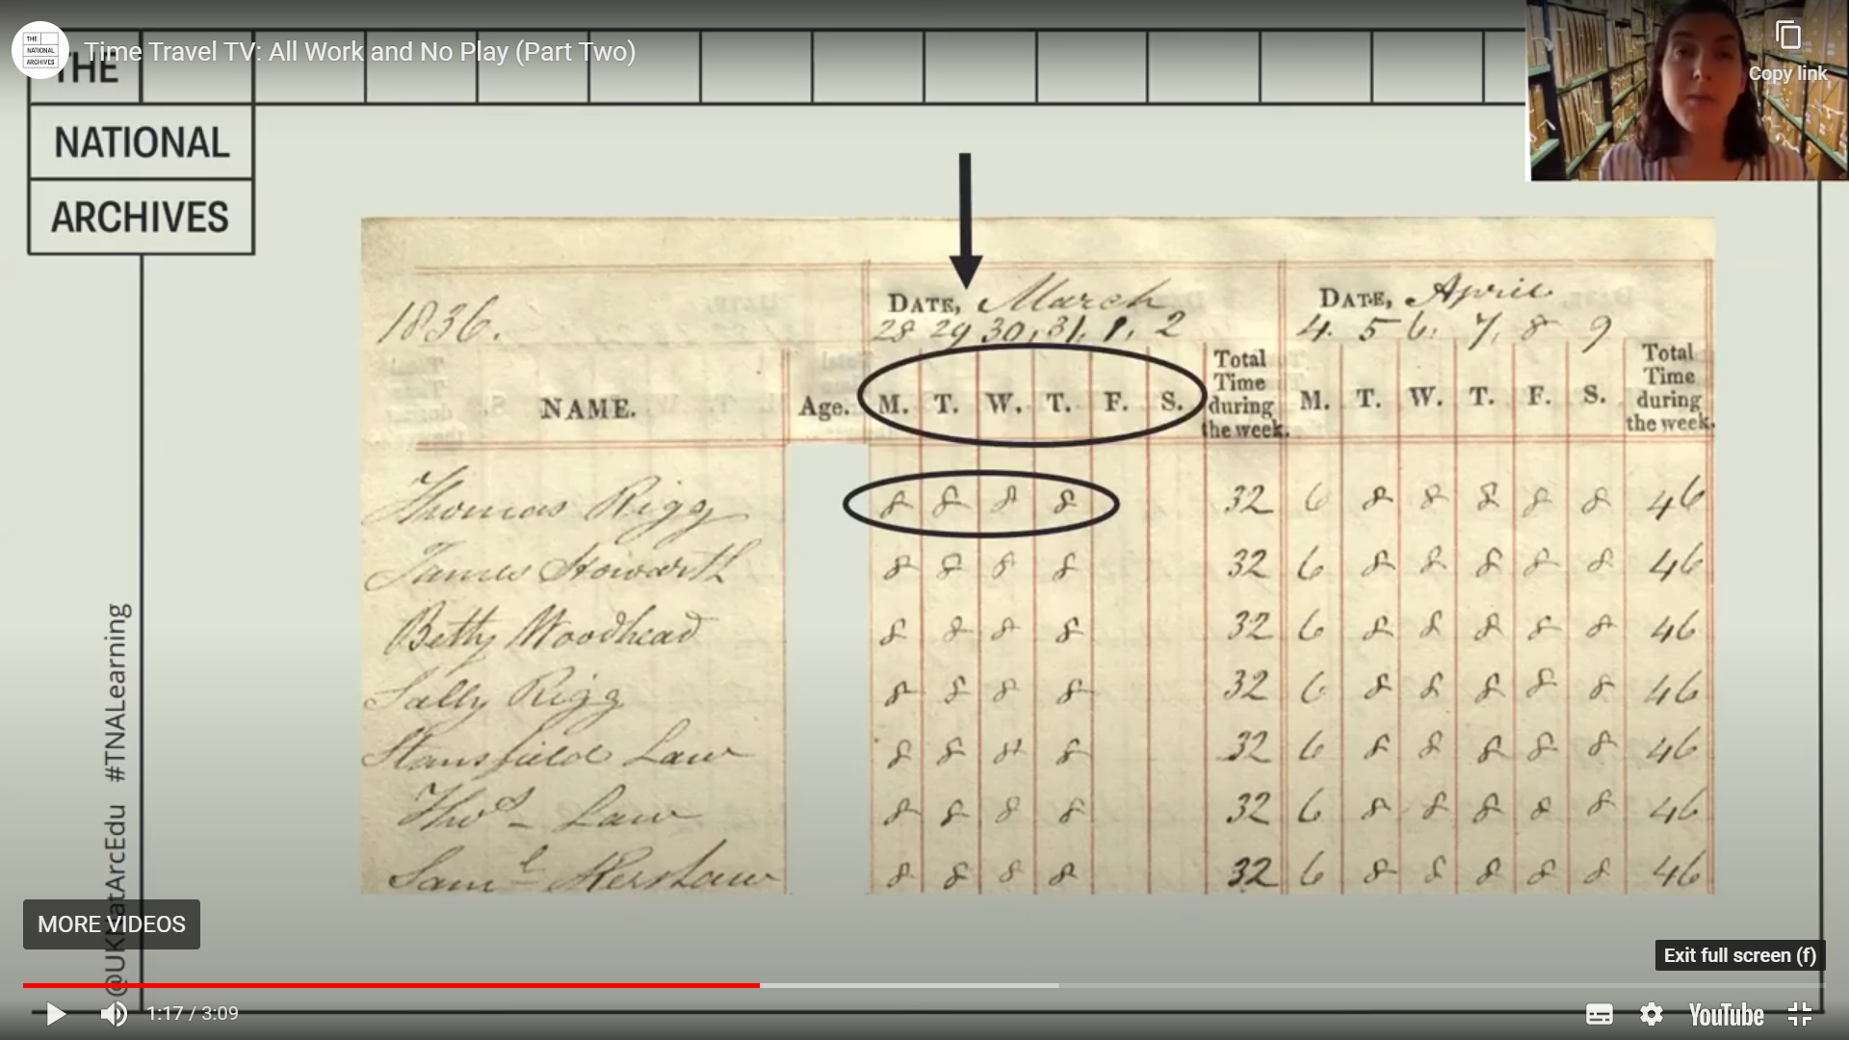

Slide 19
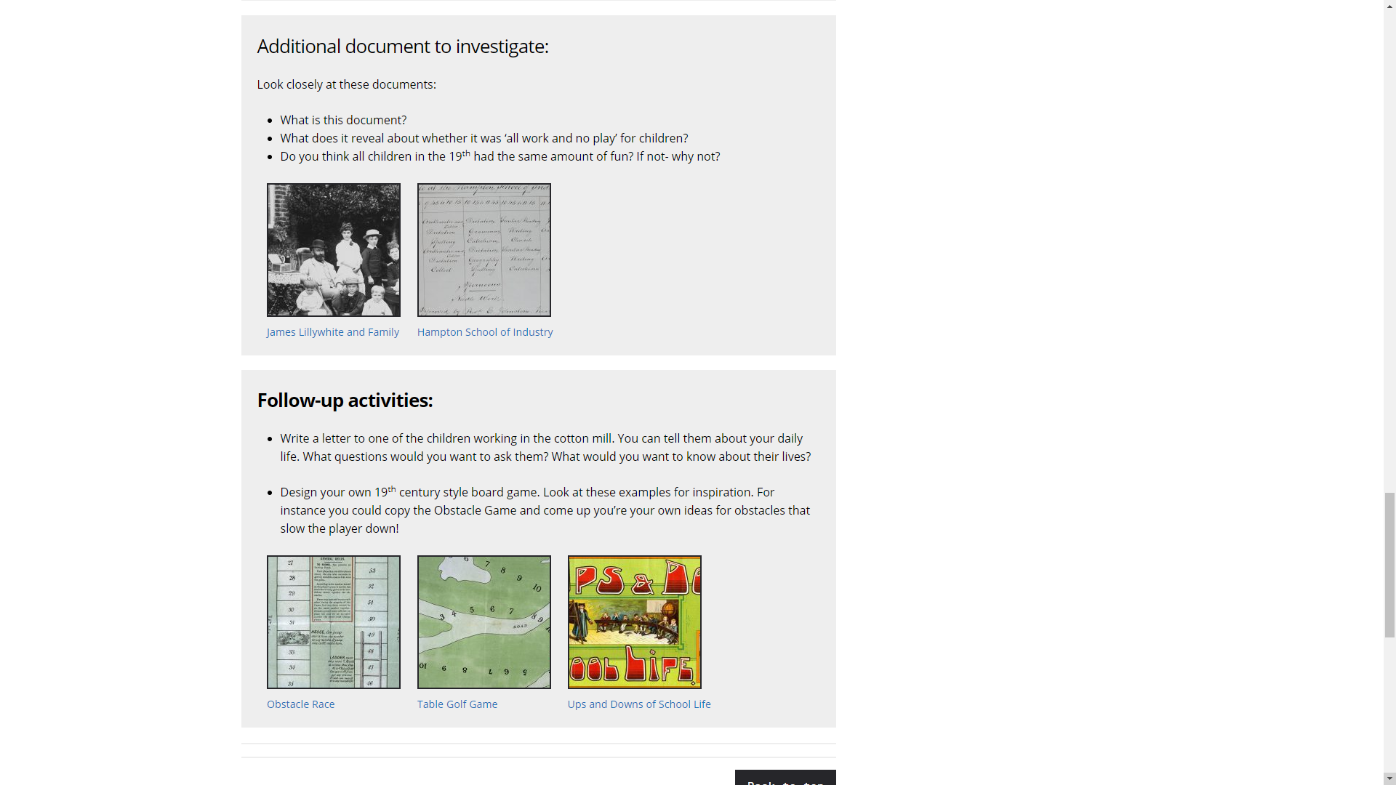

Slide 21
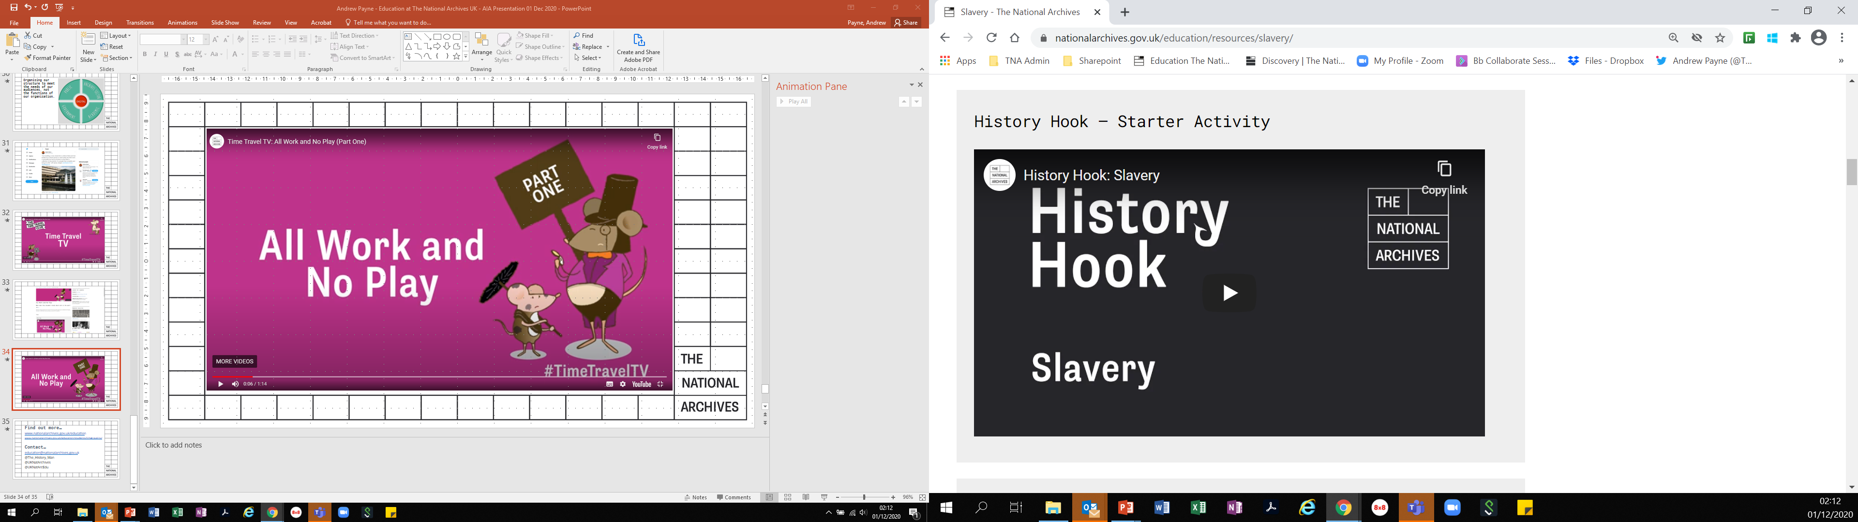
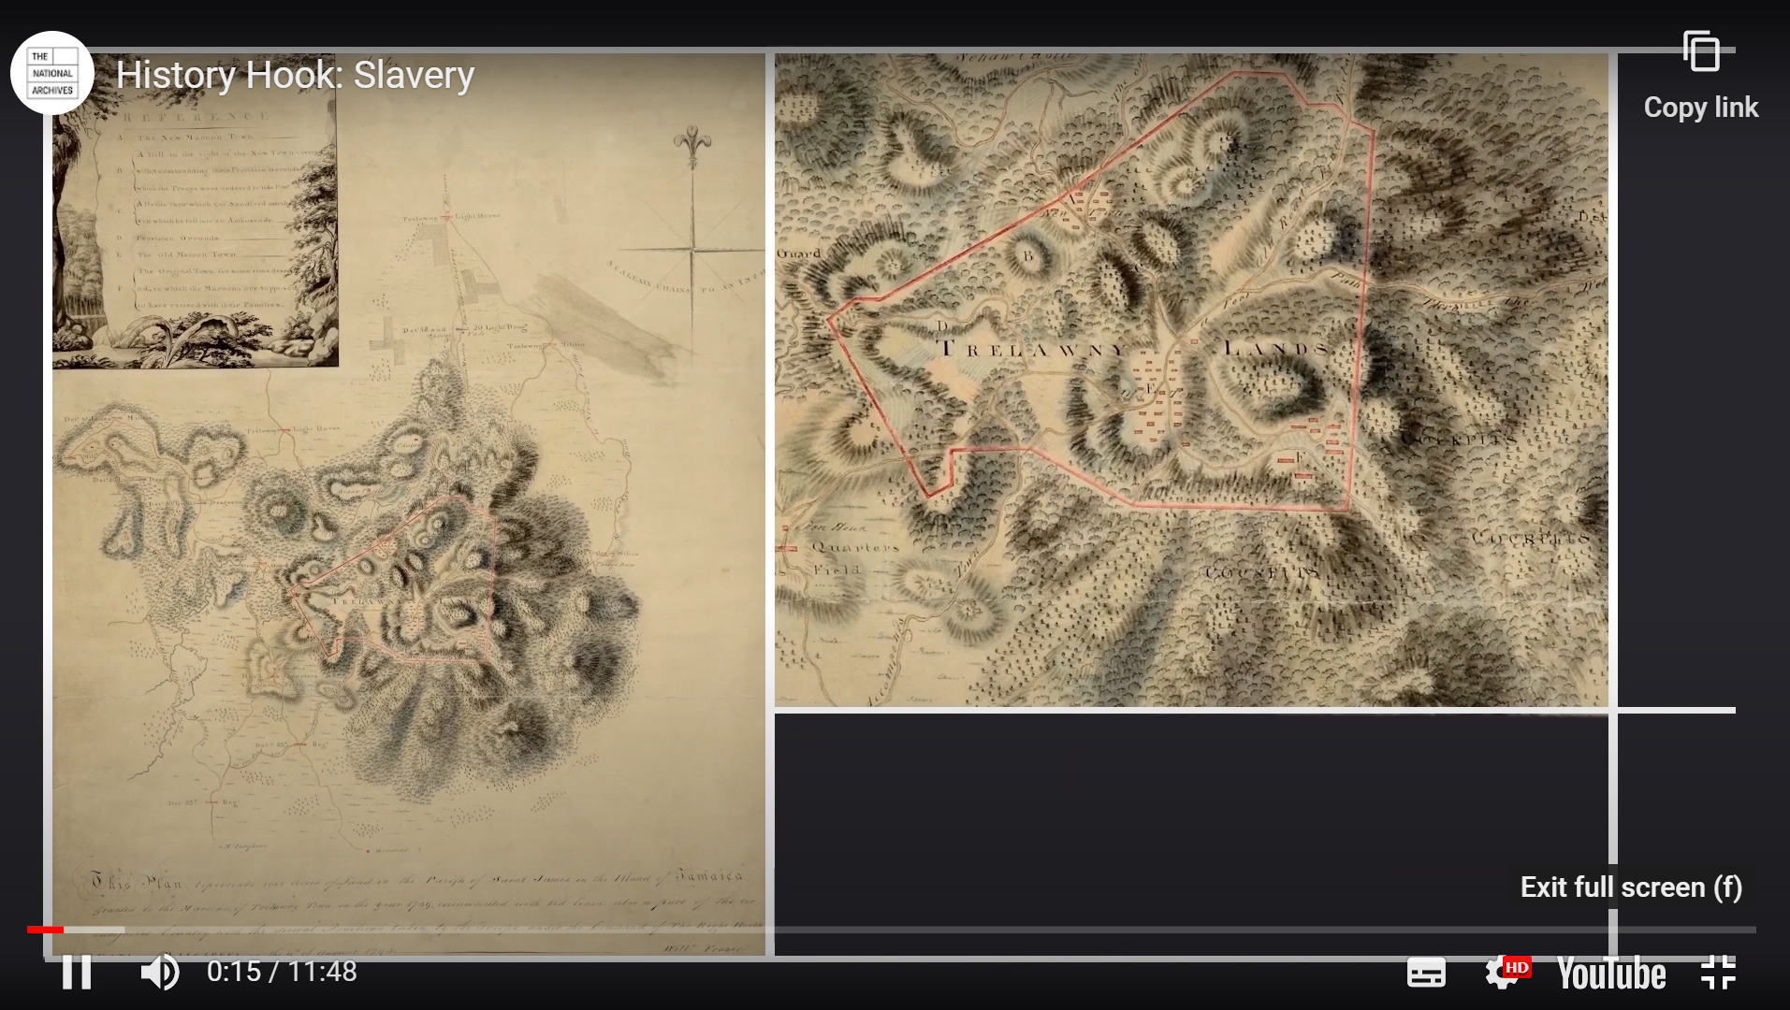
Notes:
We are now producing a series of videos called History Hook which provide a short introduction to our ppopular online lessons in a similar way that a classroom teacher would do. This offers better engagement, guidance and support for students required to work from home during periods of Covid isolation. Many teachers also find it offers an engaging start to their own lessons by providing a direct link to the archives and documents that the students are working with.

Slide 22
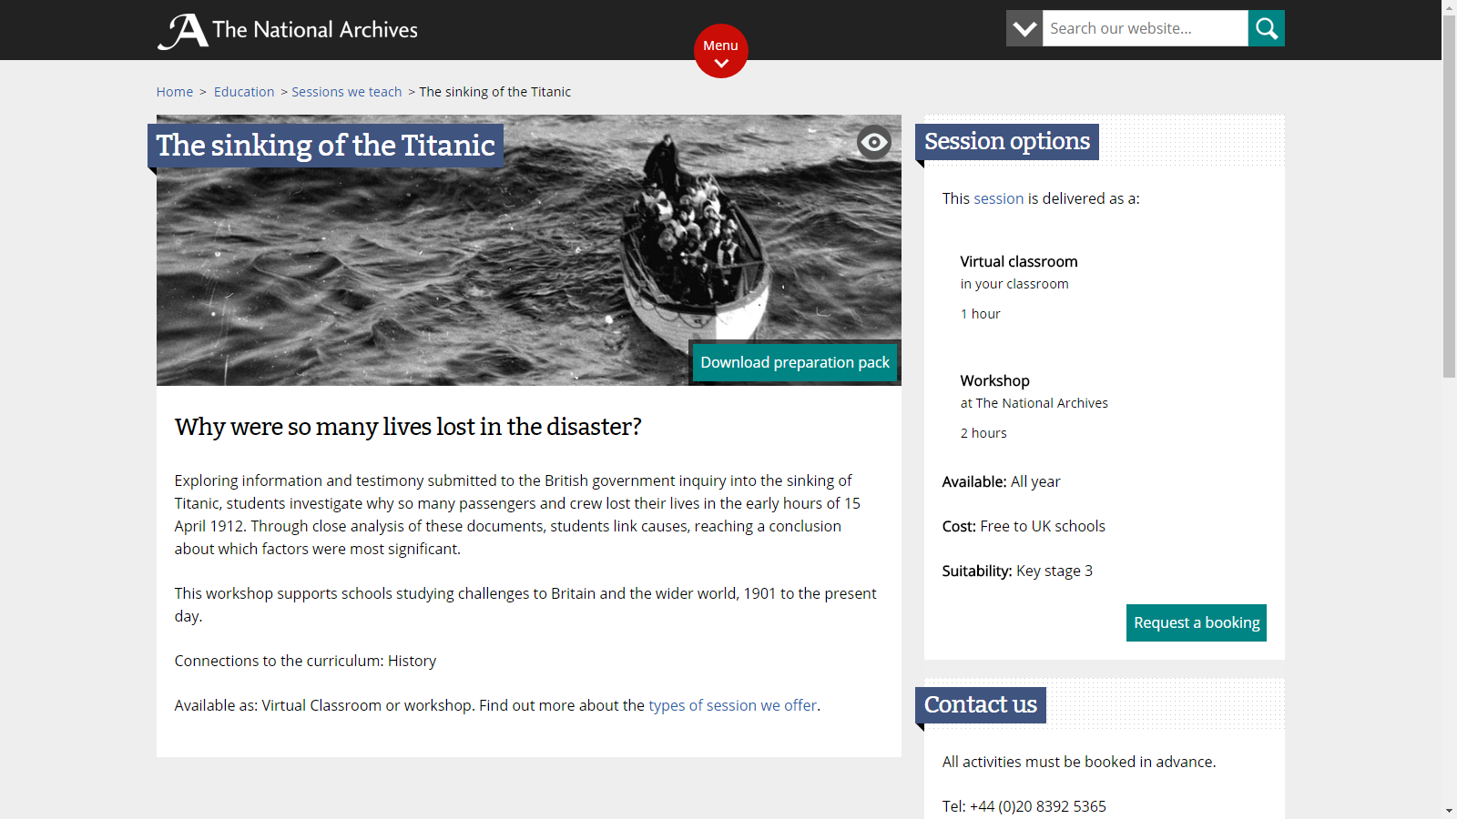
Online Workshops

Slide 23
Online Workshops - Practicalities
Develop sessions of 1 hour maximum - be flexible with timings!
Offer any session, any time, any day to fit with lesson timetable
Offer as many platforms as possible
  Blackboard Collaborate
  Zoom
  Microsoft Teams
  Google Meet
Offer a test link beforehand with schools IT support
Test in the room on the devices using the network for the lesson!
Consider safeguarding

Slide 24
Online Workshops – Practicalities
Think about what the students will be doing and what they will learn from doing it!
Design document-based enquiries that students actively investigate
Downloadable PDF resource packs for teachers to distribute
Use polling and chat to benchmark prior knowledge
Invite 2-3 students to lead on a specific activity e.g. underlining / annotating documents
Encourage participation by rest of group by using Chat, Thumbs-Up/Down, Emojis, etc to give support / agree / disagree

Slide 25
Online Workshops – Practicalities
Use whole-class approaches for primary
Include group work tasks for secondary using breakout rooms
Keep the task clear and specific – don’t overload students
Each group to investigate one document and feed back
Use a maximum of 5 documents
Create 5 groups of 6 students for a typical class of 30
Provide instructions / documents / questions in resource pack
Check groups understand what to do before sending to breakout
Nominate a group spokesperson to feedback
Set timer for group work

Slide 26
www.nationalarchives.gov.uk

Slide 30
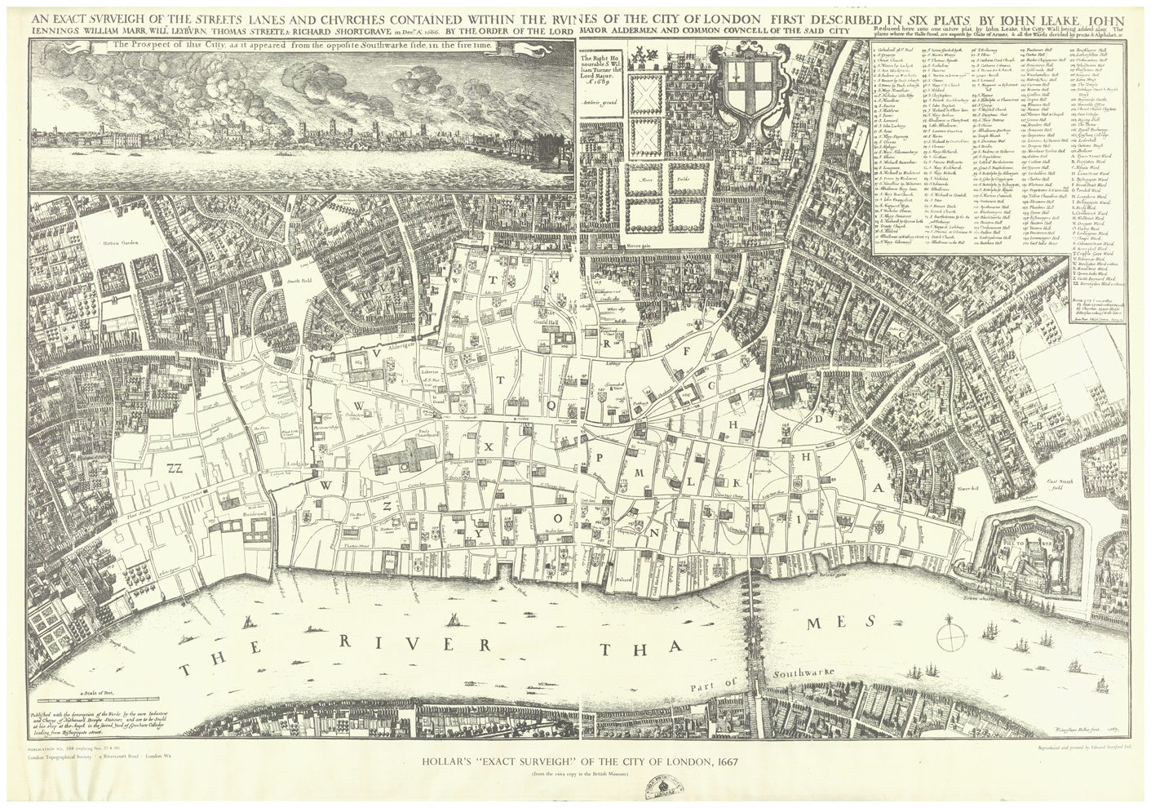
TNA Ref: ZMAP 4/18
Notes:
This is Wenceslaus Hollar’s map from 1667, showing the area of the city that was destroyed by the fire and includes a wonderful prospect of the city as seen from the south side of the River Thames, showing the fire raging. And then we introduce them to other documents and give them facsimiles to work with to find the evidence for the events that they already know about.

Slide 31
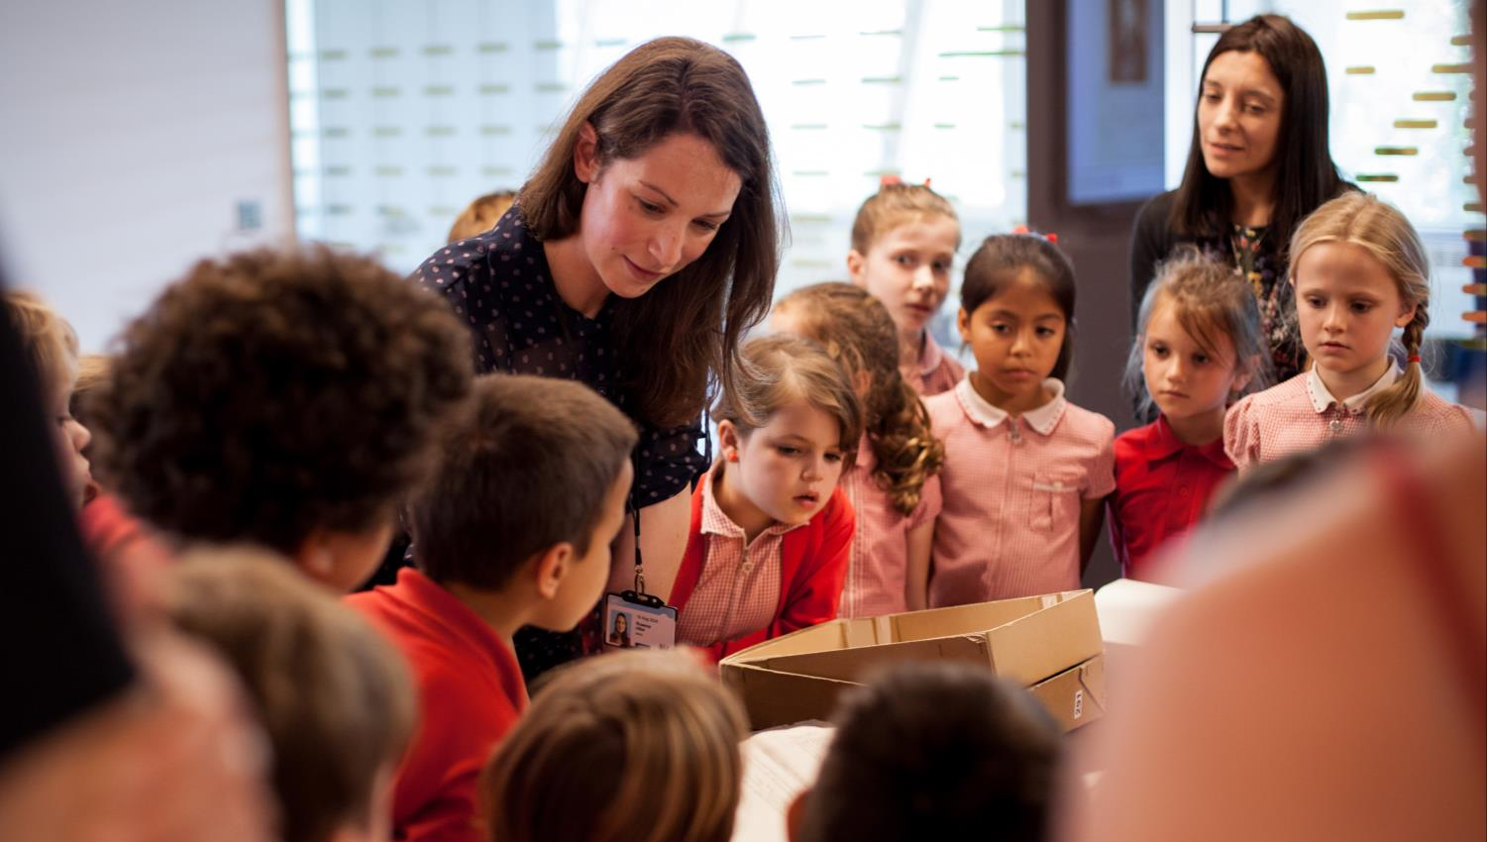
Notes:
We then build up to the grand finale in the workshop which is what is happening in this picture… what you see hear is something quite extraordinary. These are 6 year olds who are looking in awe and wonder at something remarkable. It’s not a Superhero or a Power Ranger or even a Pokemon. It’s a 17th century tax document!

Slide 32
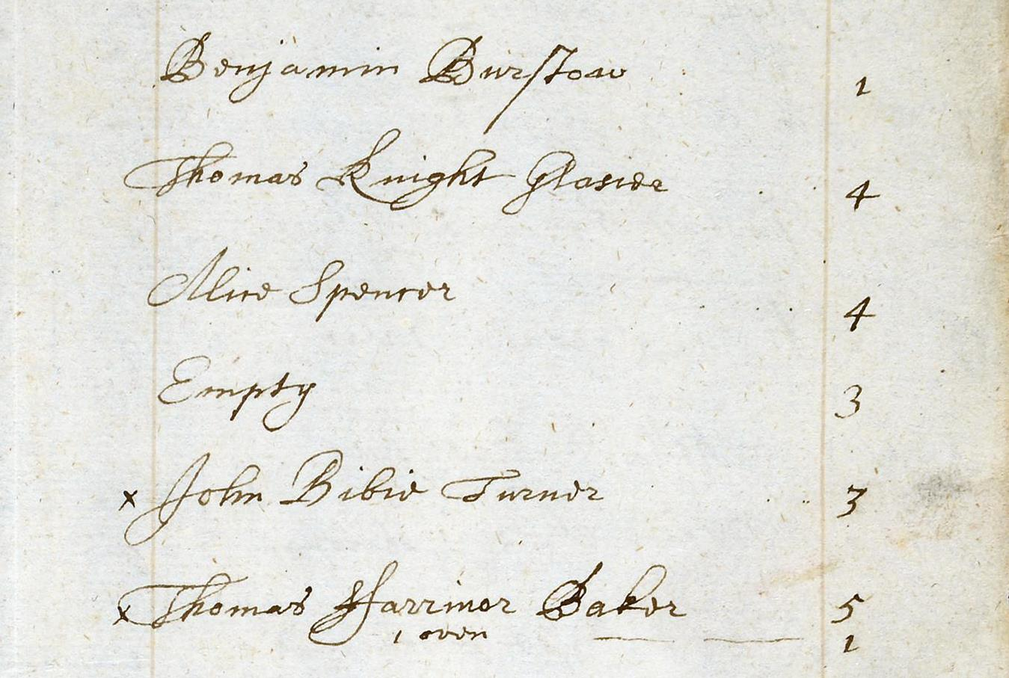
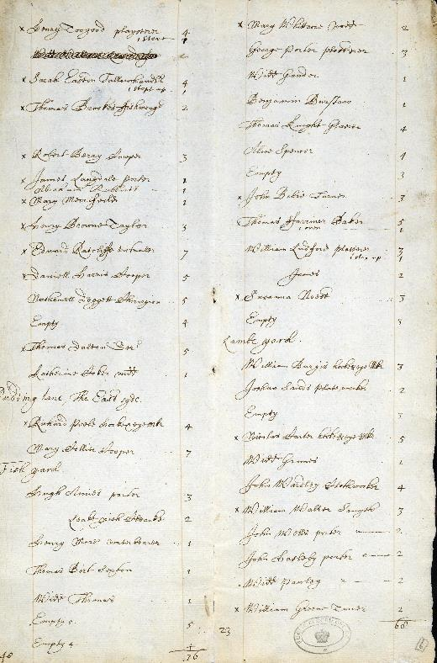
TNA Ref: E 170/252
Notes:
This is a Hearth Tax return. The Hearth Tax was one of those ingenious ways that 17th Century governments found for working out how wealthy someone was by counting up the number of fireplaces, or hearths, that they had in their house. The bigger the house, the greater the number of rooms and the greater the number of fireplaces; and so the more tax you were liable for. But this is not just any Hearth Tax return. This is the actual one for Pudding Lane which shows Thomas Farrinor’s bakery with its five hearths and one oven, which is where The Great Fire broke out. You would not believe the excitement that this document causes! I have heard children literally squeal with excitement, but more importantly it creates a powerful learning experience which transforms their understanding of what History is and how it is studied.

Slide 33
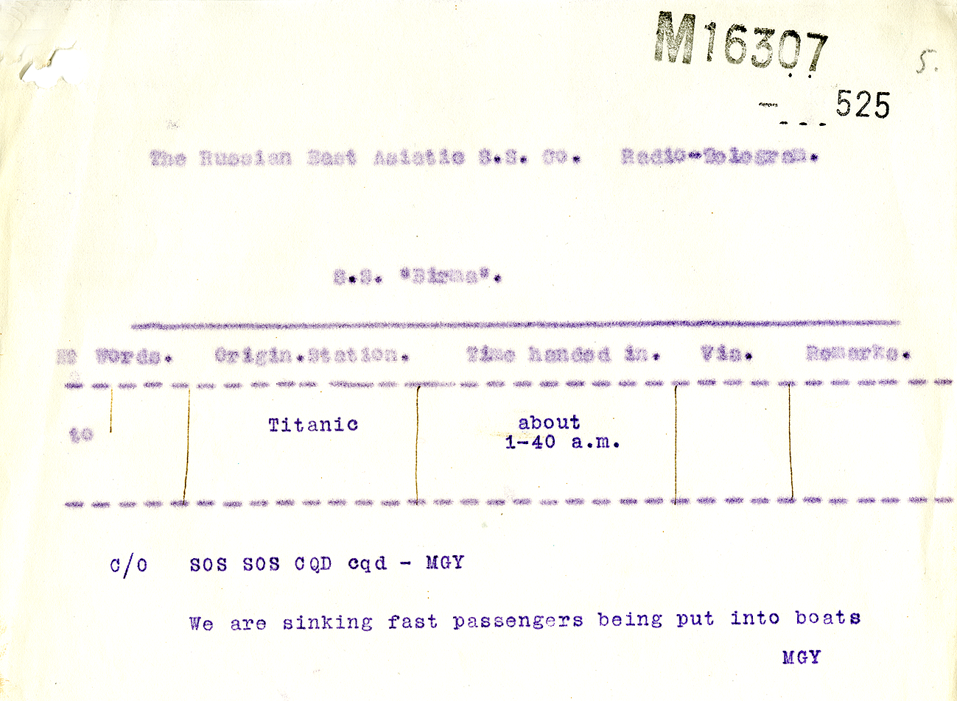
MT 9/920C

Slide 34
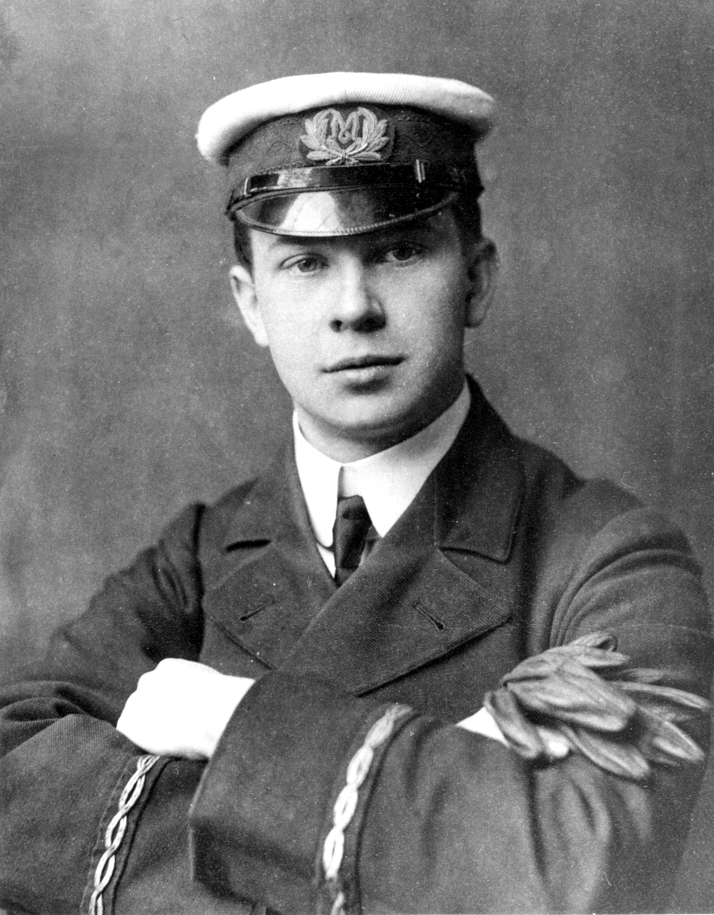
Jack Philips
Wireless operator on the Titanic

Slide 35
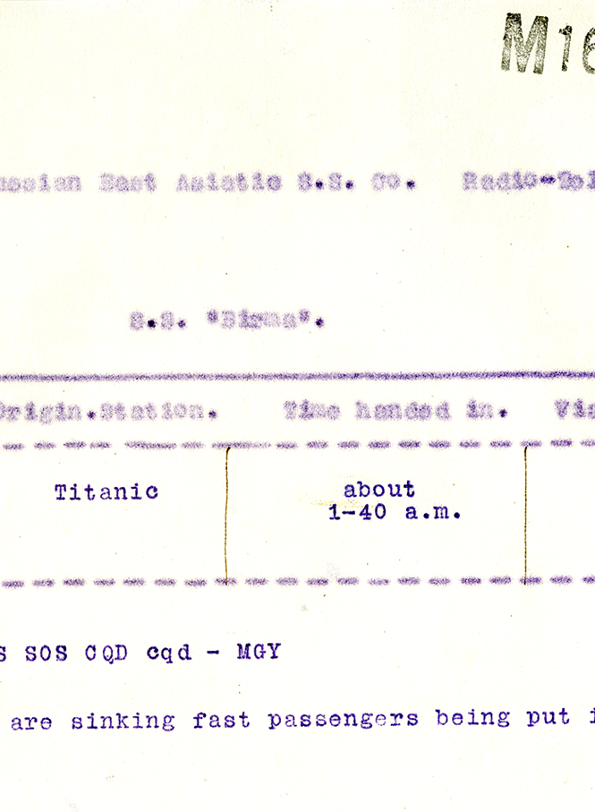
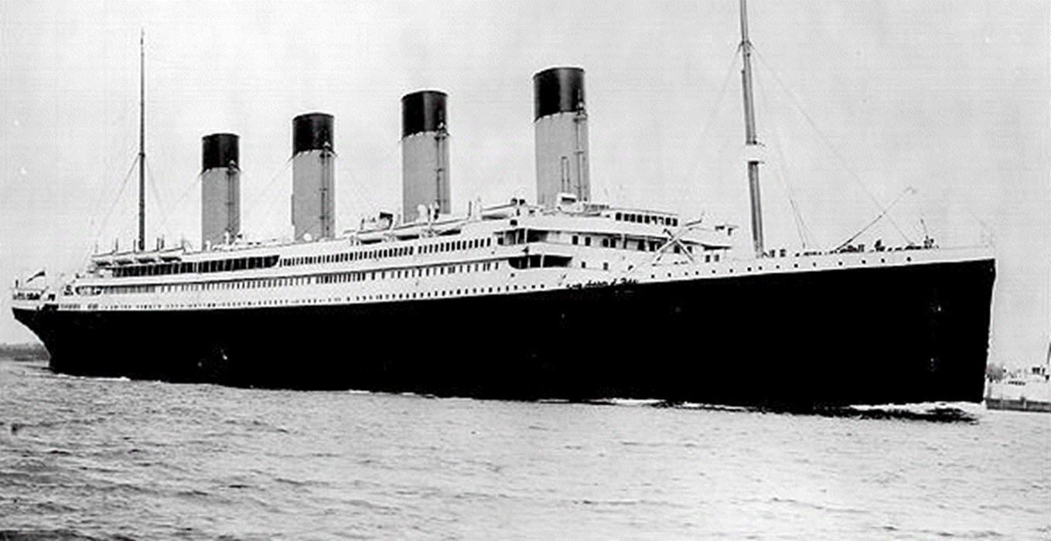
The Sinking of the Titanic
Why were so many lives lost?

Slide 36
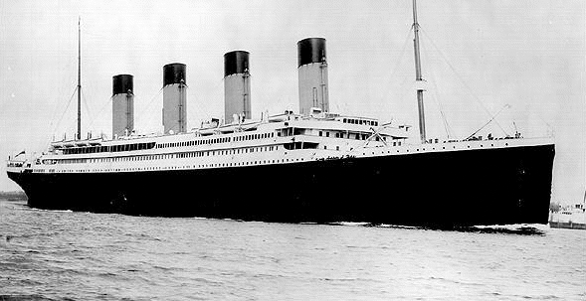
What do you already know about Titanic?
Titanic is famous because…
It sank because…
COPY1-566 (56506)

Slide 37

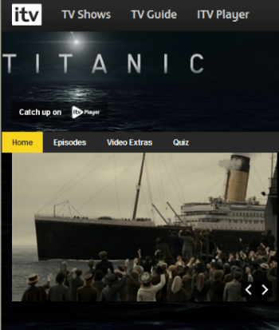
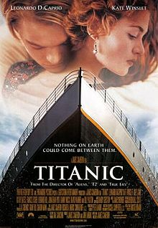
VOTE- Where has your knowledge of Titanic come from?
a. Books
b. Television
c. Films
d. Other

Slide 38
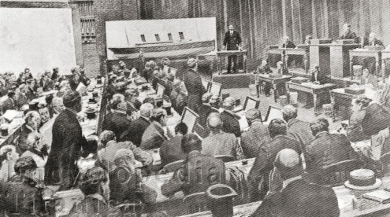
In May 1912, the British Board of Trade conducted a formal inquiry into the loss of Titanic. It lasted for 36 days, and took statements from passengers, crew and experts.
The evidence collected by the British inquiry is now stored at The National Archives.

Slide 39
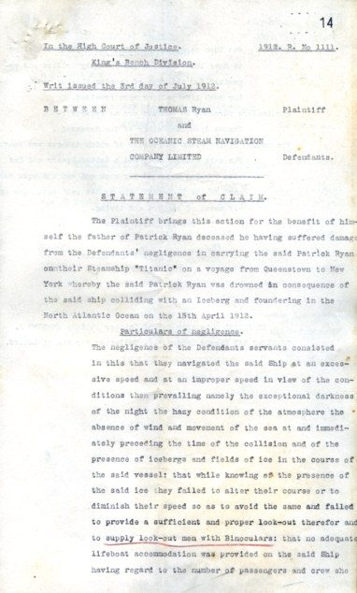
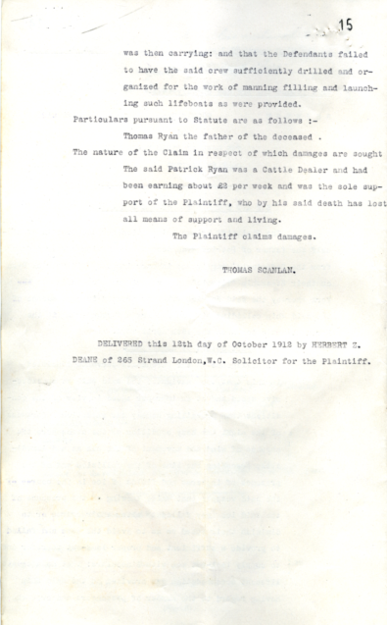
Sinking Pack Pages 5 & 6
J 54/1548

Slide 40
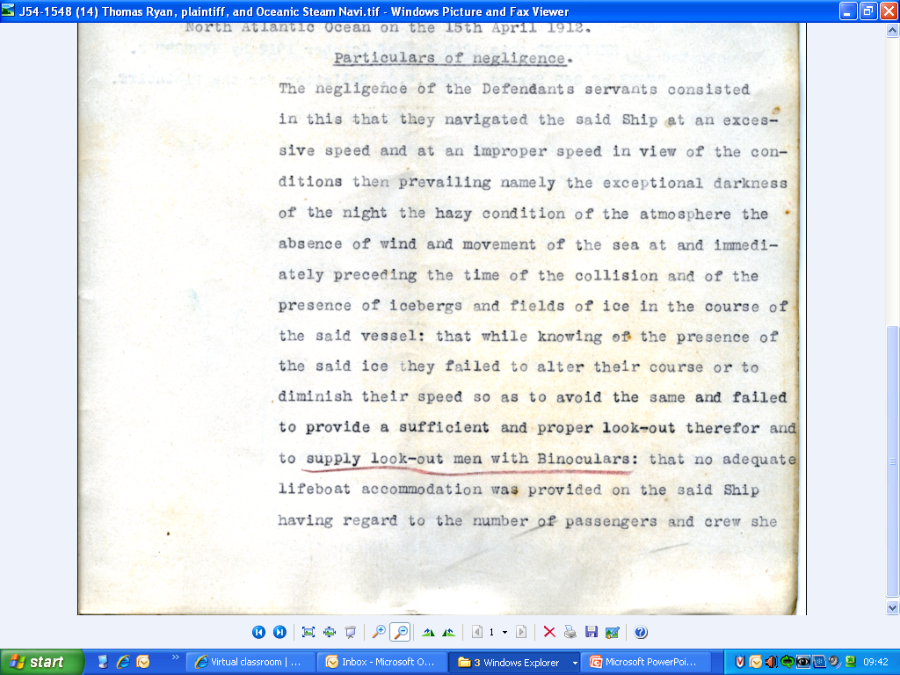
Look at the ‘Particulars of negligence’ on your preparation document.
Underline the following factors:
In Red – factors due to negligence of the company
In Blue – factors that contribute but are not directly the company’s fault

Slide 41
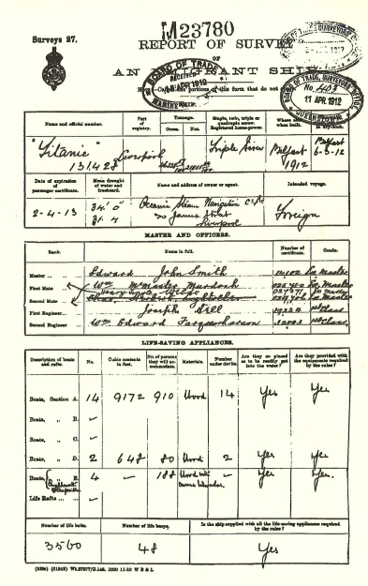
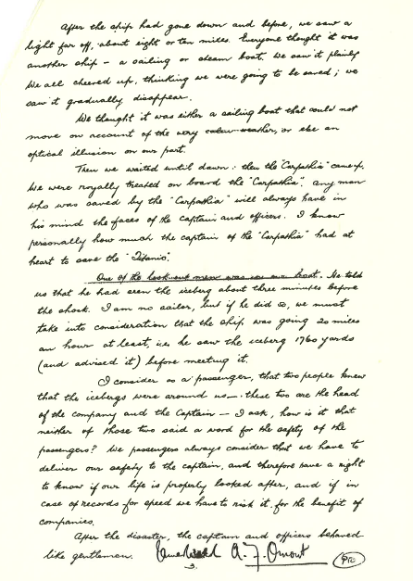
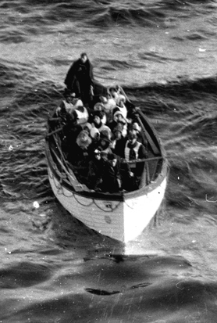
MAIN TASK: You can now choose which document to work on. Each group will examine a piece of evidence which supports a different cause of loss of life on Titanic.
‘So many people lost their lives because…’
1
2
3
...there were not enough lifeboats on board
...the ship was sailing too fast
...the lifeboats were not properly filled

Slide 42
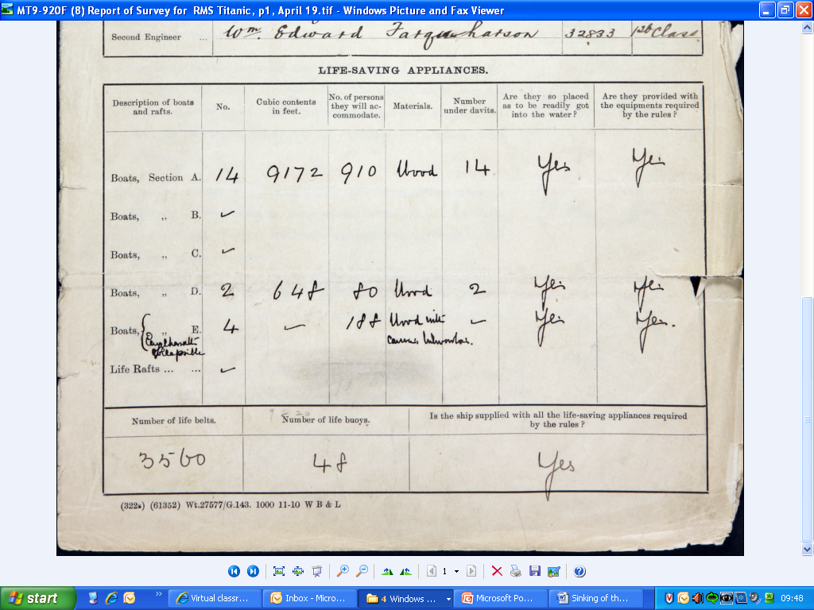
Document 1- MT 9/920 F
Sinking Pack Page 9
How many life belts were provided for the 2228 people on board?
How many people could the 20 lifeboats accommodate (approximately)?
Did Titanic supply all the life-saving appliances required by the rules?
Why do you think that Titanic was allowed to set sail?
How significant was the lack of lifeboats in causing loss of life?

Slide 43
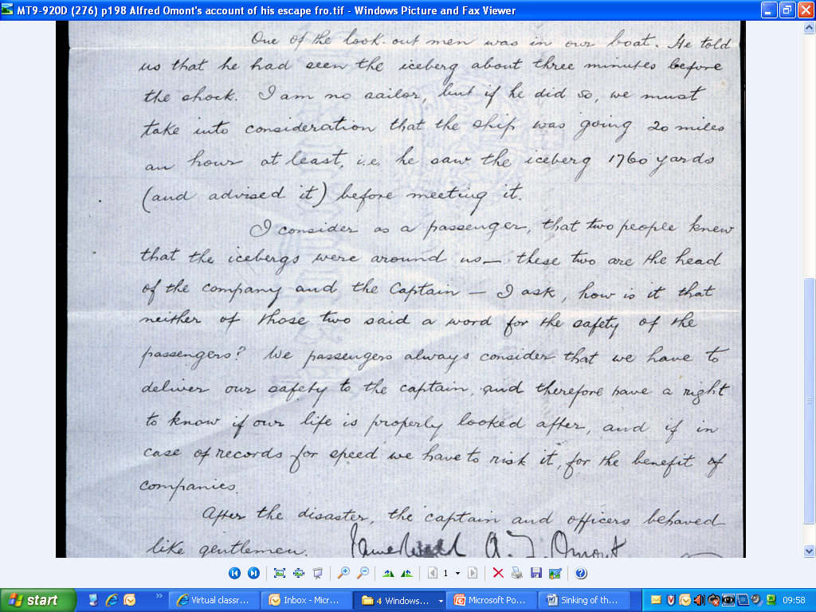
Document 2- MT 9/920 D
Sinking Pack Page 12
Which two people does Ormont blame for Titanic’s speed on the night it sank.
What reasons does Ormont give for the ship travelling so quickly despite the presence of ice?
How useful do you think the British inquiry found Ormont’s evidence?
How significant do you think the ship’s speed was in causing loss of life?

Slide 44

Lifeboat No. 6 could hold up to 65 people. Does the photo suggest that this capacity had been used?
The British inquiry concluded that 28 people were in lifeboat No. 6. Does the photo support this conclusion?
Why do you think that most of the lifeboats were not used to their fullest capacity?
How significant do you think the failure to fill lifeboars was in causing loss of life?
Sinking Pack Page 14
COPY 1/566
RMS Titanic lifeboat No.6 approaches rescue ship Carpathia.

Slide 45
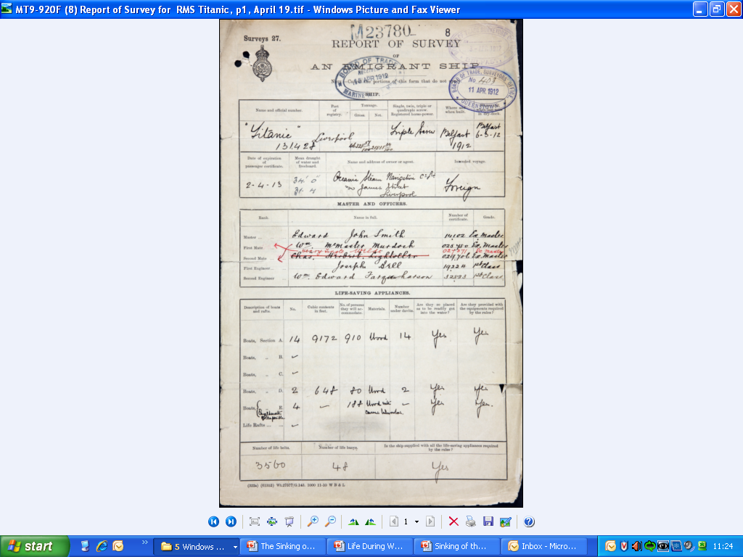
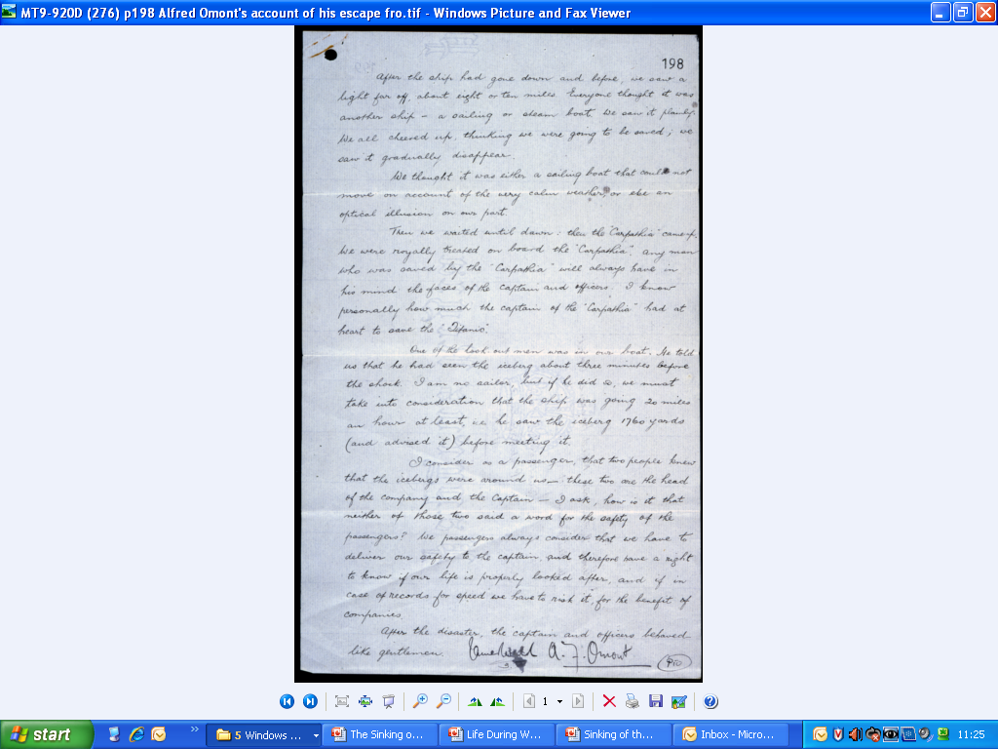
Which factor do you think was most significant in causing loss of life:
There were not enough lifeboats on board
The ship was sailing too fast
The lifeboats were not properly filled
Do you think that any of the causes we have examined today could be considered the only reason why so many lives were lost?

Slide 46
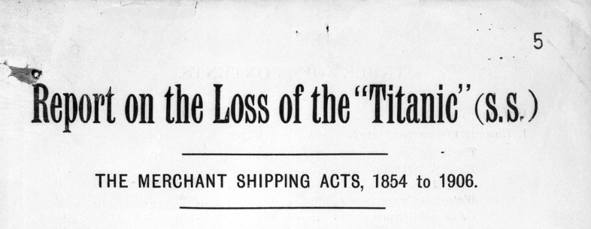
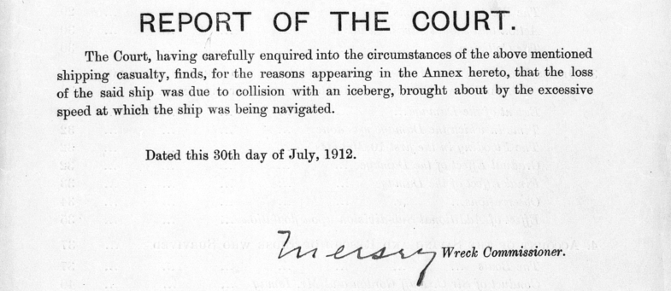
EXT 11-136

Slide 47
Find out more…
Presentation & Resources…
http://bit.ly/2gptnvy
www.nationalarchives.gov.uk/education
Contact…
education@nationalarchives.gov.uk
@The_History_Man
@UKNatArchives
@UKNatArcEdu
@UKNatArcSector

