Slide 1
Ar(t)chiving

Slide 2
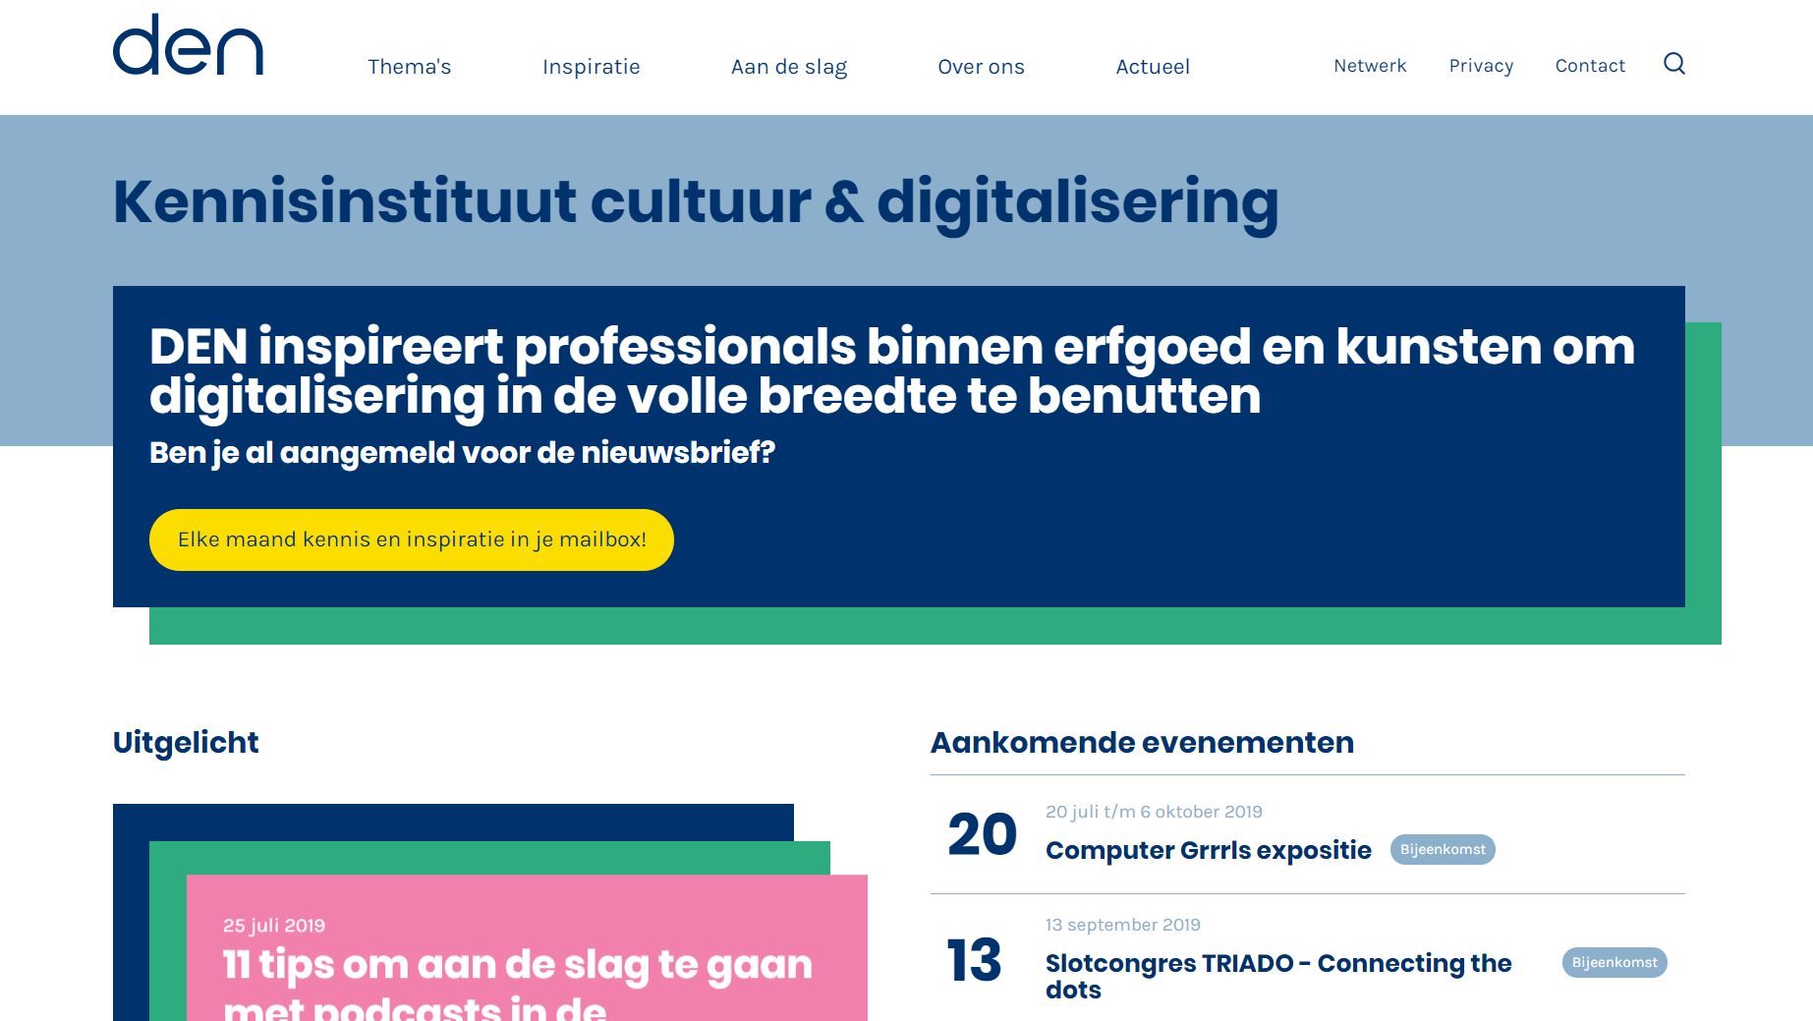
About us

Slide 3
The archive as a source

Slide 4
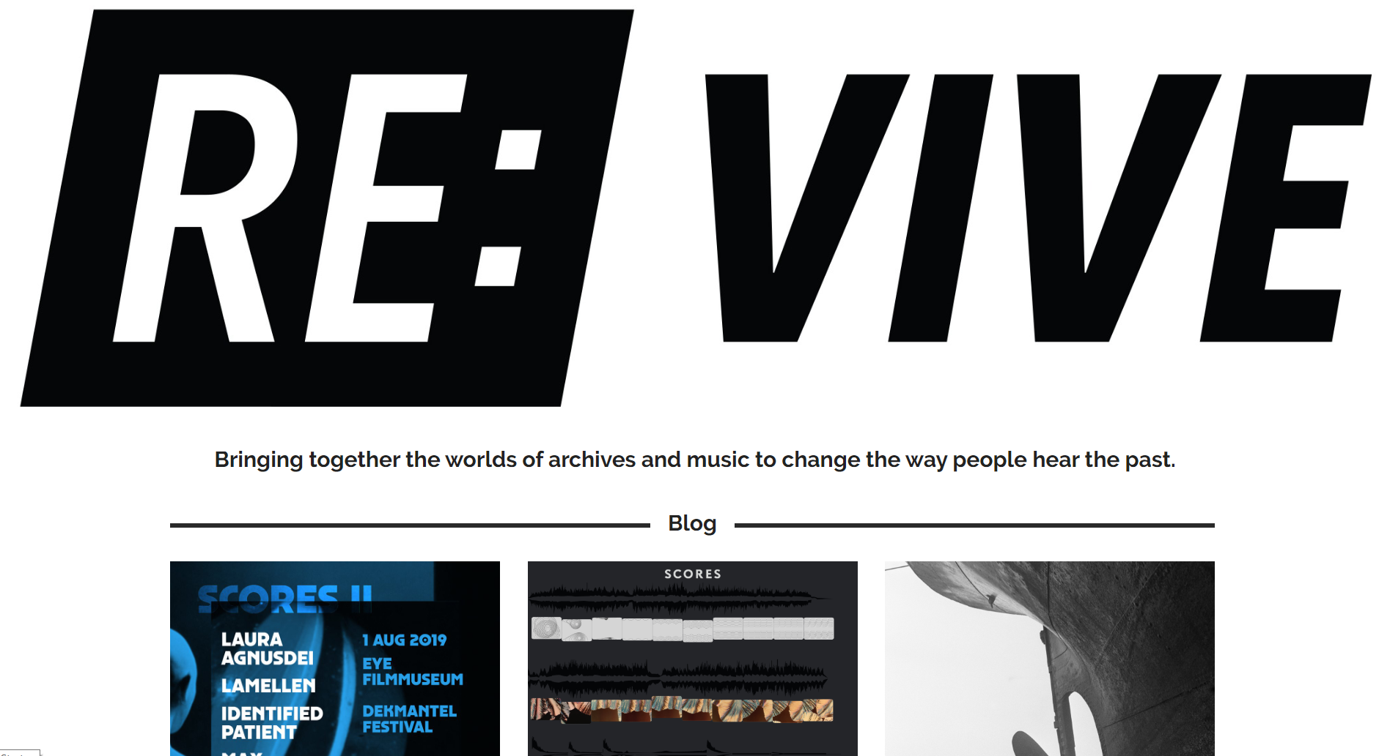
Notes:
This is revive
“The main goal of RE:VIVE is that audio material from archives is reused for new compositions. RE:VIVE organizes sessions around a specific thematic audio collection. In these sessions, not only are new audio productions created around this theme, but the importance of the role of archives is also stressed. The emphasis is on creative reuse, providing context and involvement. “
Musicians use archival material from for instance the Institute of Sound and Vision to create new music or music videos.

Slide 5
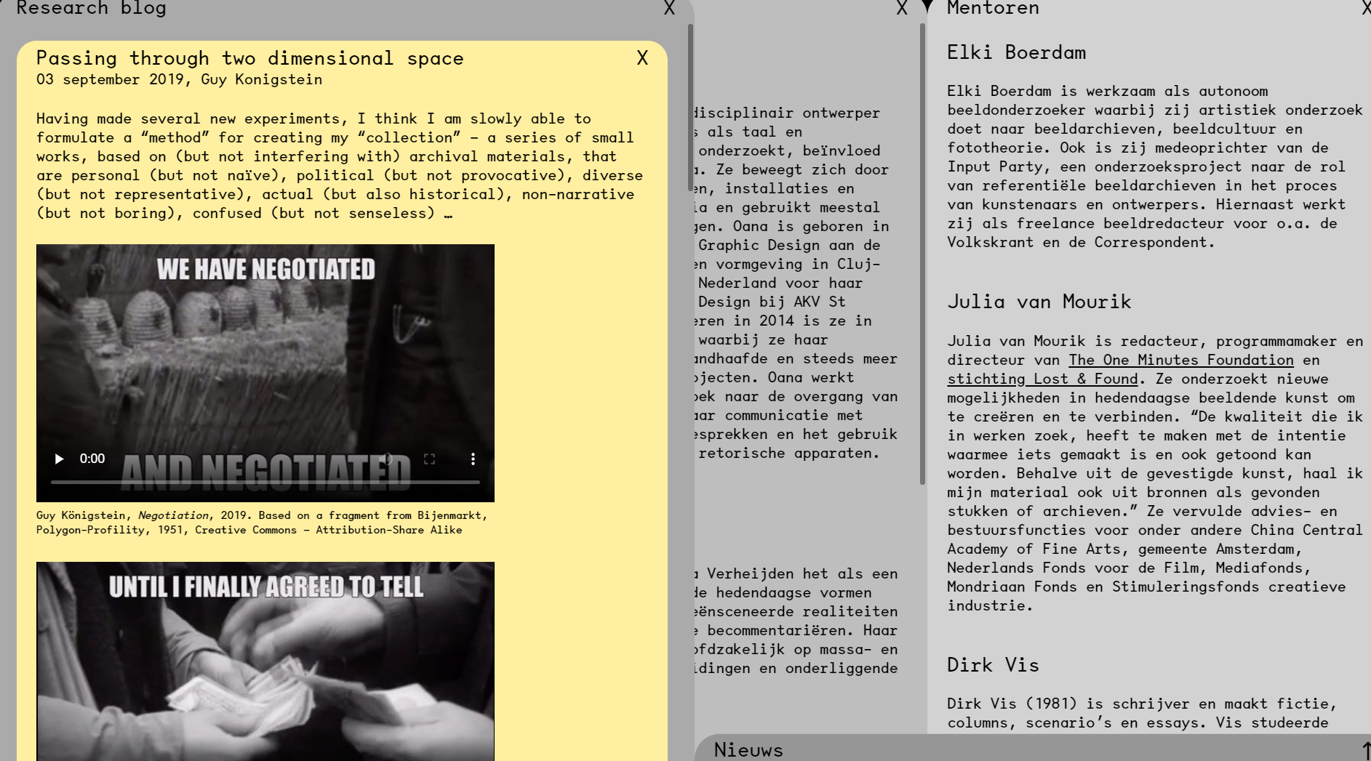
Notes:
This project is called Open Archive. Three artists are working as an artist-in-residence with the Institute of Sound and Vision and the New Institute. They create new autonomous art works based on the collections. The works are still in progress, but they’ve just launched a website where you can find some of their experiments.

Slide 6
Archiving as art

Slide 7
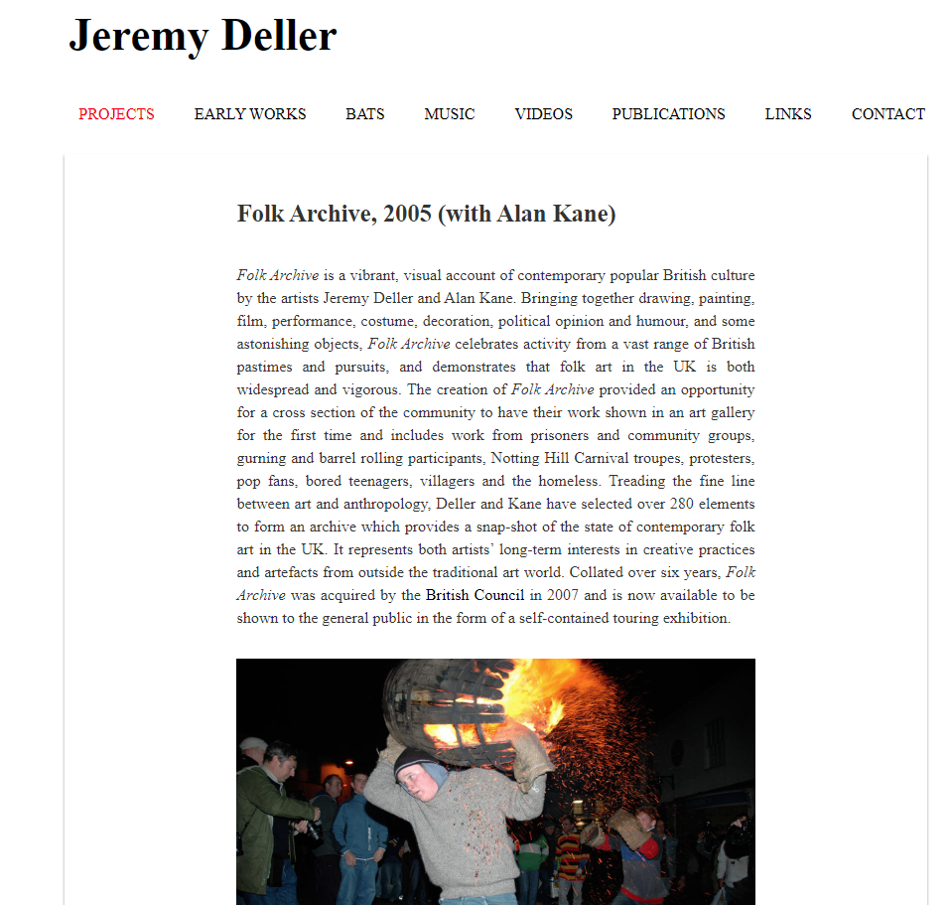
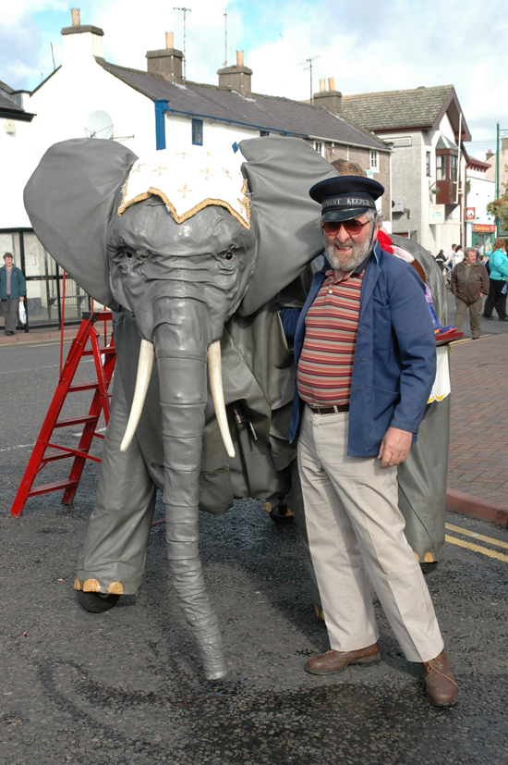
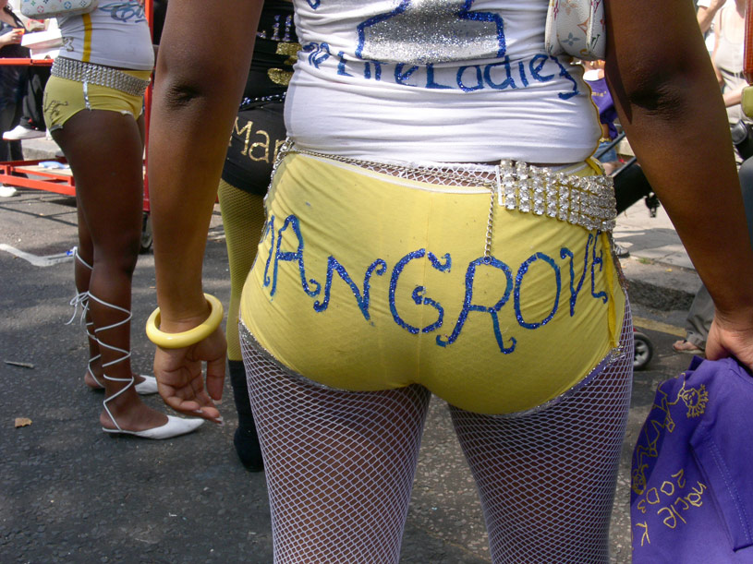
Notes:
An example of archiving as art is the Folk Archive, by Jeremy Deller and Alan Kane in 2005. For 6 years, they collected folk art from all kinds of communities and groups. In this work art becomes a kind of anthropology. They also wanted the community to be an active part of their artwork.

Slide 8
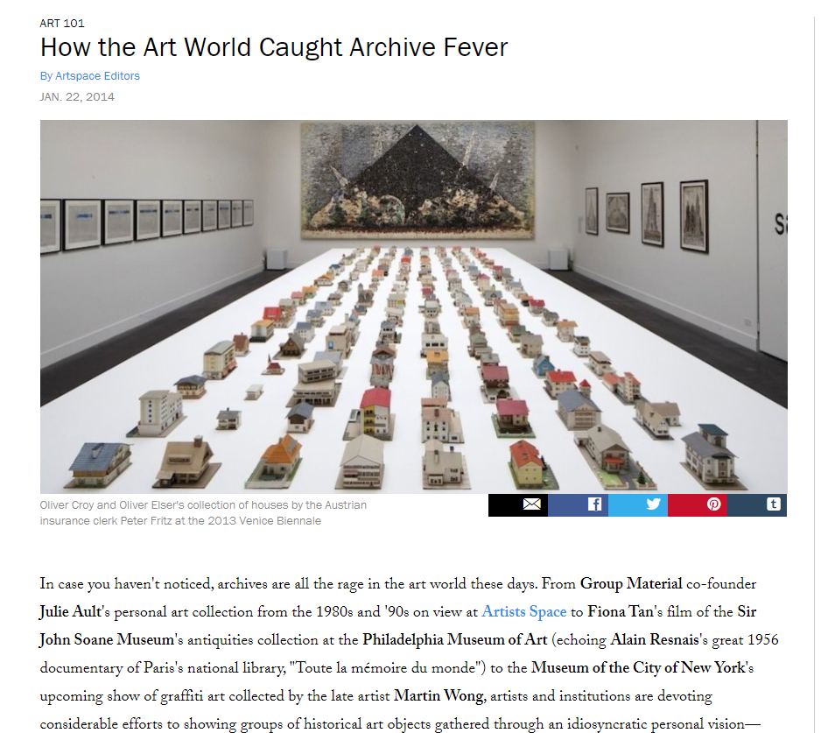
Notes:
Then I found this article on Artspace about archiving in the art world. The article gives a nice overview of how artists not only use the material as a source of inspiration, but also make the archiving process an art work in itself. The artwork can be a collection of existing ‘real physical or digital objects’ or in some cases a distorted or enhanced version of reality, or a completely fictional archive. This is also about storytelling: fictional characters are created and through the objects, the audience ‘discovers’ the story behind this character.
On a side note: some of the images in the article seem to contain broken links or are disappeared, which shows the complexity of keeping older stuff alive online.

Slide 9
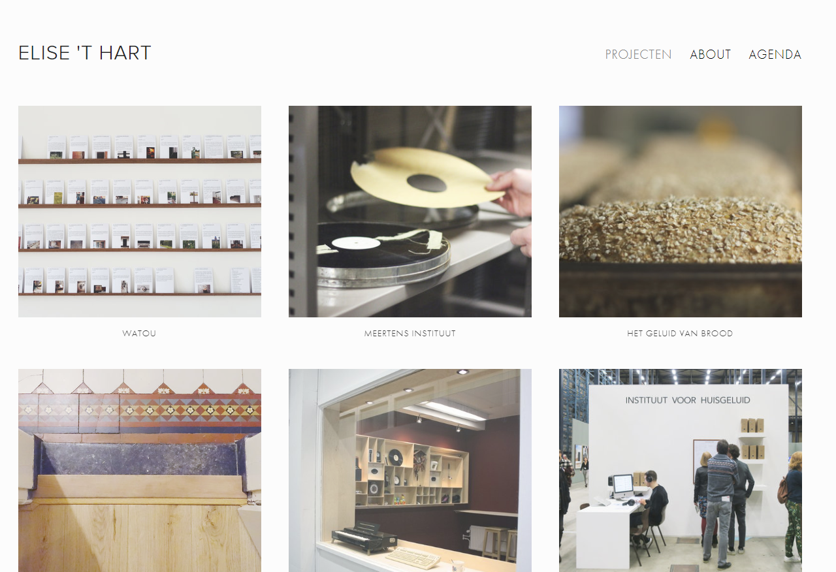
Notes:
A more recent example: this is the website of Elise ‘t Hart. She is a soundscape artist and she collects everyday sounds, especially sounds from houses. She has founded her own institute of ‘Huisgeluid’ and she makes small sound ‘portaits’ of houses, so you can take your favourite sounds with you in case you move. She worked together with the Meertens institute, where she listenend to old recordings and added new information about sounds in the background. This information can be used to search through the archive in new ways. Her own archive is now also part of the Meertens Institute.
Demo: https://www.elisethart.com/#/brood/

Slide 10
Art against archiving

Slide 11
Notes:
About Ephemeral data:
De toekomst van het internet is vergankelijkheid. Het internet evolueert van een wereldwijde archiefmachine naar een wereldwijde performancemachine. Tijdelijke, unieke, lokale en vergankelijke content wordt de nieuwe status-quo. Jongeren zijn tegenwoordig al gewend aan deze verschuiving binnen de digitale cultuur. Ephemeral Data is een tien dagen durende performance op de Neude die deze verschuiving visualiseert. In Ephemeral Data wordt zand, de grondstof voor glasvezelkabels, gebruikt om een enorme zandmandala in de vorm van het glasvezelnetwerk van de stad Utrecht te maken. Gedurende het festival werkt een groep performers beetje bij beetje, korrel voor korrel aan deze zandmandala. Op de laatste dag om 15:00 uur wissen performers de zandmandala weer helemaal uit. Het enige wat achterblijft is een berg zand.

Slide 12
To talk and think about: How to move beyond objects? How to keep the archive alive? Should we archive at all?

