Slide 1
STRUCTURAL TAGGING

Slide 2
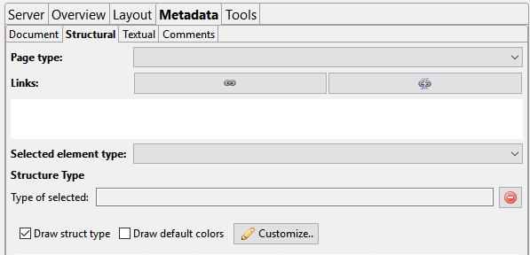
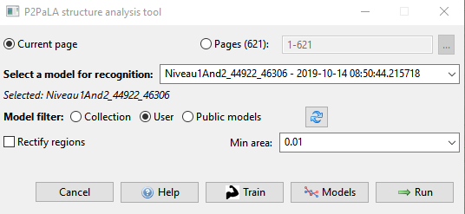

Slide 3
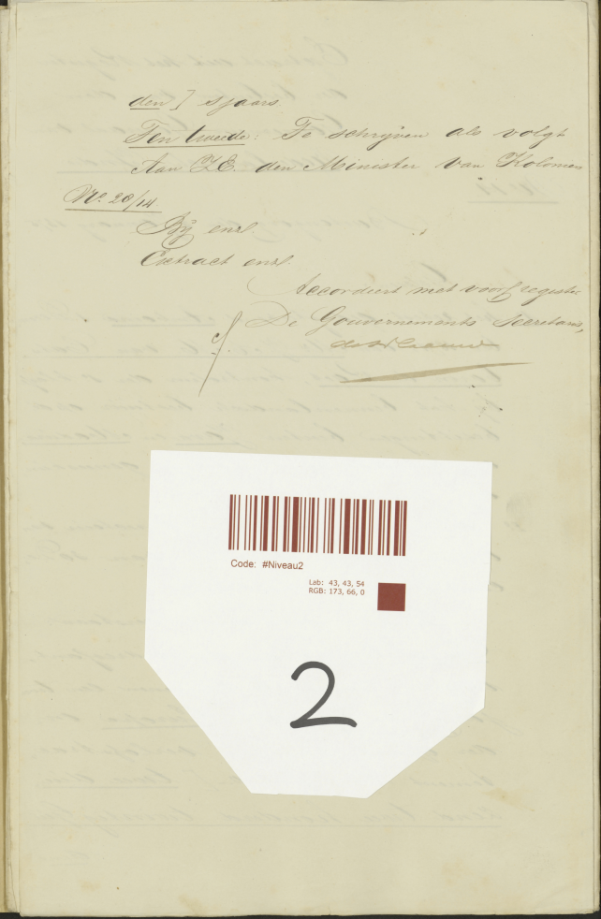
1

Slide 4
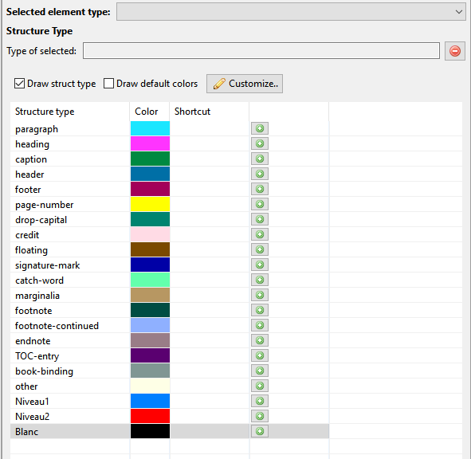

Slide 5
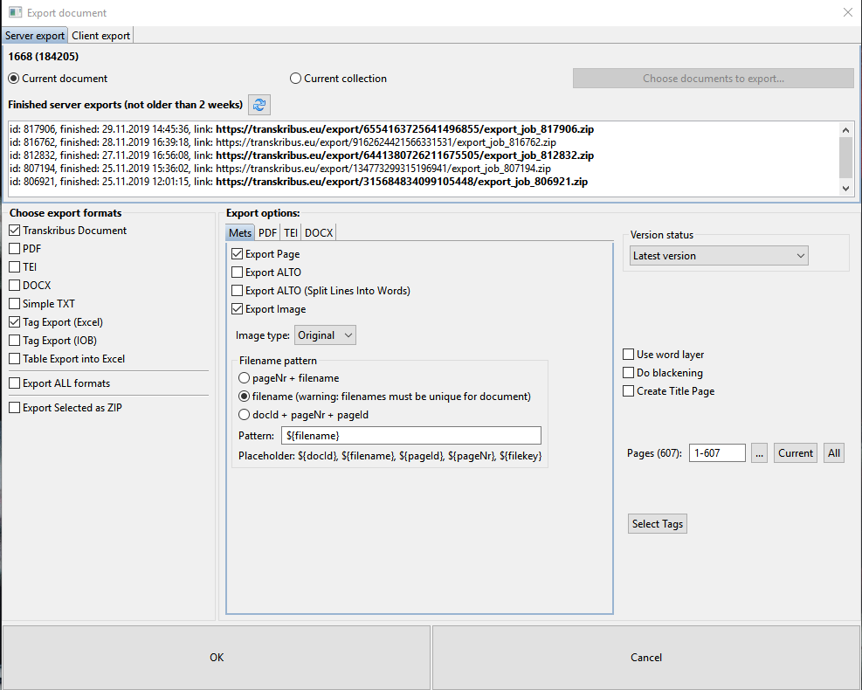
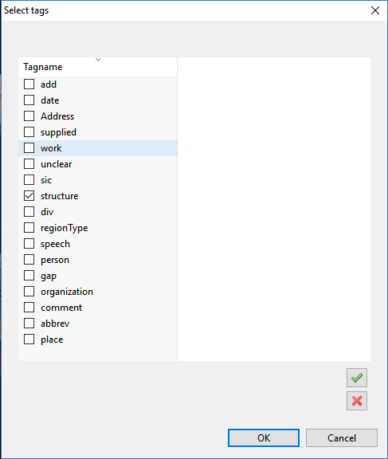

Slide 6
THE PROCESS

Slide 7
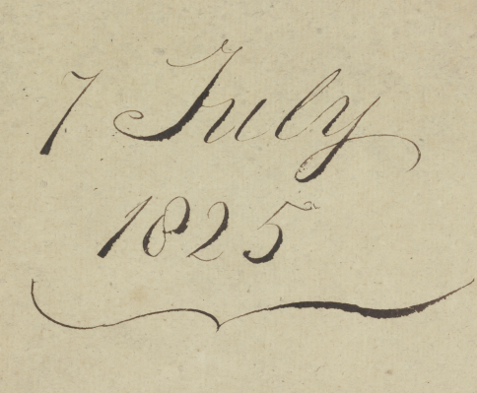
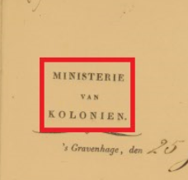
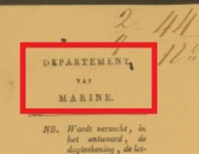
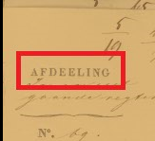
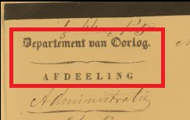
PATTERNS

Slide 8
Niveau 1
1 Pattern - 1 Tag

Slide 9
Niveau 2
4 Pattern - 1 Tag

Slide 10
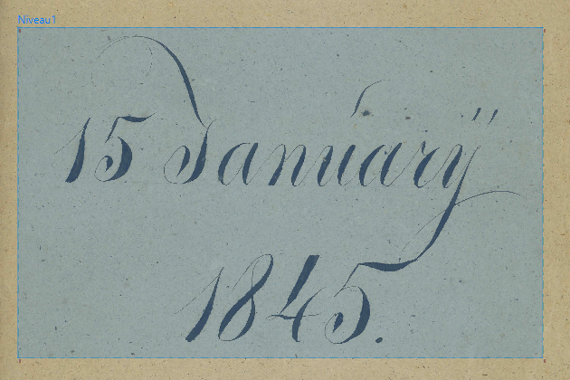
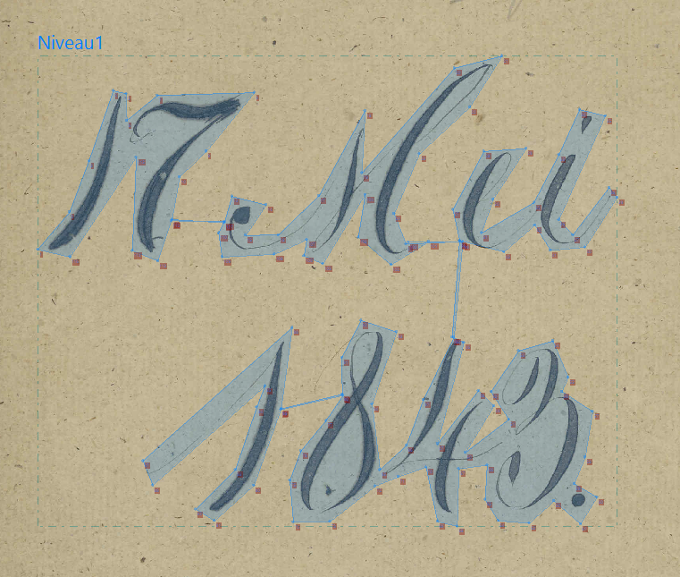

Slide 11
GRADUAL PATTERN ENRICHMENT

Slide 12
MODEL ISSUES

Slide 13
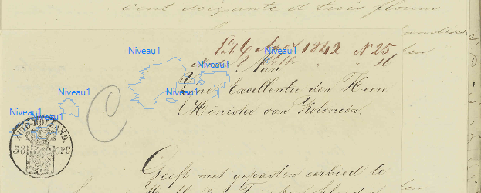
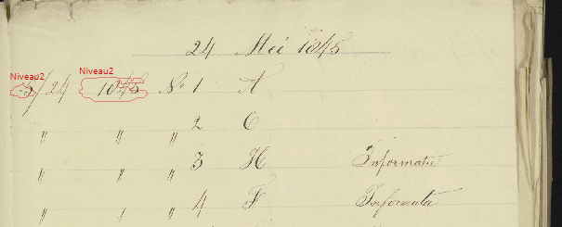
CREATION OF SMALL RANDOM REGIONS
TAGGING AREAS ON THE TOP LEFT SIDE OF THE PAGE

Slide 14
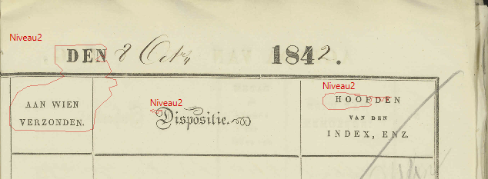
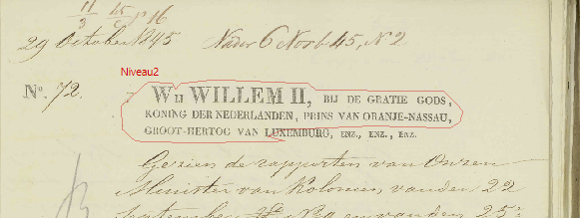
TAGGING LARGE AREAS IN PAGES THAT CONTAIN TABLES
TAGGING AREAS
THAT CONTAIN TYPEWRITING FORMAT

Slide 15
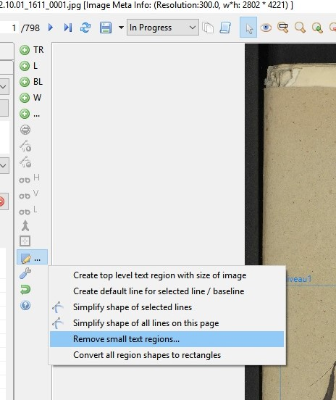
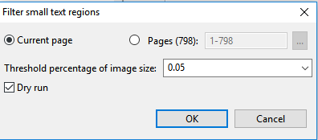
Remove Small Text Regions

Slide 16
RESULTS

Slide 17
RESULTS BASED ON 100 INV. NUMBERS TEST
 | SCANS WITH TAGS | SCANS WITHOUT TAGS | TOTAL
FALSE | 50 | 5 | 55
CORRECT | 67 | 178 | 245
TOTAL | 117 | 183 | 300
100 INV. NUMBERS IN ALTO XML FORMAT (APPROXIMATELY 65.000 SCANS)
RANDOM SELECTION OF 300 SCANS
MANUAL CHECKING OF THE RESULTS

Slide 18
NUMERICAL | SCANS WITH TAGS | SCANS WITHOUT TAGS | TOTAL
FALSE | 50 | 5 | 55
CORRECT | 67 | 178 | 245
TOTAL | 117 | 183 | 300
PERCENTAGE | SCANS WITH TAGS | SCANS WITHOUT TAGS | TOTAL
FALSE | 43 % | 3% | 18%
CORRECT | 57% | 97% | 82%
TOTAL | 100% | 100% | 100%

Slide 19
NUMERICAL | SCANS WITH TAGS | SCANS WITHOUT TAGS | TOTAL
FALSE | 50 | 5 | 55
CORRECT | 67 | 178 | 245
TOTAL | 117 | 183 | 300
PERCENTAGE | SCANS WITH TAGS | SCANS WITHOUT TAGS | TOTAL
FALSE | 43 % | 3% | 18%
CORRECT | 57% | 97% | 82%
TOTAL | 100% | 100% | 100%
PERFORMANCE PERCENTAGE | SCANS WITH TAGS | SCANS WITHOUT TAGS | TOTAL
FAILURE | 91% | 9% | 100%
SUCCESS | 27% | 73% | 100%
TOTAL | 39% | 61% | 100%

Slide 20
CONCLUSIONS

Slide 21
FINAL CONCLUSIONS
Structural Tagging is a process that requires time and planning.
The training process requires a great amount of material that should be manually tagged.
Users should not expect the same results from structure analysis tools as from the HTR.
Structural analysis is more difficult task than HTR.
The demand for structural analysis should be increased.
The amount of produced ground truth can be used for further research.
It is time to invest our time in other tools and platforms as well.

Slide 22
THANK YOU !

