Slide 1
File format policy van het IISG: uitdagingen & oplossingen KIA bijeenkomst preservering en (pre)ingesttooling 15-4-2019 RCE
Robèrt Gillesse

Slide 2
Specifieke uitdagingen particulier digitaal geboren
Archief: acquisitie
Archiefdonor bepaalt – tot op zeker hoogte – de agenda
Geen dwingende afspraken kunnen maken over aanlevering:
Ordening
Metadata
Bestandsformaten
Voorkeursformaten richtlijn niet zinvol
Notes:
The IISH is a research institute and private archive collecting in the field labour history and socio-economical movements (like trade unions but also Greenpeace or Amnesty). The institute was erected in 1935 to literally save collections from the totalitarian regimes of those days and in some case we still rescue collections. In this respect we have a so called safe haven function.

Slide 3
Specifieke uitdagingen particulier digitaal geboren
Archief: preservering
Digitale preservering lastig – want niet kunnen bepalen hoe het binnenkomt. Gevolgen:
Veelheid van verschillende bestandsformaten
Van chaotisch tot geordend
Met maar veelal zonder beschrijvende metadata
Notes:
The IISH is a research institute and private archive collecting in the field labour history and socio-economical movements (like trade unions but also Greenpeace or Amnesty). The institute was erected in 1935 to literally save collections from the totalitarian regimes of those days and in some case we still rescue collections. In this respect we have a so called safe haven function.

Slide 4
IISG file format policy
Rekening houden met veelheid van formaten die binnenkomen
Uitgangspunten hanteren die midden houden tussen zorgvuldigheid en pragmatiek
Gezien als kernonderdeel van breder IISG digitale preservereringsbeleid
Notes:
The IISH is a research institute and private archive collecting in the field labour history and socio-economical movements (like trade unions but also Greenpeace or Amnesty). The institute was erected in 1935 to literally save collections from the totalitarian regimes of those days and in some case we still rescue collections. In this respect we have a so called safe haven function.

Slide 5
IISG file format policy: uitgaan van IISG ”digital
preservation intent”
“All digital objects will be kept and (as much as possible) preserved in their original form(at).
But the IISH will, ultimately, give priority to the informational value within these objects. This means that objects may be migrated to other file formats - as the original format is obscure and/or obsolete - as long as can be guaranteed that the information within these files is still authentic.
These migrated files are called preservation copies.
As the proof of authenticity will in some cases be a challenge the original object will always be available as a fall-back file.
The digital object is always shown within the right context and is findable through the correct contextual information.”
Notes:
The IISH is a research institute and private archive collecting in the field labour history and socio-economical movements (like trade unions but also Greenpeace or Amnesty). The institute was erected in 1935 to literally save collections from the totalitarian regimes of those days and in some case we still rescue collections. In this respect we have a so called safe haven function.

Slide 6
IISG file format policy: migratie/normalisatie als
preserveringstrategie
Voorlopig uitgaan van migratie als preserveringstrategie
Normaliseren naar preservation en access copies
Emulatie op lange termijn en voor lastige formaten of digital objecten zeker niet uitgesloten
Notes:
The IISH is a research institute and private archive collecting in the field labour history and socio-economical movements (like trade unions but also Greenpeace or Amnesty). The institute was erected in 1935 to literally save collections from the totalitarian regimes of those days and in some case we still rescue collections. In this respect we have a so called safe haven function.

Slide 7
IISG file format policy: voorbeelden
Voorkeursformaten Nationaal Archief
DANS preferred and accepted file formats
Sustainability of Digital Formats: Planning for Library of Congress Collections
DE BASIS van DEN
Notes:
The IISH is a research institute and private archive collecting in the field labour history and socio-economical movements (like trade unions but also Greenpeace or Amnesty). The institute was erected in 1935 to literally save collections from the totalitarian regimes of those days and in some case we still rescue collections. In this respect we have a so called safe haven function.

Slide 8
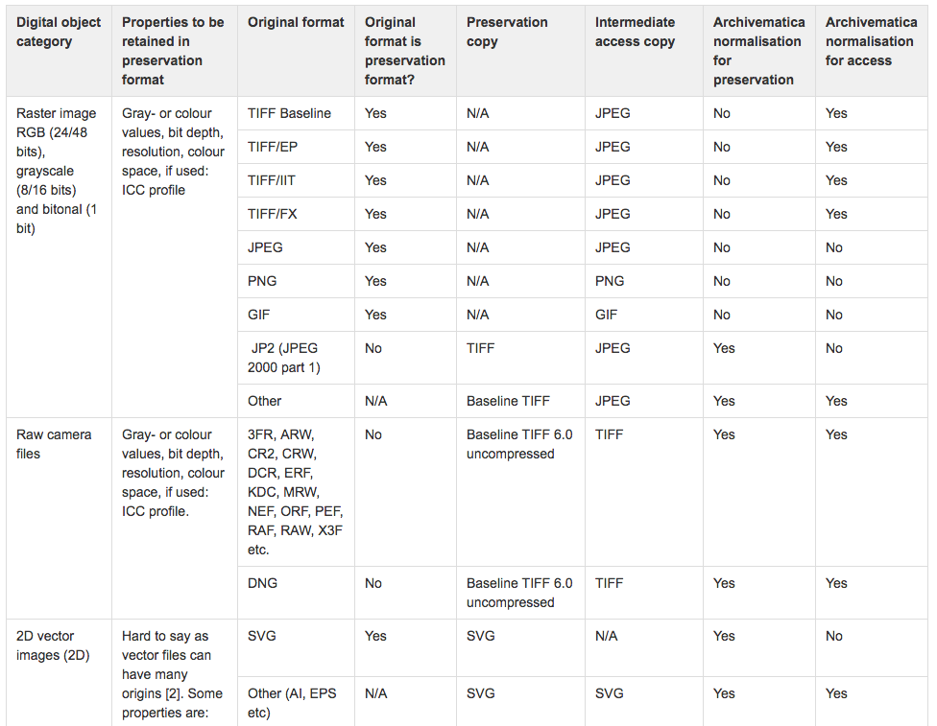
IISG file format policy: voorbeelden
Voorkeursformaten Nationaal Archief
DANS preferred and accepted file formats
Sustainability of Digital Formats: Planning for Library of Congress Collections
DE BASIS van DEN
Notes:
The IISH is a research institute and private archive collecting in the field labour history and socio-economical movements (like trade unions but also Greenpeace or Amnesty). The institute was erected in 1935 to literally save collections from the totalitarian regimes of those days and in some case we still rescue collections. In this respect we have a so called safe haven function.

Slide 9
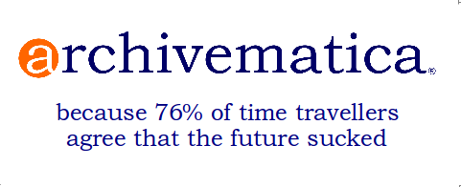
IISG file format policy: uitvoering
Uitvoering door
Op basis PRONOM
Gebruik makende open source conversietools
ImageMagick en FFMPEG
Probleem ontbrekende open source tools voor oa Office tools
Gat tussen theorie en praktijk
Notes:
The IISH is a research institute and private archive collecting in the field labour history and socio-economical movements (like trade unions but also Greenpeace or Amnesty). The institute was erected in 1935 to literally save collections from the totalitarian regimes of those days and in some case we still rescue collections. In this respect we have a so called safe haven function.

Slide 10
IISG file format policy: ‘hoofdpijndossier’ video
Nu alle video migreren naar MKV FFV1 preservation copies.
Argument: videoformaten/codecs veranderen snel
Lossloss compressie = grote bestandsomvang
IISG preservation storage: 4x maal opslaan, plus nog 2 access copies (huidige stavaza: €0,48 per GB)
Bij een omvangrijk video archief: hoge opslagkosten
Is deze policy financieel haalbaar?
Meer realistische aanpak: migratie wanneer echt nodig en niet bij voorbaat
Opnieuw gat tussen theorie en praktijk
Notes:
The IISH is a research institute and private archive collecting in the field labour history and socio-economical movements (like trade unions but also Greenpeace or Amnesty). The institute was erected in 1935 to literally save collections from the totalitarian regimes of those days and in some case we still rescue collections. In this respect we have a so called safe haven function.

Slide 11
IISG file format policy: toekomst
Zien als belangrijk beleidsstuk
Echter geen dogma: aanpassen als nodig
Toetsing aan praktijk en financiele randvoorwaarden
Ontwikkelingen emulatie in gaten houden
Gezamenlijke ontwikkeling preservation watch (NDE)
Notes:
The IISH is a research institute and private archive collecting in the field labour history and socio-economical movements (like trade unions but also Greenpeace or Amnesty). The institute was erected in 1935 to literally save collections from the totalitarian regimes of those days and in some case we still rescue collections. In this respect we have a so called safe haven function.

